Slide 1
HAZARDOUS MATERIALS
MANAGEMENT
Compliance with DOT requirements - 49 CFR 172.704
Section 1 – HMR General Information
Bill Kesack
Senior Project Manager
Environmental Compliance

Slide 2

Hazardous Material
Any substance or material that can pose an unreasonable risk to health, safety, and property when transported in commerce.
1.2 Million Hazmat Shipments Transported Daily
1.6 Billion Hazmat Shipments Transported Annually by All Modes
>13,000 spills and leaks of hazmats per year

Slide 3
HMR
HMR = Hazardous Materials Regulations
  Title 49 of the Code of Federal Regulations (CFR)
  Chapter I
  Subchapter C
  Parts 171 – 180
Minimum requirements that must be met to transport hazmats in commerce.
Designed to keep the hazmat in the package and therefore you, the public, and the environment safe during transportation.

Slide 4
Location of Specific Regulations
  Part 171 – General Information, regulations and definitions
  Part 172 – Hazardous Materials Table, special provisions, hazardous materials communications, emergency response information and training requirements
  Part 173 - Shippers general requirements for shipments and packagings
  Part 174 – Carriage by Rail
  Part 175 – Carriage by Aircraft
  Part 176 – Carriage by Vessel
  Part 177 – Carriage by Public Highway
  Part 178 – Specifications for Packaging
  Part 179 – Specifications for Tank Cars
  Part 180 – Continuing Qualification and Maintenance of Packagings

Slide 5
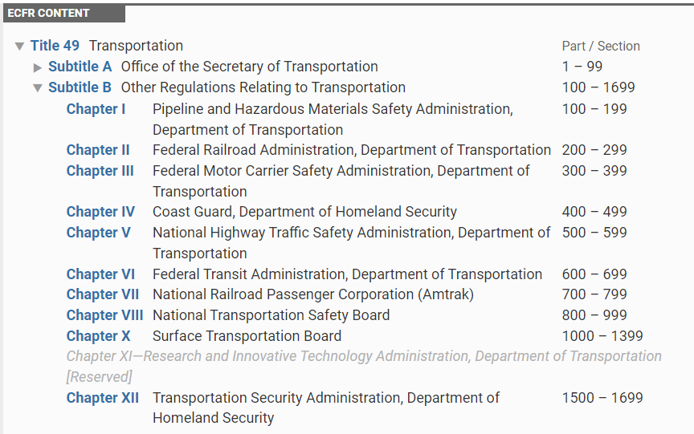
Chapters within 49 CFR

Slide 6
Hazmat Employer
Transports hazmat in commerce
Causes hazmat to be transported in commerce
Designs, manufactures, tests, inspects, maintains, reconditions, repairs and marks containers for use in transporting hazmats in commerce

Slide 7
Hazmat Employee
Any person employed by the hazmat employer who directly affects the safety of hazardous materials during transportation.
Includes employees who:
  Loads, unloads or handles hazmat
  Prepares hazmat for transportation
  Responsible for the safety of transporting hazmat
  Operates a vehicle used to transport hazmat
  Designs, manufactures, tests, inspects, maintains, reconditions, repairs and marks containers for use in transporting hazmats in commerce

Slide 8
Training Requirements
Training is mandated by the HMR for all hazmat employees:
  Within 90 days of employment
  Within 90 days of transfer to a hazmat job
  Every three (3) years
  When regulations change
    PHMSA Website for regulation updates
      https://www.phmsa.dot.gov/regulations-and-compliance
  Employer is required to keep training information and certificates on file.
  Hazmat employee should keep a copy of the training certificate

Slide 9
Required Training Topics
  General Awareness/Familiarization: The general provisions of the regulations
  Function-Specific: focusing on the job functions of an individual
  Safety Training: associated hazards and emergency response details (overlap with OSHA regulations)
  Security Awareness: focusing on security threats relating to transporting hazardous materials
Notes:
Routine site safety and health inspections are designed to catch hazards missed at other stages. This type of inspection should be done at regular intervals, generally on a weekly basis. In addition, procedures should be established that provide a daily inspection of the work area.
You can use a checklist already developed or make your own, based on:
- Past problems
- Standards that apply to your industry
- Input from everyone involved
- Your company's safety practices or rules
Important things to remember about inspections are:
- Inspections should cover every part of the worksite
- They should be done at regular intervals
- In-house inspectors should be trained to recognize and control hazards
- Identified hazards should be tracked to correction
Information from inspections should be used to improve the hazard prevention and control program.

Slide 10
Hazmat Terminology
Hazardous Material (hazmat) - substance or material that can pose an unreasonable risk to health, safety, and property when transported in commerce.
Hazardous Waste – any material that is subject to the Hazardous Waste Manifest Requirements of the EPA specified in 40 CFR Part 262.
  If it is a hazardous waste, it is also a hazardous material

Slide 11
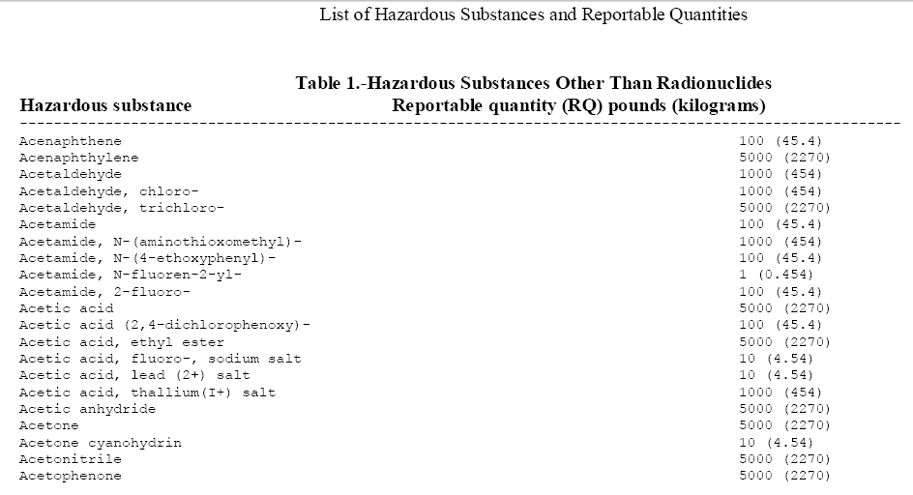
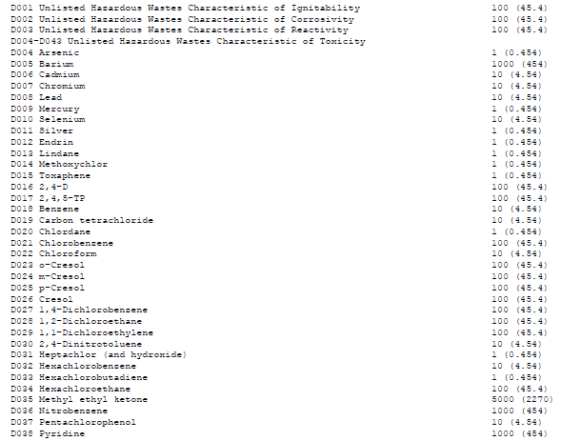
Hazmat Terminology
Hazardous Substance – a material listed in Appendix A to the Hazmat Table and is present in one package in an amount that equals or exceeds the reportable quantity (RQ).
If the hazardous material is a Hazardous Substance and the name of the Hazardous Substance is not a part of the Proper Shipping Name, then §172.203(c) requires the name of the Hazardous Substance, or a Hazardous Waste Code if applicable, be entered in (parenthesis) in association with the RQ in the Basic Description.

Slide 12

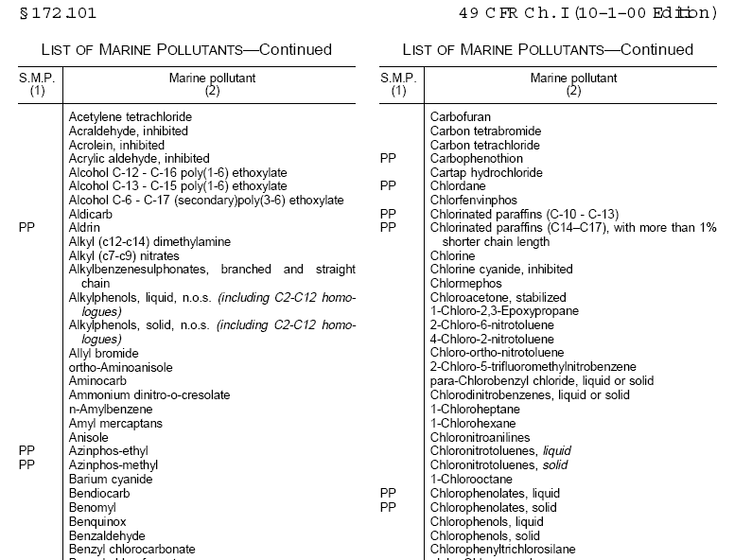
Hazmat Terminology
Marine Pollutant – a material listed in Appendix B to the Hazardous Materials Table.
  Applies to all marine pollutants transported by vessel.
  Does not apply to non-bulk packages transported by motor vehicles, rail cars, or aircraft (171.4(c)).
  Does apply to bulk packagings transported by motor vehicle, rail car, or aircraft.

Slide 13

Marine Pollutant Marking
For shipment of a non-bulk packaging by vessel, refer to 49 CFR 172.322(a).
A shipment of a bulk packaging by motor vehicle, rail car, or aircraft must have the MARINE POLLUTANT mark on at least two opposing sides if the packaging has a capacity of <1,000 gallons or on all four sides if >1,000 gallons. In either case, a marking the size of a placard (9.84″x9.84″) may be used.
The transport vehicle or freight container that contains a bulk packaging marked as indicated above must be marked with the MARINE POLLUTANT mark. This marking must be the same size as a placard.
49 CFR 172.322(d) lists some situations where the MARINE POLLUTANT mark is not required.

Slide 14
Hazmat Terminology
Consignor = Shipper
Consignee = Receiver

Slide 15
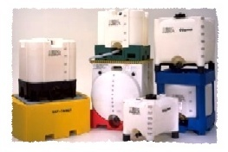
Hazmat Terminology
Bulk Packaging
  Liquids with maximum capacity >119 gallons (450 L)
  Solids with maximum net mass >882 pounds (400 kg) and maximum capacity >119 gallons (450 L)
  Gas with a water capacity >1,000 pounds (454 kg)

Slide 16

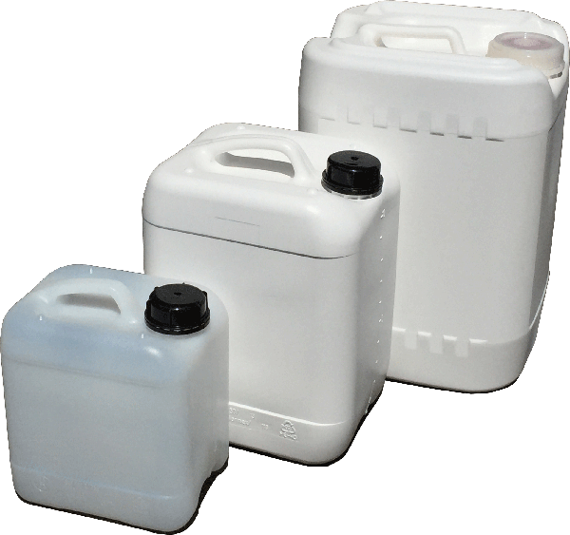
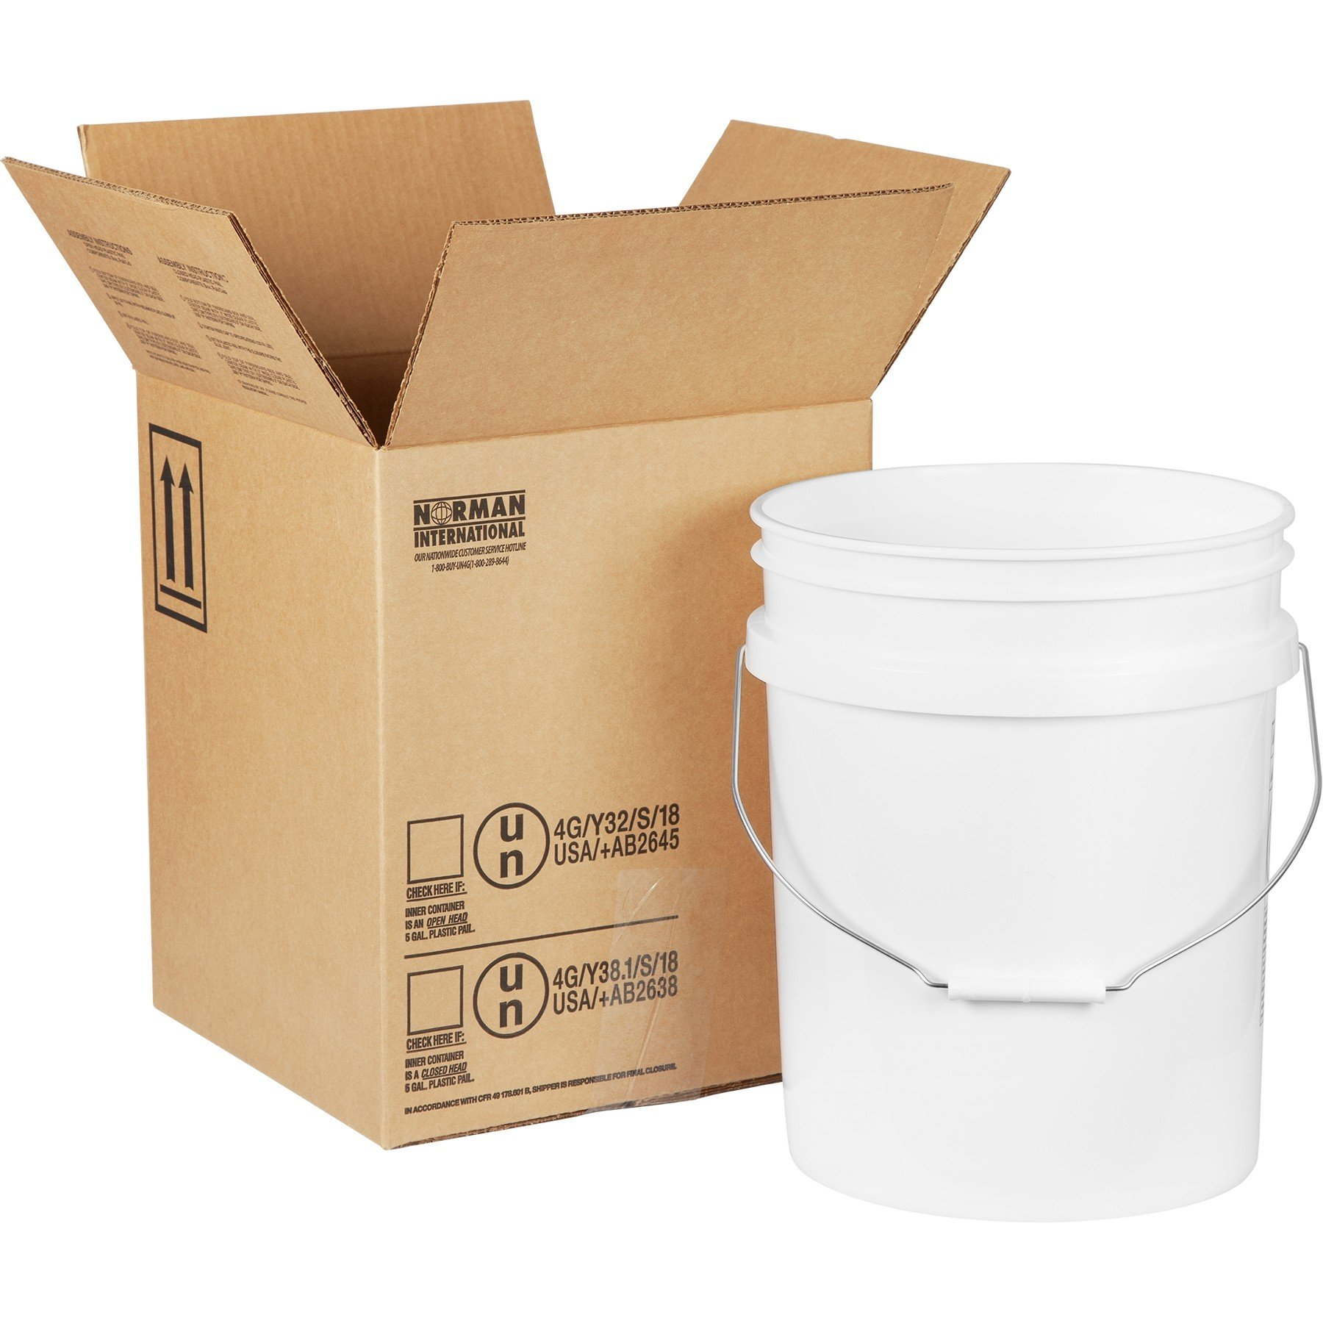
Hazmat Terminology
Non-bulk Packaging
  Liquids with maximum capacity < 119 gallons (450 L)
  Solids with maximum net mass < 882 pounds (400 kg) and maximum capacity < 119 gallons (450 L)
  Gas with a water capacity < 1,000 pounds (454 kg)

Slide 17
Non-bulk containers
§ 178.502 Identification codes for packagings.
(a) Identification codes for designating kinds of packagings consist of the following:
(1) A numeral indicating the kind of packaging, as follows:
  (i) “1” means a drum.
  (ii) “2” means a wooden barrel.
  (iii) “3” means a jerrican.
  (iv) “4” means a box.
  (v) “5” means a bag.
  (vi) “6” means a composite packaging.
  (vii) “7” means a pressure receptacle.
(2) A capital letter indicating the material of construction, as follows:
(i) “A” means steel (all types and surface treatments).
(ii) “B” means aluminum.
(iii) “C” means natural wood.
(iv) “D” means plywood.
(v) “F” means reconstituted wood.
(vi) “G” means fiberboard.
(vii) “H” means plastic.
(viii) “L” means textile.
(ix) “M” means paper, multi-wall.
(x) “N” means metal (other than steel or aluminum).
(xi) “P” means glass, porcelain or stoneware.

Slide 18
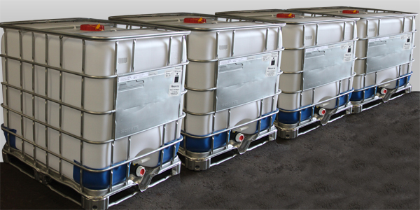
Hazmat Terminology
Intermediate Bulk Container (IBC)
  Rigid or flexible portable packaging, other than a cylinder or portable tank, which is pallet mounted and designed for mechanical handling.
  According to the U.S. CFR, intermediate bulk containers have an allowable volume range greater than 119 gallons (450 liters) and up to 793 gallons (3000 liters) while maintaining UN/DOT shipping approval.

Slide 19
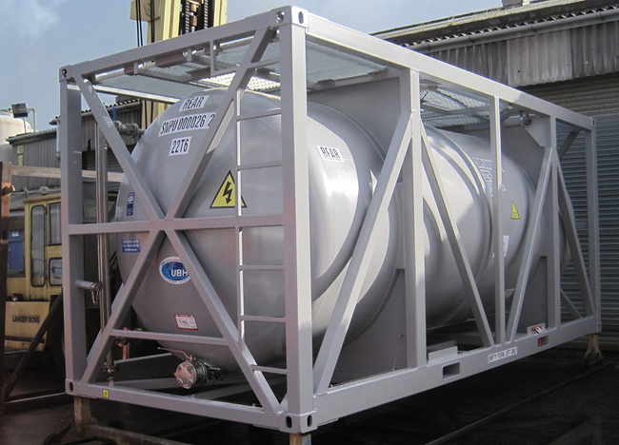
Hazmat Terminology
Portable Tank
  A bulk packaging designed primarily to be loaded onto, or on, or temporarily attached to a transport vehicle or ship and equipped with skids, mountings or accessories to facilitate handling of the tank by mechanical means

Slide 20
Reconditioned vs remanufactured (49 CFR 173.28)
(c) Reconditioning of non-bulk packaging.
(1) For the purpose of this subchapter, reconditioning of metal drums is:
(i) Cleaning to base material of construction, with all former contents, internal and external corrosion removed, and any external coatings and labels sufficiently removed to expose any metal deterioration that adversely affects transportation safety;
(ii) Restoring to original shape and contour, with chines (if any) straightened and sealed, and all non-integral gaskets replaced: and
(iii) Inspecting after cleaning but before painting, Packagings that have visible pitting, significant reduction in material thickness, metal fatigue, damaged threads or closures, or other significant defects, must be rejected.
(d) Remanufacture of non-bulk packagings. For the purpose of this subchapter, remanufacture is the conversion of a non-specification, non-bulk packaging to a DOT specification or U.N. standard, the conversion of a packaging meeting one specification or standard to another specification or standard (for example, conversion of 1A1 non-removable head drums to 1A2 removable head drums) or the replacement of integral structural packaging components (such as non-removable heads on drums). A person who remanufactures a non-bulk packaging to conform to a specification or standard in part 178 of this subchapter is subject to the requirements of part 178 of this subchapter as a manufacturer.

Slide 21
Hazmat Terminology
Exception - a statement in the HMR that removes some or all of the requirements of the HMR.
  Gives relief from HMR requirements
  e.g., excepted from certain labeling requirements for a specific material, when packaged in smaller quantities.

Slide 22

Hazmat Terminology
Two types of Exceptions:
  Limited Quantity
    Applies to combination packages (inner and outer)
    Limits the quantity of material in the inner package and limit the total weight of the entire package, will except the material from some regulations.
  Consumer Commodity
    A limited quantity of hazmat that is prepared and packaged for retail sale.
    Excepted from most of the requirements in the HMR.

Slide 23
Hazmat Terminology
    Special Permit (Exemption)
    An special permit is a special authorization from PHMSA that allows a person or company to do something that is not authorized in the HMR (e.g. packaging exemptions authorize shipper to use non-specification packaging).
    DOT grants an special permit letter based on a shippers application.

Slide 24
Classification
Includes:
  Identifying what hazards the material possesses.
  Assigning the hazard class or division.
  Determining the packing group.
  Choosing the proper shipping name.
Standard tests will determine what hazards the hazmat possesses.
Found in 49 CFR Part 173

Slide 25
Hazard Classes/Divisions
Classes -
  HMR groups hazmats into classes according to different hazard characteristics.
  Each hazmat is assigned to one primary hazard class based on the highest hazard characteristic or type of hazard it possesses.
Divisions -
  Divisions may indicate the severity of the hazard.
    Explosives, Class 1, have 6 divisions. As you progress from 1.1 to 1.6, the degree of danger decreases.
  The division may also indicate materials with different properties within the same hazard class.
    Gases, Class 2, have 3 divisions.
      2.1 – Flammable Gas
      2.2 – Non-Flammable Gas
      2.3 – Poison Gas

Slide 26
Hazard Classes
  Class 1 – Explosives (6 Divisions)
  Class 2 – Gases (3 Divisions)
  Class 3 – Flammable Liquids
  Class 4 – Flammable Solids (3 Divisions)
  Class 5 – Oxidizers and Organic Peroxides (2 Divisions)
  Class 6 – Poisons and Infectious Substances (2 Divisions)
  Class 7 – Radioactive Materials
  Class 8 – Corrosives
  Class 9 – Miscellaneous Materials

Slide 27
Packing Groups (PGs)
Hazmats are assigned to one of three PGs:
      PG I – Great Danger
      PG II – Medium Danger
      PG III – Minor Danger
Test results are used to determine the packing group or the amount of danger each hazmat possesses during transportation. SDS and generator knowledge are also used.
Degree of danger correlates to the required strength of the package. The more hazardous a material is, the more stringent packaging requirements will be.

Slide 28

Class 1 – Explosives
Products that are made for the sole purpose of creating explosions or pyrotechnic effects.
Divisions 1.1 to 1.6 As you progress from 1.1 to 1.6, the degree of danger decreases.
DOT assigns PGII to explosives.
49 CFR reference §173.50

Slide 29
Class 1 – Explosives
Division 1.1 – Explosives that have a mass explosion hazard, which affects almost entire load instantaneously.
Division 1.2 – Explosives that have a projection hazard but not a mass explosion hazard.
Division 1.3 – Explosives that have a fire hazard and either a minor blast hazard or a minor projection hazard or both, but not a mass explosion hazard.
Division 1.4 – Explosives that present a minor explosion hazard.
Division 1.5 – Very insensitive explosives.
Division 1.6 – Extremely insensitive articles that do not have a mass explosion hazard.

Slide 30
Class 1 – Explosives
Compatibility group letters are used to specify the controls for the transportation and storage of explosives to prevent an increase in hazard that might result if certain types of explosives were stored or transported together.
  Compatibility Groups - A to H and J, K, L, N and S

Slide 31
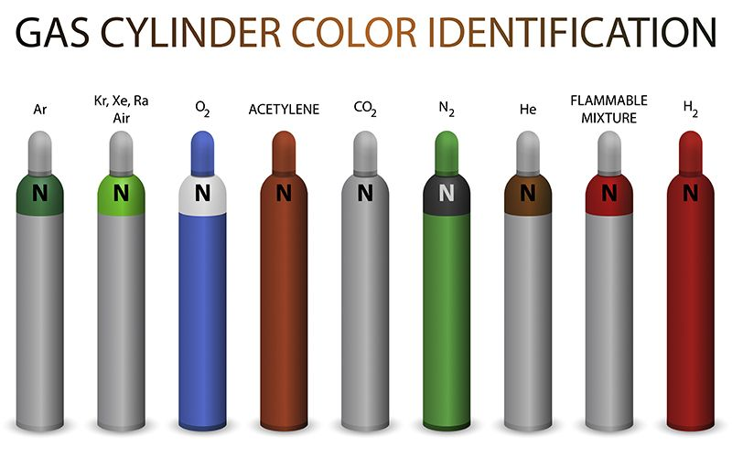
Class 2 – Gases
Products which are cooled, compressed, or dissolved to make their transportation and handling easier.
No Packing Groups – Hazard Zones
49 CFR reference §173.115

Slide 32

Class 2 – Gases
Division 2.1: Flammable
  Gas at 20°C (68°F) or less and 101.3 kPa (14.7psi).
  Ignitable at 101.3 kPa when in mixture 13% or less by volume with air.
  Flammable range with air of at least 12 % regardless of lower limit.
  Acetylene, Propane and Hydrogen.

Slide 33

Class 2 – Gases
Division 2.2: Non – Flammable
  Absolute pressure of 280 kPa (40.6 psi) at 20°C (68°F) .
  Does not meet the definition of Division 2.1 or 2.3.
  Nitrogen, Oxygen, Argon.

Slide 34

Class 2 – Gases
Division 2.3: Poisonous by Inhalation
  Gas at 20°C (68°F) or less and 101.3 kPa (14.7psi).
  Known to be toxic – hazard to health during transportation.
  Has LC50 value of not more than 5,000ml m-3
  Chlorine Gas (ammonia & bleach), Hydrogen Cyanide.
  Assigned Hazard Zones, A(1) – D(4).
    Hazard Zones are listed in Column 7 of the HMT

Slide 35
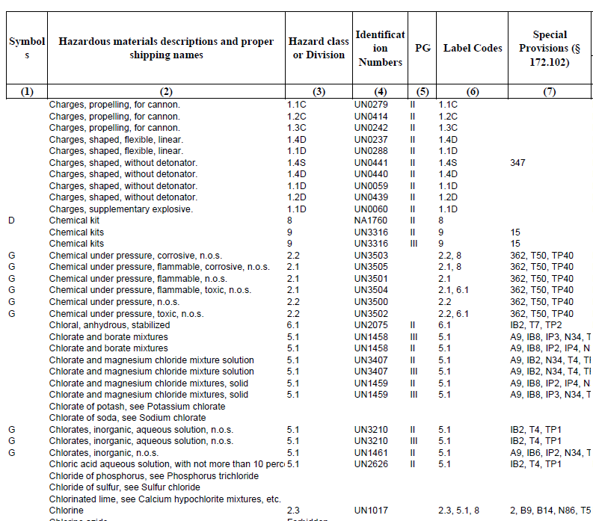
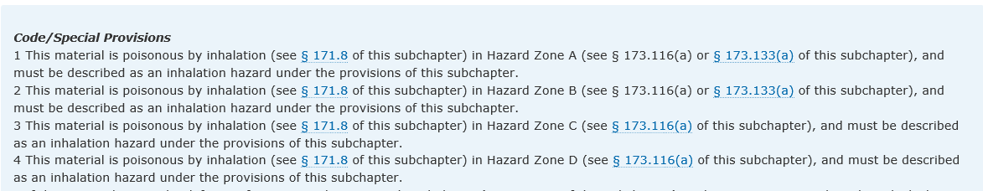
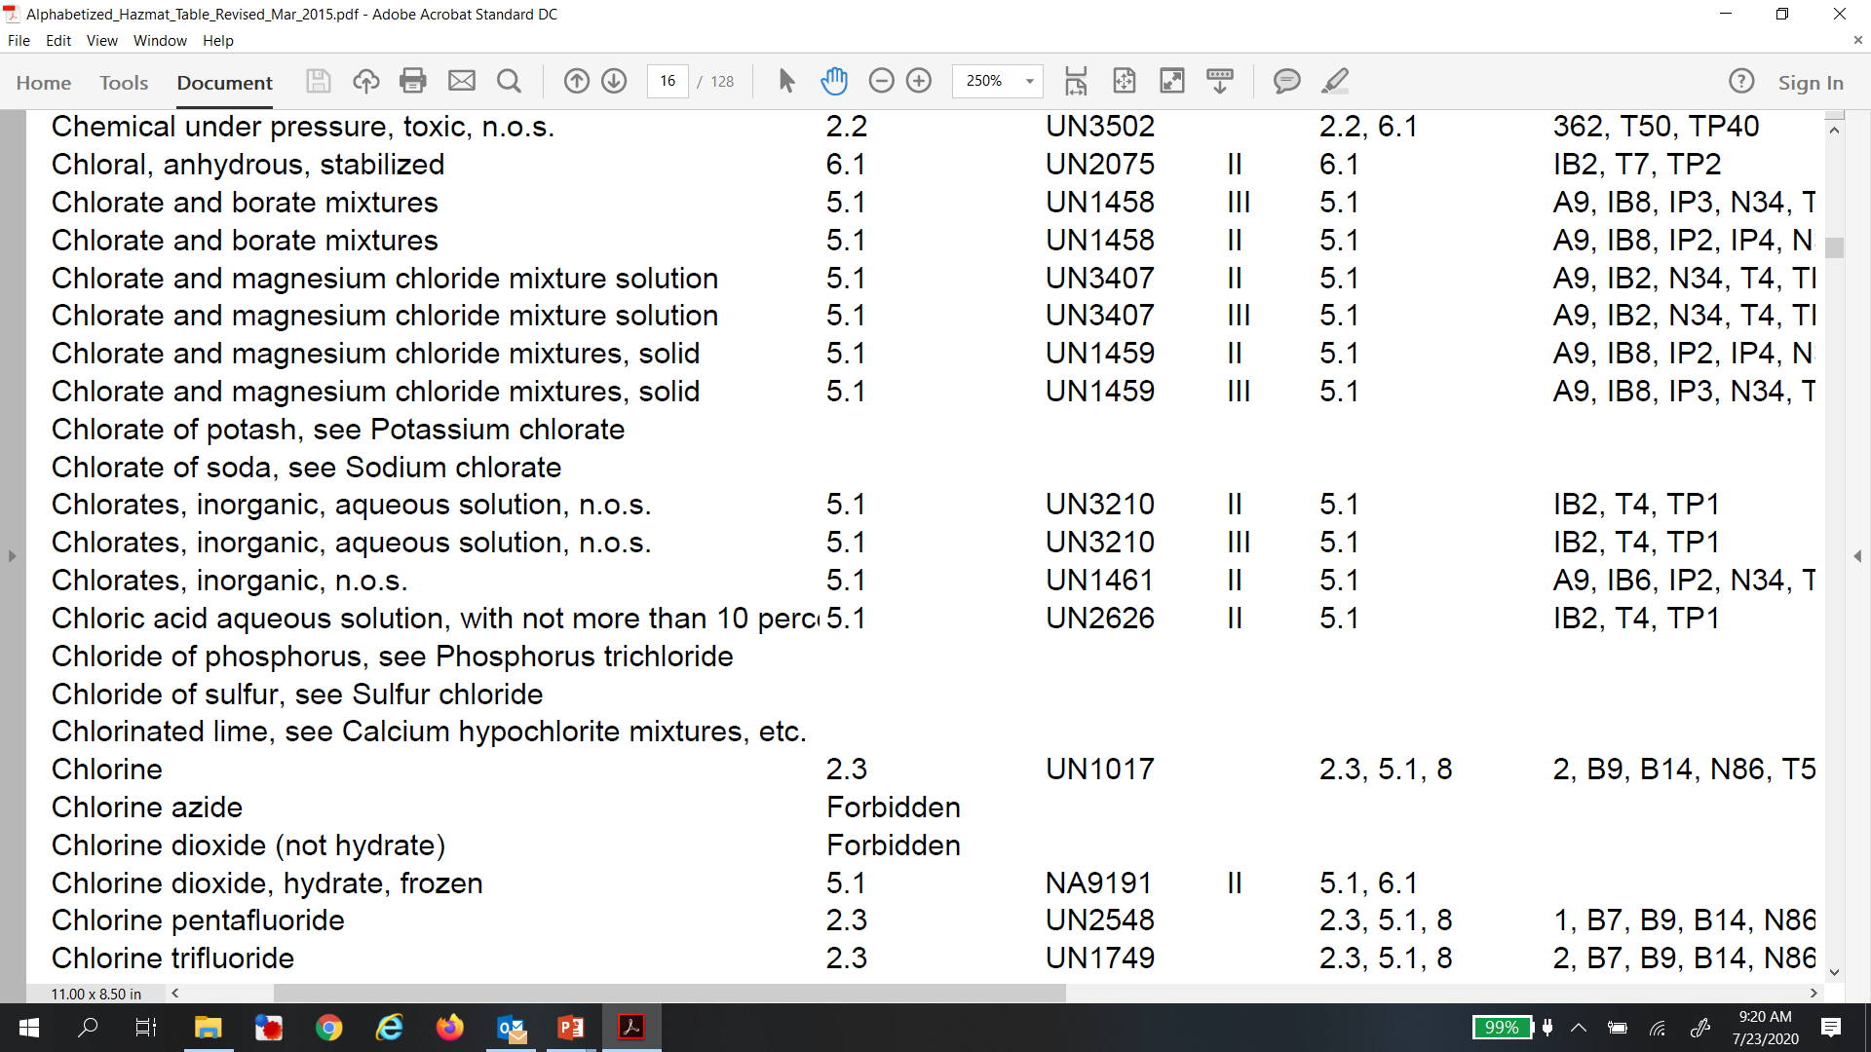
Hazard Zones
Hazard Zone Inhalation Toxicity
A LC₅₀ < 200ppm
B 200ppm < LC₅₀ < 1,000ppm
C 1,000ppm < LC₅₀ < 3,000ppm
D 3,000ppm < LC₅₀ < 5,000ppm

Slide 36
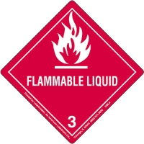
Class 3 – Flammable Liquid
Flash Point ≤ 140°F (60.5°C ).
Isopropanol, Acetone, Solvent Based Inks, Gasoline, Xylene, Toluene.
49 CFR reference §173.120

Slide 37

Class 3 – Combustible Liquid
Does not meet the definition of any other class and has a flash point above 140°F (60.5°C ) and below 200°F (93°C).
  Kerosene, Diesel Fuel.
Packing group | Flash point (closed-cup) | Initial boiling point
I |  | ≤35 °C (95 °F)
II | <23 °C (73 °F) | >35 °C (95 °F)
III | ≥23 °C, ≤60 °C (≥73 °F, ≤140 °F) | >35 °C (95 °F)

Slide 38



Class 4 – Flammable Solids
Division 4.1: Flammable Solids
  Ignite with ease and burn without oxygen.
Division 4.2: Spontaneously Combustible
  Ignite spontaneously, without a source of ignition.
Division 4.3: Dangerous When Wet
  React with water, release emissions of combustible gas or become spontaneously combustible.
49 CFR §173.124

Slide 39

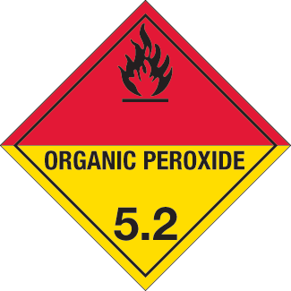
Class 5 – Oxidizers and Organic Peroxides
Division 5.1: Oxidizers
  Materials that give off oxygen, thereby promoting the combustion of flammable materials.
  49 CFR §173.127
Division 5.2: Organic Peroxides
  Materials that are highly unstable, they contain both oxygen and combustible material.
  49 CFR §173.128

Slide 40


Class 6 – Toxic/Poison Materials
Division 6.1: Poison Inhalation Hazards
  Poisonous by inhalation in Zone A or B.
Division 6.1: Other than Poison Inhalation Hazards
  Poisonous by skin absorption or ingestion.
49 CFR §173.132

Slide 41

Class 6 – Toxic/Poison Materials
Division 6.2: Infectious Substances
  Organisms that cause disease in humans and/or animals.
  No packaging group assignments.
  Regulated Medical Waste: PG II.
49 CFR §173.134

Slide 42



Class 7 – Radioactive Materials
Emit radiation or subatomic particles.
Grouped into one of three categories, according to level of radioactivity and source of radioactive emissions.

Slide 43

Class 8 – Corrosives
Liquids or solids that cause full thickness destruction of human skin at the site of contact, or liquids that have a severe corrosion rate on steel or aluminum.
Liquids or solids that corrode steel or aluminum at a faster rate than 6.25 mm (1/4 inch) per year at 130°F (55°C).
49 CFR §173.136
Packaging Groups:
  PG I: Full thickness destruction of skin tissue within 60 minutes of exposure (< = 3 minutes).
  PG II: Full thickness destruction of skin tissue within 14 days of exposure (>3 minutes, < 60 minutes).
  PG III: Full thickness destruction of skin tissue within 14 days of exposure (>60 minutes < 4 hours).
    Materials that do not cause full thickness destruction of skin tissue but does corrode steel or aluminum faster than 6.25 mm (1/4 inch) per year

Slide 44
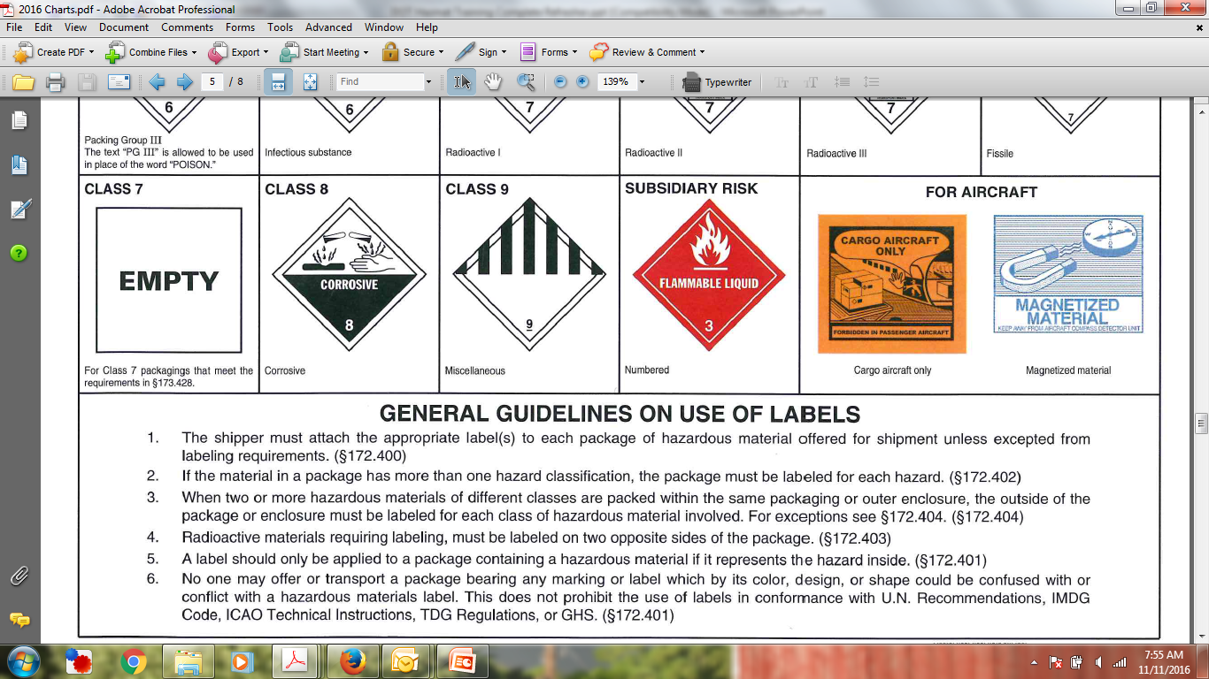
Class 9 – Miscellaneous
Products that do not fall into any other hazard class and that have anesthetic, noxious, or other similar property, or meet DOT’s definition of a hazardous substance, hazardous waste, marine pollutant, or elevated-temperature material.
    Asbestos, Dry Ice, PCBs and Hazardous Waste not classed 1-8.
    49 CFR §173.136

Slide 45
HAZARDOUS MATERIALS MANAGEMENT
Compliance with DOT requirements - 49 CFR 172.704
Section 2 – Hazmat Table
Bill Kesack
Senior Project Manager
Environmental Compliance

Slide 46
The Hazardous Materials Table
The HazMat Table:
HMR 49 CFR §172.101
The HazMat Table provides information for each proper shipping name that is used when preparing a hazmat for transportation.
Choosing the correct proper shipping name is the single, most important step when preparing your shipment for transportation.

Slide 47
HazMat Table Columns
Symbols
Proper Shipping Names
Hazard Class
Identification Numbers
Packing Group
Label codes
Special Provisions
Packaging
Quantity Limitations
Vessel Stowage

Slide 48
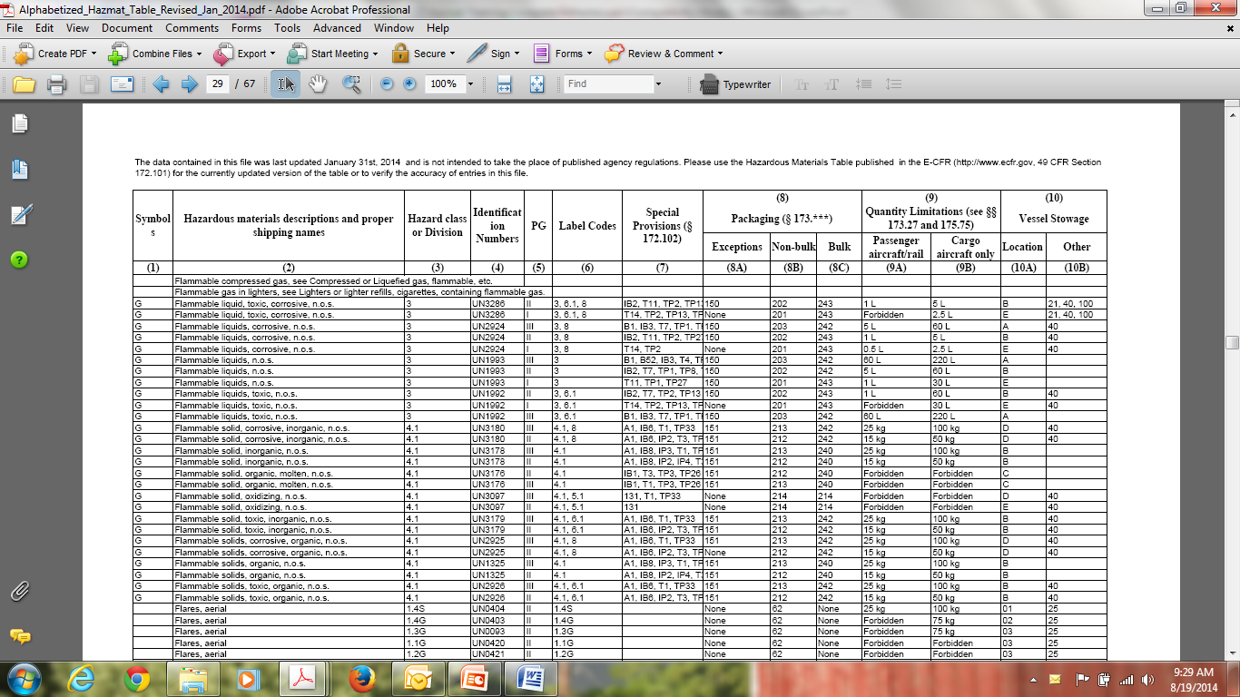
HazMat Table

Slide 49
Column 1: Symbols 49 CFR § 172.101(b)(1-6)
Designate groups of hazardous materials with specific transportation requirements. May contain one or more of six symbols:
  +: Fixes the proper shipping name, hazard class and packing group – no changes allowed
  A: Denotes a material that is subject to the requirements of subchapter 172 when offered or intended to be transported by aircraft
  D: Proper shipping names that may only be used within US
  G: Proper shipping names that require additional description (technical names)
  I: Proper shipping names that are appropriate international transportation
  W: Denotes a material that is subject to the requirements of subchapter 172 when offered or intended to be transported by vessel

Slide 50
Column 2: Proper Shipping Names 49 CFR § 172.101(c)(1-16)
Remainder of the regulatory requirements depend on this decision.
Proper name is shown in Plain Roman Type – not italics
Online the proper shipping names are in plain test (not italicized)
Words marked in italics may be used in addition to the proper shipping name, but are not required.
Proper shipping name may be used in the singular or plural and either in capital or lower case letters.
May indicate an option:
  Ethanol or Ethyl alcohol or Ethanol solutions or Ethyl alcohol solutions are all acceptable.

Slide 51
Column 3: Hazard Class 49 CFR § 172.101(d)(1-4)
Indicates that primary hazard class and division (if applicable) for each proper shipping name.
Isopropanol – Class 3 (flammable liquid)
Hydrochloric Acid – Class 8 (corrosive liquid)

Slide 52
Column 4: Identification Number 49 CF 172.101(e)
Four digits preceded by “UN” or “NA”.
Each proper shipping name has a corresponding ID (few exceptions).
“UN” (United Nations) Domestic and International.
“NA” (North America) only in the continental US.

Slide 53
Column 5: Packing Group 49 CFR § 172.101(f)
Indicates the packing group for the proper shipping name.
  PG I Great Danger
  PG II Medium Danger
  PG III Least (minor) Danger
If more than one PG is shown for a shipping name, you need to refer to the class-specific sections in Part 173 to determine the correct packing group for your hazmat.
Some shipping names have more than one packing group, others have none.

Slide 54
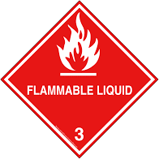

Column 6: Label Codes 49 CFR § 172.101(d)
Indicates the label codes that correspond with each proper shipping name.
Same as hazard class or division number.
Where there are more than two label codes listed, the first is the primary hazard.
  Example: Flammable Liquid, Corrosive Classes: 3 and 8.

Slide 55
Column 7: Special Provisions 49 CFR § 172.101 (h)
Specifies codes for special provisions applicable to hazardous materials (§172.102).
  A: Air
  B: Bulk
  IB or IP: Intermediate Bulk Containers (IBCs)
  N: Non-bulk
  R: Rail
  T: UN or IM specification portable tanks
  TP: Additional UN or IM specification portable tank information
  W: Water
  A number listed by itself applies to multi-modal transportation and bulk and non-bulk packaging.

Slide 56
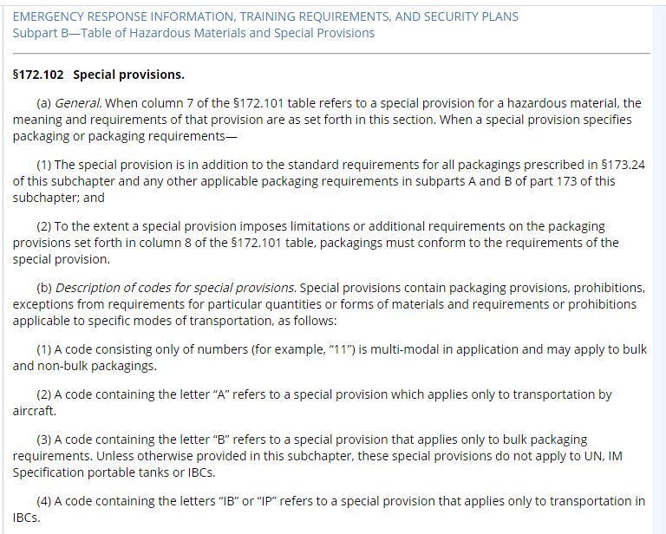
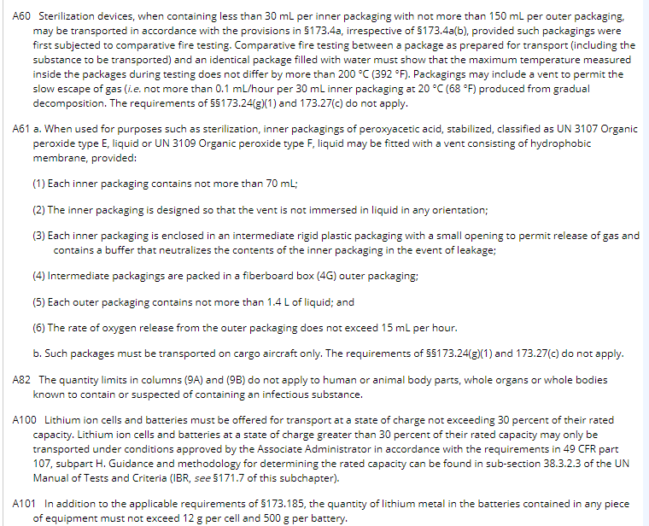
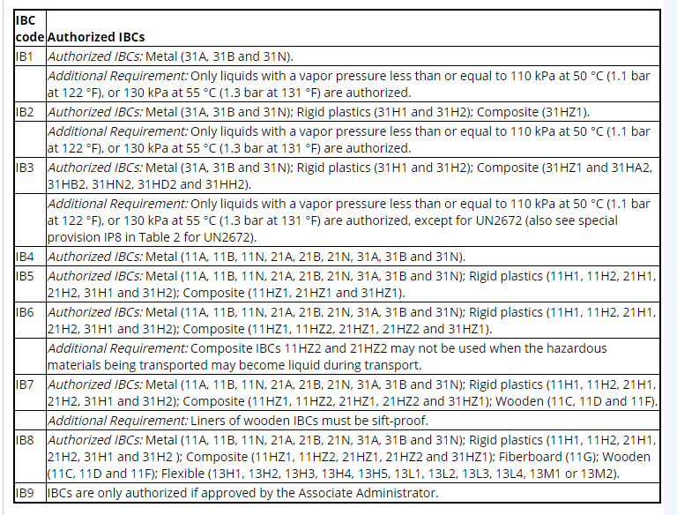
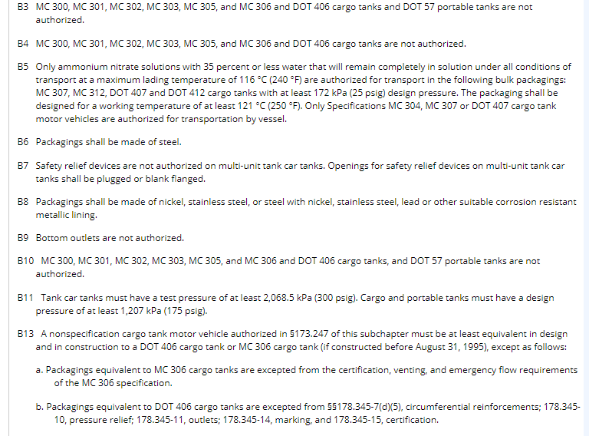
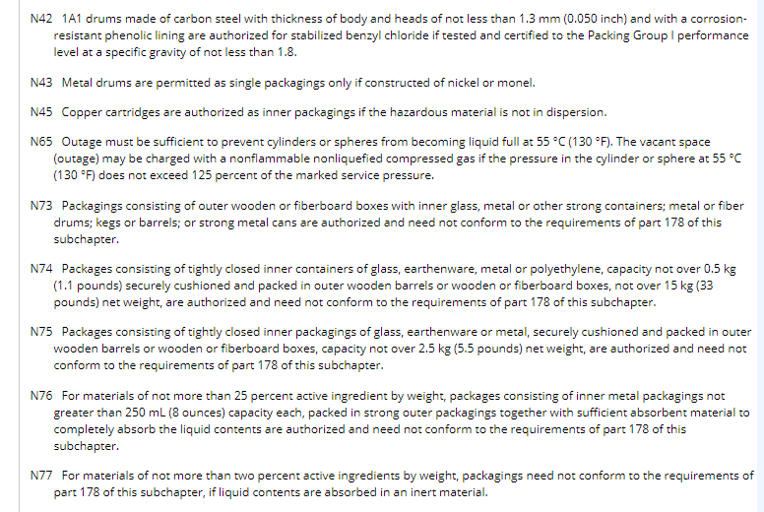
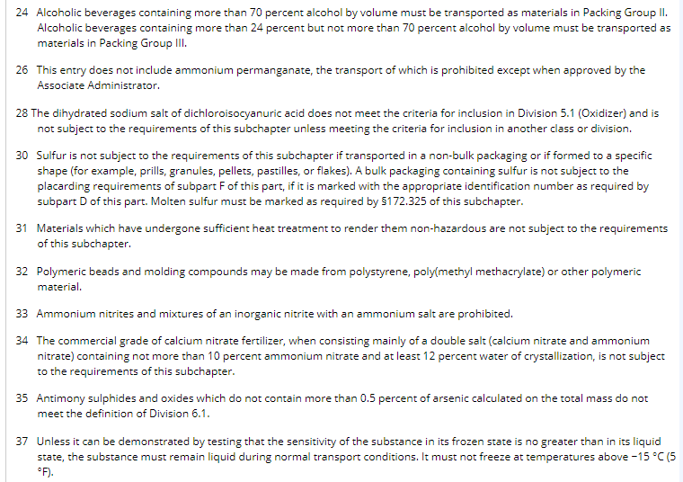
Special Provisions

Slide 57
Column 8: Packaging Authorizations 49 CFR § 172.101(i)(1-4)
Three Sub-columns of packaging authorizations:
  8A for limited quantity shipment and other exceptions. If no exception apply then move on to 8B/8C.
  8B for non-bulk package selection (≤ 119 gallons).
  8C for bulk package selection (>119 gallons).
All found in part 173 of the HMR.

Slide 58
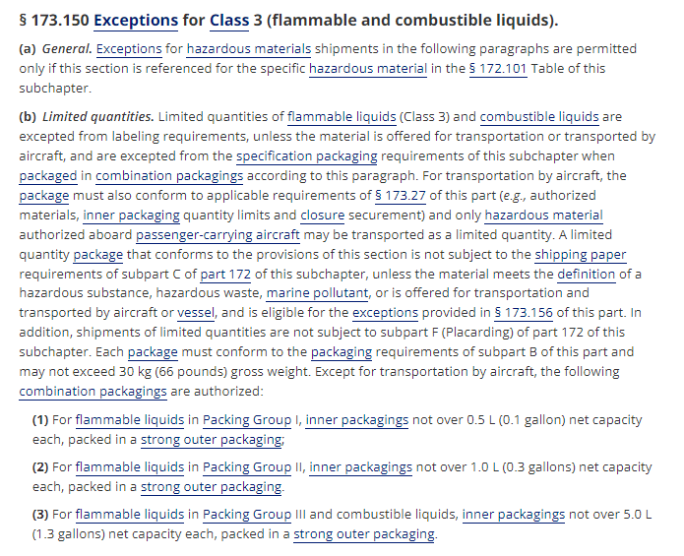
Example Exception

Slide 59
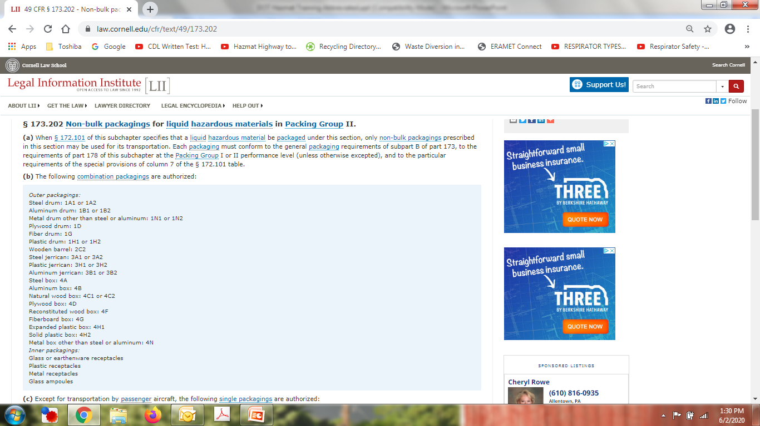
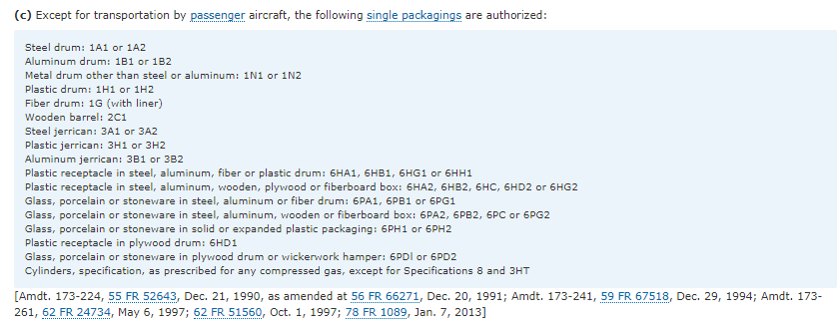

Slide 60
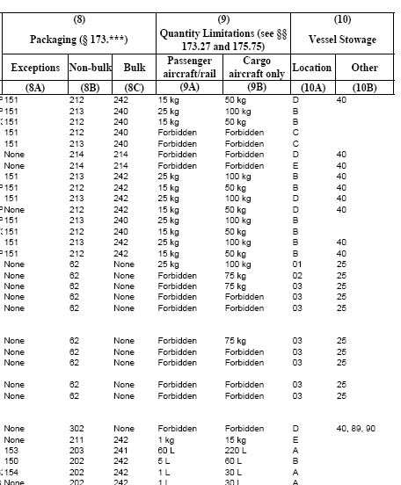
Column 9: Quantity Limitations 49 CFR § 172.101(j)(1-5)
Two columns that specify the maximum quantities that may be offered for transport in one package by:
  Passenger aircraft or passenger rail car (9A)
  Cargo aircraft (9B)

Slide 61
Column 10 : Vessel Stowage 49 CFR § 172.101(k)(1-20)
Two columns that specify how the hazardous material is to be stowed on board vessels for transportation via water.
  10A – Stowage locations
  10B – Additional requirements for segregation of specific types of hazmats
    Section 176.84

Slide 62
49 CFR § 172.101(k)(1-20)
(k) Column 10: Vessel stowage requirements. Column 10A [Vessel stowage] specifies the authorized stowage locations on board cargo and passenger vessels. Column 10B [Other provisions] specifies codes for stowage and handling requirements for specific hazardous materials. Hazardous materials offered for transportation as limited quantities are allocated stowage category A and are not subject to the stowage codes assigned by column 10B. The authorized stowage locations specified in Column 10A are defined as follows:
(1) Stowage category “A” means the material may be stowed “on deck” or “under deck” on a cargo vessel or on a passenger vessel.
(2) Stowage category “B” means -
  (i) The material may be stowed “on deck” or “under deck” on a cargo vessel and on a passenger vessel carrying a number of passengers limited to not more than the larger of 25 passengers, or one passenger per each 3 m of overall vessel length; and
  (ii) “On deck only” on passenger vessels in which the number of passengers specified in paragraph (k)(2)(i) of this section is exceeded.
(3) Stowage category “C” means the material must be stowed “on deck only” on a cargo vessel or on a passenger vessel.
(4) Stowage category “D” means the material must be stowed “on deck only” on a cargo vessel or on a passenger vessel carrying a number of passengers limited to not more than the larger of 25 passengers or one passenger per each 3 m of overall vessel length, but the material is prohibited on a passenger vessel in which the limiting number of passengers is exceeded.

Slide 63
49 CFR § 172.101(k)(1-20) (cont’d)
The authorized stowage locations specified in Column 10A are defined as follows:
(5) Stowage category “E” means the material may be stowed “on deck” or “under deck” on a cargo vessel or on a passenger vessel carrying a number of passengers limited to not more than the larger of 25 passengers, or one passenger per each 3 m of overall vessel length, but is prohibited from carriage on a passenger vessel in which the limiting number of passengers is exceeded.
(6) Stowage category “01” means the material may be stowed “on deck” in closed cargo transport units or “under deck” on a cargo vessel (up to 12 passengers) or on a passenger vessel.
(7) Stowage category “02” means the material may be stowed “on deck” in closed cargo transport units or “under deck” on a cargo vessel (up to 12 passengers) or “on deck” in closed cargo transport units or “under deck” in closed cargo transport units on a passenger vessel.
(8) Stowage category “03” means the material may be stowed “on deck” in closed cargo transport units or “under deck” on a cargo vessel (up to 12 passengers) but the material is prohibited on a passenger vessel.
(9) Stowage category “04” means the material may be stowed “on deck” in closed cargo transport units or “under deck” in closed cargo transports on a cargo vessel (up to 12 passengers) but the material is prohibited on a passenger vessel.
(10) Stowage category “05” means the material may be stowed “on deck” in closed cargo transport units on a cargo vessel (up to 12 passengers) but the material is prohibited on a passenger vessel.

Slide 64
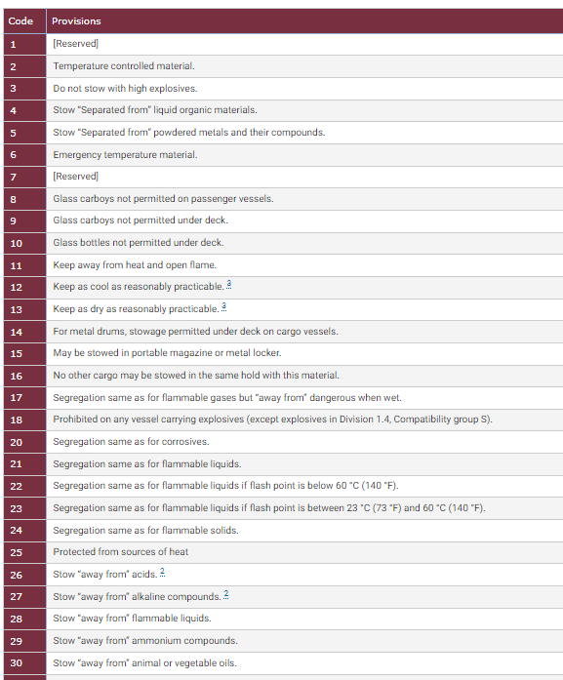
49 CFR 176.84

Slide 65
HAZARDOUS MATERIALS MANAGEMENT
Compliance with DOT requirements - 49 CFR 172.704
Section 3 - Packaging
Bill Kesack
Senior Project Manager
Environmental Compliance

Slide 66
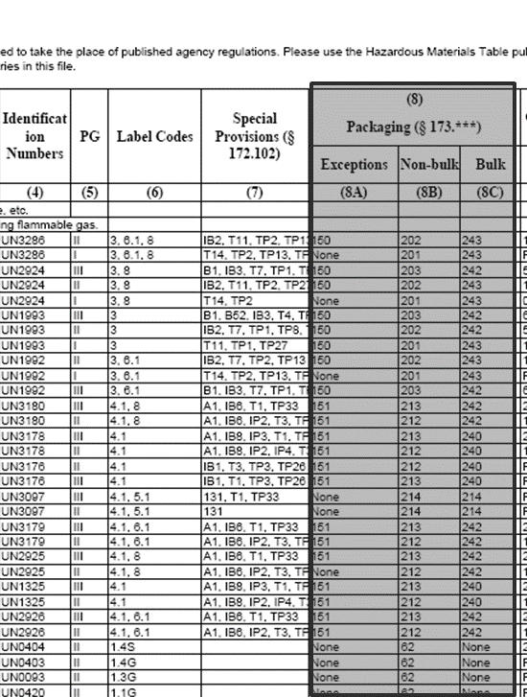
Packaging
Selecting the right packaging is crucial to keeping the HazMat in the package.
Requirements are designed to ensure the packaging selected is appropriate for the hazmat and can stand up to the conditions normally encountered in transport.
Columns 8A, 8B and 8C of the HazMat Table

Slide 67
Packaging
Only containers that meet DOT or UN performance standards can be used.
Not all materials are compatible with every container type.
DOT has specified containers for each class.
Must ensure that the container is closed properly and filled correctly when offering for shipping.

Slide 68
Performance-Oriented Packaging (POP)
Most non-bulk shipments that require specification packaging (not applicable to cylinders, bulk packaging and non-bulk packaging in Class 1 and 7).
Must pass:
  Drop Test (§178.603) All packaging design types.
  Leakproofness Test (§178.604) All packaging design types intended for liquids.
  Hydrostatic Test (§178.605) All metal, plastic, and composite design types intended to contain liquids.
  Stacking Test (§178.606) All packaging design types other than bags.
  Cooperage Test (§178.607) All bung-type wooden barrels.
  Vibration Test (§178.608) All packaging design types.
  Infectious Substances See §178.609 for test requirements for packagings for infectious substances.
  Pressure Differential (§173.27) Packagings intended for air transport.
Different criteria for the difference PGs.

Slide 69
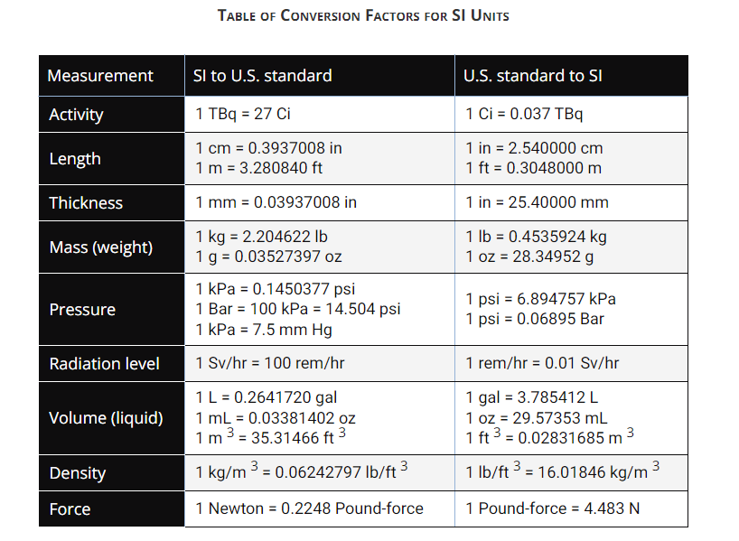
Unit Conversions §171.10

Slide 70
Performance-Oriented Packaging (POP)
Performance Levels the package has been tested at:
  X – packaging meeting Packing Group I, II and III tests.
  Y – packaging meeting Packing Group II and III tests.
  Z – packaging meeting Packing Group III tests.

Slide 71
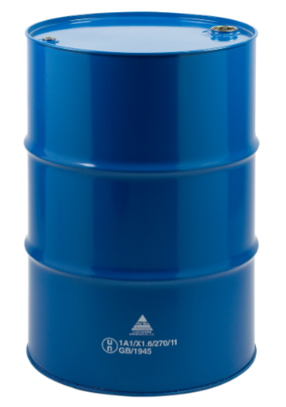

POP Marking Codes (non-bulk packaging)
Detailed explanations of the UN identification codes and package marking requirements are found in 178.502 and 178.503. Always make sure that all markings required by the HMR are on the packaging.
1A1/X 1.6/270/11
GB/1945
UN – United Nations
1A1 – 1=Drum, A=Steel, 1=Non removable Head
X – Performance code (PG I, II or III)
1.6 – Max specific gravity
270 – Max Hydrostatic Pressure (kPa)
11 – Year or manufacture
GB – Country of Origin
1945 – Manufacturers mark

Slide 72

POP Marking Codes (non-bulk packaging)
UN – United Nations
4GV – 4=Box, G=Fiberboard, V=alternate test methods
X – Performance code (PG I, II or III)
4.2 – Max gross wt of package (kg)
S – Solids or interior package
18 – Year or manufacture
USA – Country of Origin
+AA2741 – Manufacturers mark

Slide 73
Non Bulk Packaging Codes (§178.502)
Packaging Type
1 = Drum
2 = Wooden Barrel
3 = Jerrican
4 = Box
5 = Bag
6 = Composite Packaging
7 = Pressure Receptacle
Material of Construction
A = Steel
B = Aluminum
C = Natural Wood
D = Plywood
F = Reconstituted Wood
G = Fiberboard
H = Plastic
L = Textile
M = Paper, Multiwall
N = Metal (other than steel or aluminum)
P = Glass, Porcelain or Stoneware

Slide 74
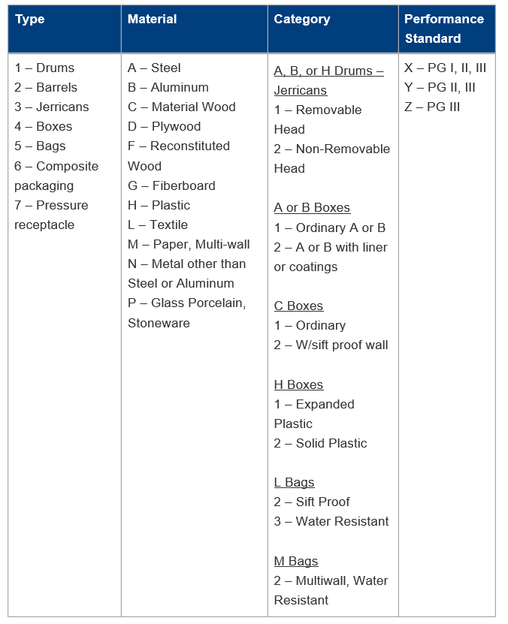
POP Table
1 – Non-Removable Head
2 – Removable Head

Slide 75
Bulk Packaging Codes (§178.702)
Material of Construction
A = Steel
B = Aluminum
C = Natural Wood
D = Plywood
F = Reconstituted Wood
G = Fiberboard
H = Plastic
L = Textile
M = Paper, Multiwall
N = Metal (other than steel or aluminum)
Type | For Solids, discharge |  | For liquids
 | By Gravity | Under pressure of more than 10 kPa (1.45 psig)
Rigid | 11 | 21 | 31
Flexible | 13 | NA | NA
Numbers after the material construction letter(s) indicate another property of the container (ex. free standing or with structural equipment)

Slide 76
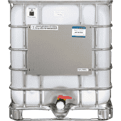
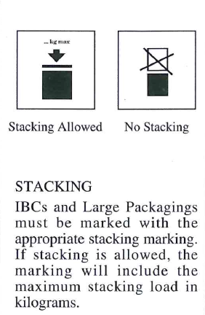
Bulk Packaging Code (§178.703)
31H1/Y/04 93/USA/ABC/O/1500
  IBC Code/Performance Standard/Month and Year of Manufacture/Country of Origin/Manufacturer’s Mark/ Stacking load/Max Gross Mass in Kg
31HA1/Y/05 93/USA/+ZT1235/1080/1200
  IBC Code (1st letter is inner receptacle, 2nd letter is outer receptacle)/Performance Standard/Month and Year of Manufacture/Country of Origin/Manufacturer’s Mark/ Stacking load/Max Gross Mass in Kg

Slide 77
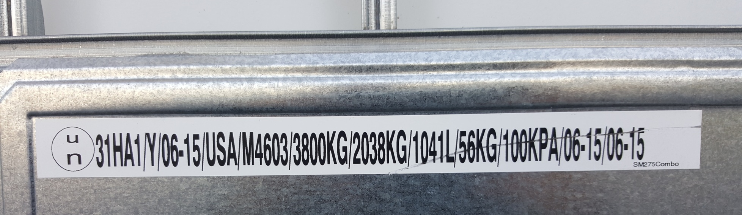
Tote POP Plates
UN – United Nations
31HA – Rigid Container for liquids
Y – Performance Code
06-15 – Month and Year of Manufacture
USA – Country of Origin
M4603 – Manufacturer’s Mark
3800 KG – Stacking Load
2038 KG – Max Gross Weight of container and contents
1041 L – Max Capacity in liters of water
56 KG - Tare (empty) weight
100 KPA – Test Pressure
06-15 – Date of leakproof test
06-15 – Date of last inspection

Slide 78
HAZARDOUS MATERIALS MANAGEMENT
Compliance with DOT requirements - 49 CFR 172.704
Section 4 – Hazard Communication
Bill Kesack
Senior Project Manager
Environmental Compliance

Slide 79
Hazard Communication
Communicating the hazard of the material:
  Shipping Papers
  Marking
  Labeling
  Placarding
  Emergency response information

Slide 80
Hazard Communication
Hazard Communication is information that travels on or with a hazmat that relates to the hazard of the material to people who come in contact with it.
Includes labels, markings, placards, shipping papers, and emergency response information

Slide 81
Shipping Papers (172.200 Subpart C)
A shipping paper is the bill-of-lading or manifest used to describe hazmats during transportation.
It must include specific information about the hazmat being shipped.

Slide 82
Shipping Papers
Shipper is responsible at all times.
Bill of lading for the hazardous material describes material, acknowledges receipt, and describes terms of contract for carriage.
In the transport vehicle, shipping papers containing a hazardous material or hazardous waste must be within reach of the driver while they are belted in (In the driver-side door or in the center console). The papers containing a hazardous material or hazardous waste must be placed on the driver’s seat when the driver is out of the truck.

Slide 83
Shipping Papers
Hazmat with Non-hazmat:
  Hazmat listed first, or
  Identified with an “X” or “RQ” in the “HM” column, or
  Entered in a contrasting color.
Hazardous Waste shipments must utilize the Federal Uniform Hazardous Waste Manifest.

Slide 84
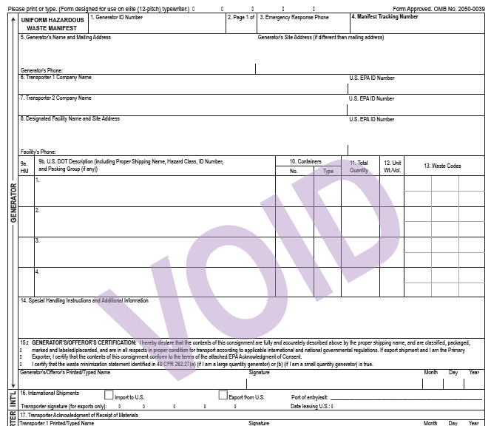
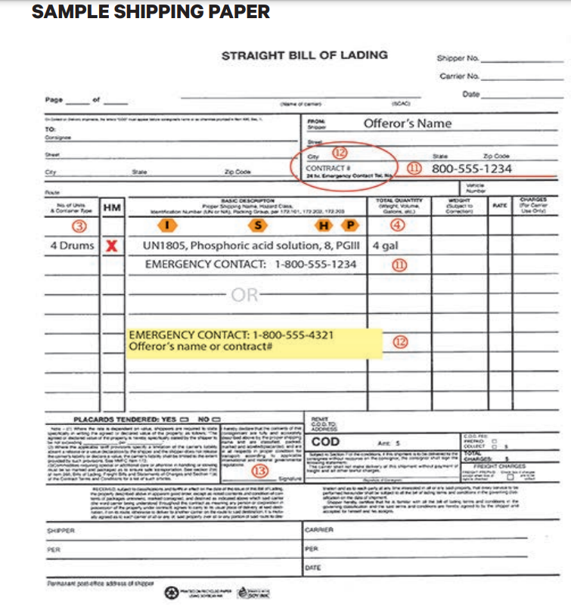
Required Information
ID# (Column 4)
Proper Shipping Name (Column 2)
Hazard Class (subsidiary hazard or division in parentheses) (Column 6)
PG (Column 5)
Additional Information – Technical Names, MP, RQ, SP, LTD QTY
Total Quantity (in weight or volume)
Total Number and type of packages
ERG # (if this is your form of emergency response info)
Transportation Info
  Names, addresses and phone numbers (Where is the material coming from and where is it going to)
Emergency Response Telephone Number
  Include name of entity that the number belongs to and contract number if for a third party provider
Shippers Certification
Transporter Certification
NCR000008799
800-424-9300
ABC Corp.
200 State Rt 401
Hometown, NC 67556
336-541-7767
We Haul
ALD000006543
XYZ Corp.
200 State Rt 66
Midway, TX 89798
601-454-9987
TXR000004544
x
RQ (D001) UN1993, Waste Flammable Liquid, N.O.S. (IPA, Acetone), 3, II
4 DM 1680 P
D001
Used Oil
1 DM 300 P
ERG128
Emergency Number: 800-424-9300 (Chemtrec CN 9872034)

Slide 85
Shipper certification 172.204
“I hereby declare that the contents of this consignment are fully and accurately described above by the proper shipping name, and are classified, packaged, marked and labeled/placarded, and are in all respects in proper condition for transport according to applicable international and national governmental regulations.”
Must be legibly signed by a principal, officer, partner, or employee of the shipper or his agent, and
May be legibly signed manually, by typewriter, or other mechanical means

Slide 86
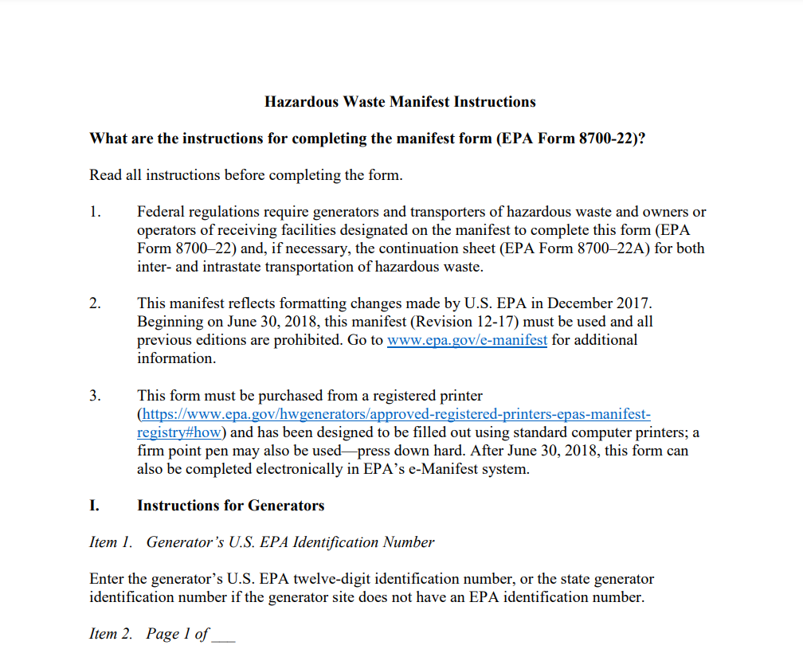
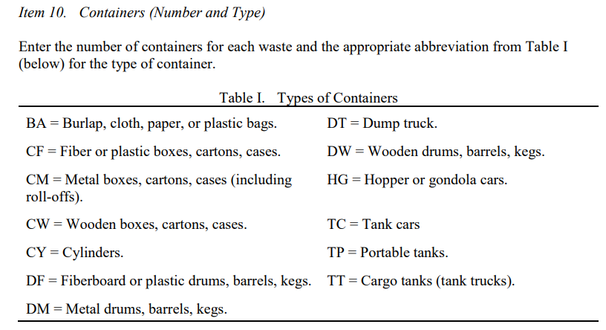
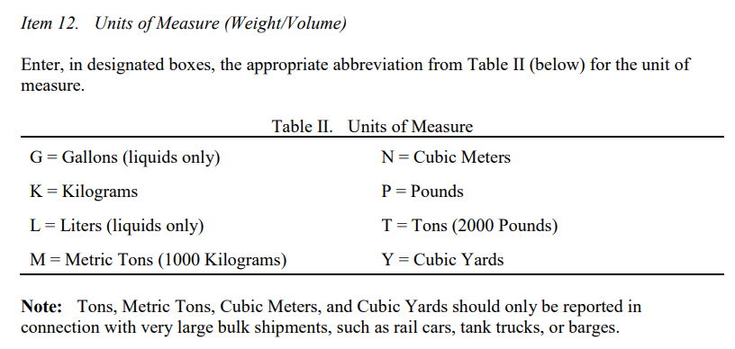
Manifest Instructions
https://www.epa.gov/sites/default/files/2018-05/documents/instructions_for_completing_the_uniform_hazardous_waste_manifest.pdf

Slide 87
Basic Description (Revised Regulation)
The “basic description” must be in order:
  ID # (HMT Column 4)
  (proper) Shipping name (HMT Column 2)
  (primary and subsidiary) Hazard class (HMT Column 6)
    Subsidiary (secondary) hazard class number is parenthesis after the primary hazard class number
  Packing group (HMT Column 5)
    Class 1, Class 5.2, Self Reactive Substances, Batteries other than those containing lithium, lithium ions or sodium are excepted from this requirement
ISHP

Slide 88
Additional Descriptive Requirements
§ 172.203 Additional description requirements.
  (a) Special permits. Except as provided in § 173.23 of this subchapter, each shipping paper issued in connection with a shipment made under a special permit must bear the notation “DOT-SP” followed by the special permit number assigned and located so that the notation is clearly associated with the description to which the special permit applies. Each shipping paper issued in connection with a shipment made under an exemption or special permit issued prior to October 1, 2007, may bear the notation “DOT-E” followed by the number assigned and so located that the notation is clearly associated with the description to which it applies.
  (b) Limited quantities. When a shipping paper is required by this subchapter, the description for a material offered for transportation as “limited quantity,” as authorized by this subchapter, must include the words “Limited Quantity” or “Ltd Qty” following the basic description.

Slide 89
Additional Descriptive Requirements
(c) Hazardous substances.
(1) Except for Class 7 (radioactive) materials described in accordance with paragraph (d) of this section, if the proper shipping name for a material that is a hazardous substance does not identify the hazardous substance by name, the name of the hazardous substance must be entered in parentheses in association with the basic description. If the material contains two or more hazardous substances, at least two hazardous substances, including the two with the lowest reportable quantities (RQs), must be identified. For a hazardous waste, the waste code (e.g., D001), if appropriate, may be used to identify the hazardous substance.
(2) The letters “RQ” must be entered on the shipping paper either before or after the basic description required by § 172.202 for each hazardous substance (see definition in § 171.8 of this subchapter). For example: “RQ, UN 1098, Allyl alcohol, 6.1, I, Toxic-inhalation hazard, Zone B”; or “UN 3077, Environmentally hazardous substances, solid, n.o.s., 9, III, RQ (Adipic acid)”.

Slide 90
Additional Descriptive Requirements
(e) Empty packagings.
(1) The description on the shipping paper for a packaging containing the residue of a hazardous material may include the words “RESIDUE: Last Contained * * *” immediately before or after the basic shipping description on the shipping paper.
(2) The description on the shipping paper for a tank car containing the residue of a hazardous material must include the phrase, “RESIDUE: LAST CONTAINED * * *” immediately before or after the basic shipping description or immediately preceding the proper shipping name of the material on the shipping paper.

Slide 91
Additional Descriptive Requirements
(k) Technical names for “n.o.s.” and other generic descriptions. Unless otherwise excepted, if a material is described on a shipping paper by one of the proper shipping names identified by the letter “G” in column (1) of the § 172.101 Table, the technical name of the hazardous material must be entered in parentheses in association with the basic description. For example “UN 1760, Corrosive liquid, n.o.s., (Octanoyl chloride), 8, II”, or “UN 1760, Corrosive liquid, n.o.s., 8, II (contains Octanoyl chloride)”. The word “contains” may be used in association with the technical name, if appropriate. For organic peroxides which may qualify for more than one generic listing depending on concentration, the technical name must include the actual concentration being shipped or the concentration range for the appropriate generic listing. For example, “UN 3102, Organic peroxide type B, solid, 5.2, (dibenzoyl peroxide, 52-100%)” or “UN 3108, Organic peroxide type E, solid, 5.2, (dibenzoyl peroxide, paste, <52%)”. Shipping descriptions for toxic materials that meet the criteria of Division 6.1, PG I or II (as specified in § 173.132(a) of this subchapter) or Division 2.3 (as specified in § 173.115(c) of this subchapter) and are identified by the letter “G” in column (1) of the § 172.101 Table, must have the technical name of the toxic constituent entered in parentheses in association with the basic description. A material classed as Division 6.2 and assigned identification number UN 2814 or UN 2900 that is suspected to contain an unknown Category A infectious substance must have the words “suspected Category A infectious substance” entered in parentheses in place of the technical name as part of the proper shipping description. For additional technical name options, see the definition for “Technical name” in § 171.8. A technical name should not be marked on the outer package of a Division 6.2 material (see § 172.301(b)).

Slide 92
Additional Descriptive Requirements
(l) Marine pollutants.
  (1) If the proper shipping name for a material which is a marine pollutant does not identify by name the component which makes the material a marine pollutant, the name of that component must appear in parentheses in association with the basic description. Where two or more components which make a material a marine pollutant are present, the names of at least two of the components most predominantly contributing to the marine pollutant designation must appear in parentheses in association with the basic description.
  (2) The words “Marine Pollutant” shall be entered in association with the basic description for a material which is a marine pollutant.
  (3) Except for transportation by vessel, marine pollutants subject to the provisions of 49 CFR 130.11 are excepted from the requirements of paragraph (l) of this section if a phrase indicating the material is an oil is placed in association with the basic description.
  (4) Except when all or part of transportation is by vessel, marine pollutants in non-bulk packagings are not subject to the requirements of paragraphs (l)(1) and (l)(2) of this section (see § 171.4 of this subchapter).

Slide 93
Emergency Response Telephone #
Two options:
  Must be the number of person offering the material for transportation
    Must be monitored at all times the hazmat is being transported.
    Person must be knowledgeable of the hazards and characteristics of the hazmat
    Person must have ER and incident mitigation information for the material or immediate access to someone who does.
  Agency capable providing detailed ER information about the hazmats on the shipping paper
    Chemtrec
    Velocity EHS (f.k.a. Chemtel)
    Info-trac
    3E

Slide 94
Shippers Certification
Certifies that the hazmat has been prepared in accordance with the regulations
Use wording as specified in the HMR
Printed either manually or mechanically
Signed legibly by hand, typewrite, or other mechanical means.

Slide 95
Retention
DOT requires shipping documents to be maintained onsite for 2 years after the date the hazmat is accepted by the initial carrier.
EPA requires Hazardous Waste Manifests be maintained onsite for 3 years from the date the waste is offered for transport.

Slide 96
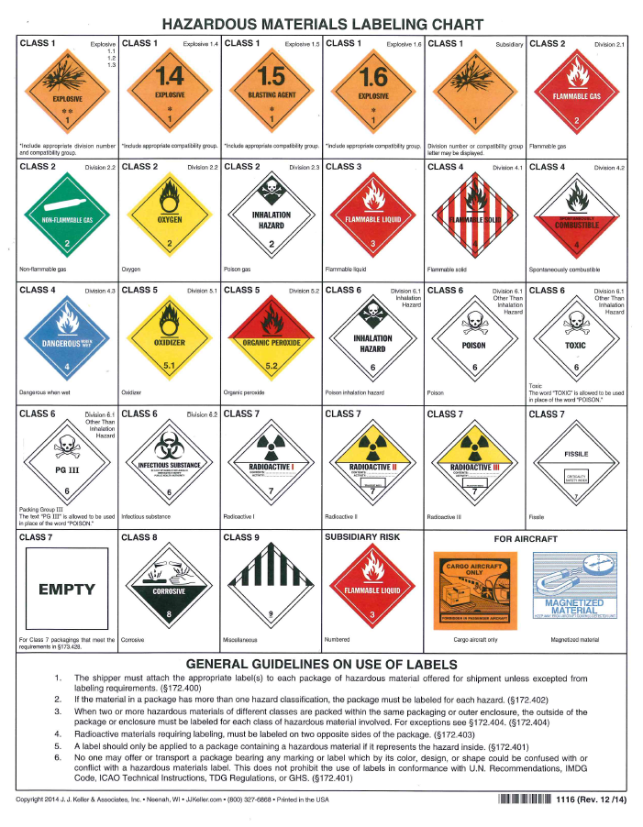
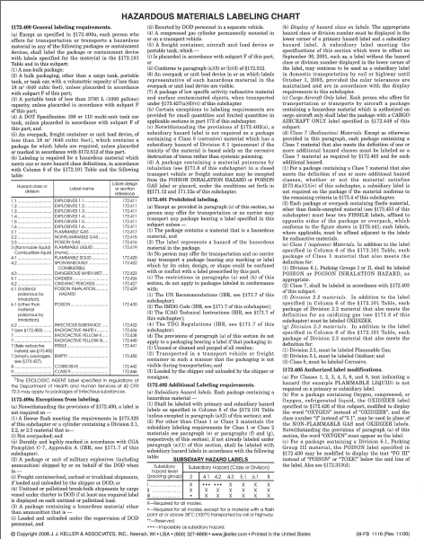
Labeling (172.400 Subpart E)

Slide 97
Labeling (172.400 Subpart E)
Primarily utilized for non-bulk packages of hazmat.
Communicate immediate warning of a hazmats hazards.
Shipper and Carrier are responsible
Denotes particular hazard class or division.

Slide 98
Label Specifications
Labels Must:
  Be durable and weather resistant
  Be diamond shape
  Contain the hazard class or division number in the bottom point
  Display the appropriate color and symbol
Words are optional

Slide 99
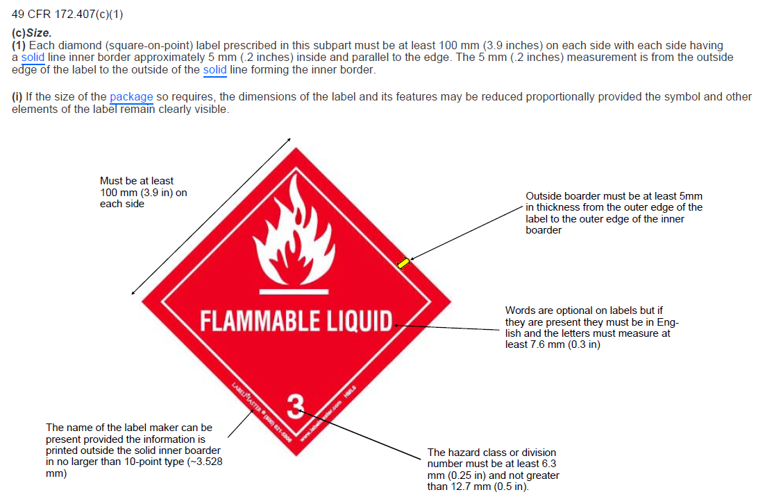
Label Specifications

Slide 100
Label Placement
Printed or affixed to the outside surface of the package, not on the bottom.
Not be hidden or concealed.
Placed on a background of contrasting color or have a dotted or solid line outer border.
Label must be place on the same side and near the proper shipping name, when possible.

Slide 101
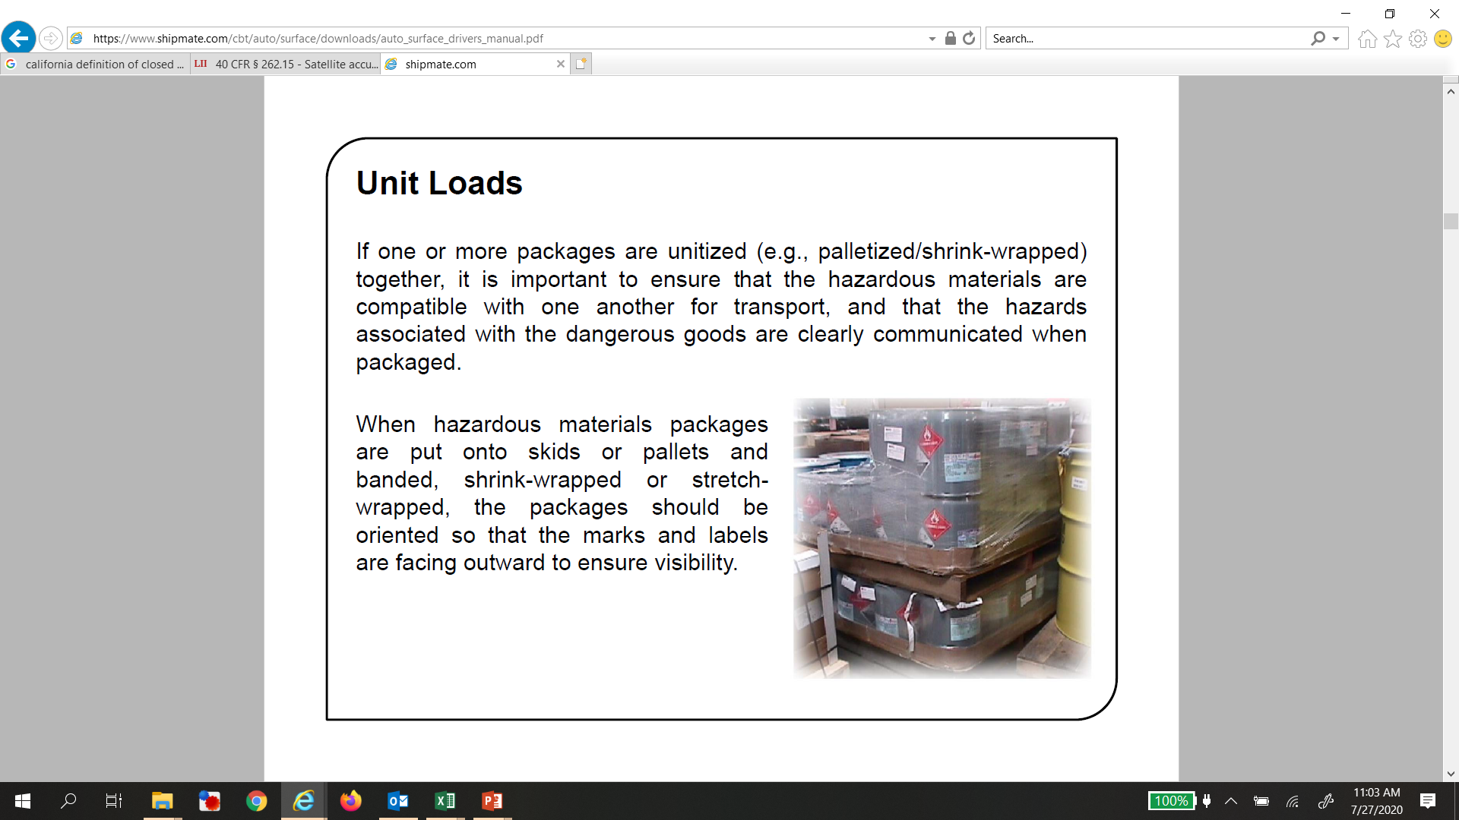
Unit Loads
If one or more packages are unitized (e.g., palletized/shrink-wrapped together), it is important to ensure that the hazardous materials are compatible with one another for transport, and that the hazards associated with the dangerous goods are clearly communicated when packaged.
When hazardous materials packages are put onto skids or pallets and banded, shrink-wrapped or stretch-wrapped, the packages should be oriented so that the marks and labels are facing outward to ensure visibility.
OVERPACK

Slide 102
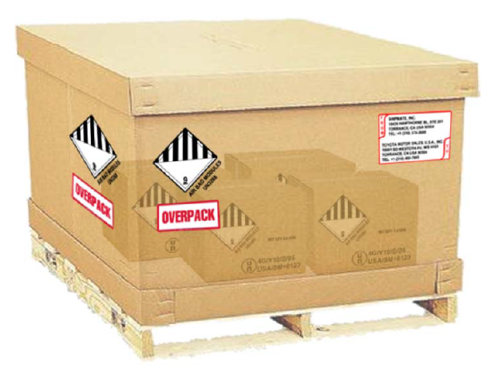
overpacks
Overpacks are larger packagings, such as pallet boxes or returnable packagings, which one or more hazardous materials or unit loads of hazardous materials where the labels and marks are not clearly visible.
Overpacks are generally used to consolidate one or more hazardous materials or other non-hazardous items to protect them while in transit or make it easier to handle.
Examples of overpacks are one or more packages:
  Placed or stacked onto a load board such as a pallet and secured by strapping, shrink wrapping, stretch wrapping, or other suitable means; or
  Placed in a protective outer packaging such as a box or crate

Slide 103
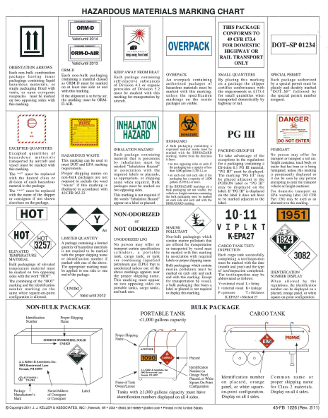
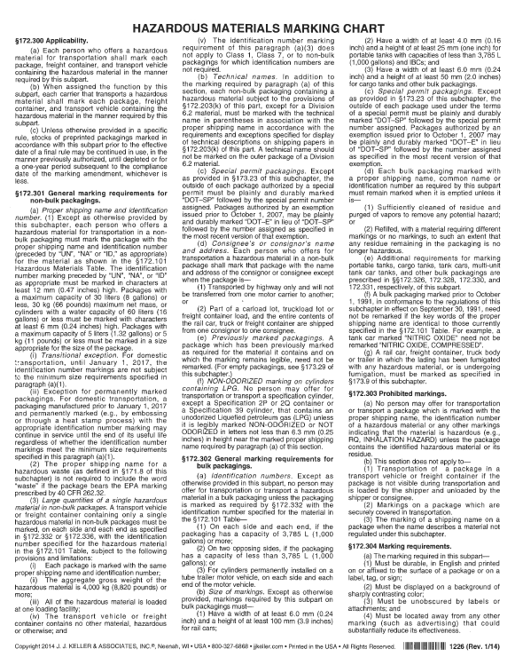

Markings (172.300 Subpart D)

Slide 104
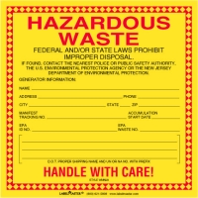

Markings (172.300 Subpart D)
Markings are any information required on the exterior of the package, except labels and placards.
Provide additional and more specific information about the hazmat.
Must be:
  Durable
  In English
  Printed on or affixed to the surface of the package
  Contrast with the background (i.e. black letters on a white box)
  Not covered in any way.
  Detached from other advertising.

Slide 105
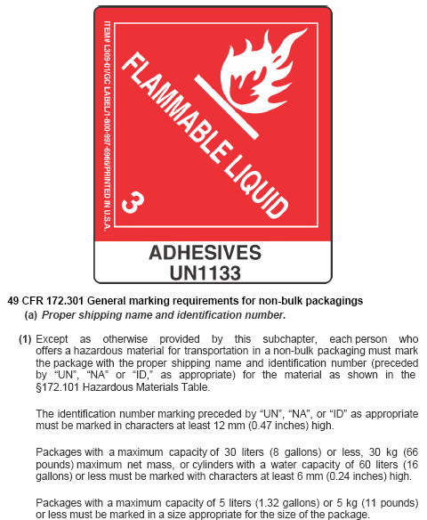

Slide 106


Using Labels on IBCs
§172.406(a)(1)(ii): HazMat label – if displayed – must be on the same surface of the package and near the proper shipping name marking.
§172.406(e)(6): Duplicate labels must be displayed on at least two sides of an IBC with a capacity of ≥1.8 m3 (475 gals).

Slide 107

Required Markings (Bulk)
49 CFR § 172.332 - Identification number markings
(c) Placards. Display of an identification number on a hazard warning placard shall be in conformance with the following:
  (1) The identification number shall be displayed across the center area of the placard in 88 mm (3.5 inches) black Alpine Gothic or Alternate Gothic No. 3 numerals on a white background 100 mm (3.9 inches) high and approximately 215 mm (8.5 inches) wide and may be outlined with a solid or dotted line border.
  (2) The top of the 100 mm (3.9 inches) high white background shall be approximately 40 mm (1.6 inches) above the placard horizontal center line.
  (3) An identification number may be displayed only on a placard corresponding to the primary hazard class of the hazardous material.
  (4) For a COMBUSTIBLE placard used to display an identification number, the entire background below the white background for the identification number must be white during transportation by rail and may be white during transportation by highway.
  (5) The name of the hazardous material and the hazard class may be shown in letters not more than 18 points high immediately within the upper border of the space on the placard bearing the identification number of the material.
  (6) If an identification number is placed over the word(s) on a placard, the word(s) should be substantially covered to maximize the effectiveness of the identification number.

Slide 108


Placards (172.500 Subpart F)

Slide 109
Placards (172.500 Subpart F)
Placards are square-on-point signs, larger than labels, used to show the hazard or hazards associated with hazmats contained in large quantities like bulk packages or trailers with large quantities of non-bulk packages of the same hazard class.
Placards and labels are different!

Slide 110
Placards
Shippers are required to supply placards to carriers.
However, the carrier usually assumes the responsibility.
Ultimately, the shipper is responsible for proper placarding.

Slide 111
Placarding requirements
To determine the placards required, you must know:
  Whether the package is bulk or non-bulk
  Hazard category and subsidiary hazards (if any)
  Weight of non-bulk packages in each hazard category.
All bulk packaging containing hazmat must be placarded with the UN/NA ID number (some exceptions).
  Residues in bulk packaging must be placarded
    The description on the shipping paper for a packaging containing the residue of the hazardous material may include the words “Residue: Last Contained mo/day/yr” immediately before or after the basic shipping description on the shipping paper.

Slide 112

Choosing Placards
For non-bulk packaged utilize:
  Table 1 and Table 2 in the HMR under section 172.504
  Placarding Chart
Table 1 (non-bulk):
  Most dangerous hazmat categories
  Must placard for any quantity of hazmat
Table 2 (non-bulk):
  Remaining hazard categories
  Do not need to placard until 1,001 lbs or more gross weight is reached

Slide 113
Materials Not Requiring Placarding
Non-Bulk Packages of Class 9 materials when transported in the US
Infectious substances
Consumer Commodities
Materials that are excepted in HMR
  Limited Quantities
  Combustible liquids in non-bulk packages

Slide 114


Prohibited Placarding
“Drive Safely” placard
Any sign, slogan or advertisement with color, design, shape or content that could be confused with any DOT placard.
Placarding may be displayed for hazmat, even when not required, if done according to the requirements.

Slide 115
HAZARDOUS MATERIALS MANAGEMENT
Compliance with DOT requirements - 49 CFR 172.704
Section 5 – Driver Qualifications
Bill Kesack
Senior Project Manager
Environmental Compliance

Slide 116
Commercial Driver’s License
Who must have a commercial driver’s license (CDL)?
Anyone who drives a commercial motor vehicle. The definition of a commercial motor vehicle is:
  a combination of vehicles with a gross vehicle weight rating of 26,001 or more pounds, provided the vehicle being towed is in excess of 10,000 pounds;
  a single vehicle with a gross vehicle weight rating of 26,001 or more pounds;
  a vehicle designed to transport 16 or more passengers, including the driver;
  a school bus; or
  any vehicle that is transporting hazardous materials and is required to be placarded in accordance with State and Federal regulations.

Slide 117
Driver tanker endorsement
The following situations require the CDL driver to have the tanker endorsement.
hauling portable or attached tanks of 1,000 gallons or more
hauling bulk containers of over 119 gallons or more with a total of 1,000 gallons
carrying filled cylinders, or IBCs that have liquids of 1,000 gallons or more

Slide 118
Commercial Driver Endorsements
Commercial Driver Endorsements
endorsement H authorizes the driver to operate a vehicle transporting hazardous materials requiring placarding
endorsement N authorizes the driver to operate tank vehicles
endorsement X hazardous materials and tank vehicle (H,N)
endorsement P authorizes the driver to operate vehicles carrying passengers
endorsement S authorizes the driver to operate a school bus (a School Bus endorsement card will be issued annually)
endorsement T authorizes the driving of double and triple trailers
restriction L restricts the driver to vehicles NOT equipped with air brakes
restriction B/M restricts the driver from a class A bus
restriction C/N restricts the driver from a class A or B bus
restriction E restricts the driver from driving manual transmission commercial vehicles
restriction K limits a driver to only operate in intrastate commerce
restriction O restricts a driver from driving a truck tractor/semi-trailer combination
restriction Z restricts a driver from driving a full air-brake equipped vehicle

Slide 119

Commercial Driver Endorsements

Slide 120

Example US License

Slide 121


Example Mexican License
1. Licencia Federal de Conductor
2. Driver’s License Number
3. Issuance Date
4. Expiration Date
5. Driver’s Name and Address
6. Date of Birth
7. License Class
8. Restrictions
9. eLicencias - Check

Slide 122


Example Canadian license
https://www.fmcsa.dot.gov/sites/fmcsa.dot.gov/files/2022-02/2022%20Canadian%20Drivers%20Licence%20Reference%20Guide.pdf

Slide 123



Canadian Territory restriction codes

Slide 124
Canadian commercial drivers
FAQ006: Are Canadian commercial drivers who transport any liquid or gaseous material in a tank having a rated capacity of 1,000 gallons or more or multiple tanks having an individual rated capacity of more than 119 gallons and an aggregate capacity of 1,000 or more gallons in the U.S. required to display a tank vehicle endorsement on their Canadian Commercial License like the CDL for a U.S. driver?
Answer: No. Canadian drivers are not required to have a tank vehicle endorsement on their commercial licenses; however, they must possess a Transportation of Dangerous Goods (TDG) training certificate when transporting hazardous materials (HM) in a tank in the United States.

Slide 125
HAZARDOUS MATERIALS MANAGEMENT
Compliance with DOT requirements - 49 CFR 172.704
Section 6 – Emergency Response Information
Bill Kesack
Senior Project Manager
Environmental Compliance

Slide 126


Emergency Response

Slide 127
Emergency Response (172.600 Subpart G)
Emergency response information is required during transportation and at facilities.
  These requirements do not apply to hazmat exempt from shipping paper requirements or Consumer Commodity.

Slide 128
Emergency Response Information
Gives specific information about the material being transported
Must be supplied with the hazmat shipment
Guides emergency responders who may need to react to a leak or spill of hazmat

Slide 129
Emergency Response Information
At a minimum, the following must be provided for each hazmat in the shipment:
  Basic Description and technical name of the hazmat
  Immediate hazards to health
  Risks of fire or explosion
  Immediate precautions to be taken in the event of an accident or incident
  Immediate methods for handling fires
  Initial methods for handling spills or leaks in absence of fire
  Preliminary first aid measures

Slide 130
Acceptable Methods
Most common methods for providing ER information
  Listing it directly on the shipping paper
  Keeping a copy of the ERG with shipping papers
  Keeping a copy of the appropriate ERG page with the shipping papers
  In a document that includes both the material’s basic description and technical names
  SDS with shipping papers.
All methods must be printed in English and available for use away from the package.

Slide 131

Using the ERG
The 2024 ERG and mobile application will be available soon!
https://www.phmsa.dot.gov/sites/phmsa.dot.gov/files/2021-01/ERG2020-WEB.pdf

Slide 132







How to use the ERG
White
Pages
User instructions - Page 1
Division and classes - Page 6
By Placard Page - 8 - 9
  For use if only the placard is visible
By Rail Car type – Pages 10 – 11
  For use if you can only see the rail car and have no other information.
By DOT Trailer type - Pages 12 – 14
  For use if you can only see the trailer and have no other information
GHS Pictograms – Pages 16 - 17
Hazard Identification Numbers Displayed on Some Intermodal Containers - Pages 18 - 21

Slide 133
Emergency Response Guide
Guidebook consists of four colored sections:
  Yellow – Hazmat in numeric order
  Blue – Hazmat in alphabetical order
  Orange – Numbered “Guides” for emergency response information
  Green – Evacuation distances for hazmats that are poisonous when inhaled

Slide 134

Emergency Response Guide
The YELLOW section lists hazardous materials in numerical order.
Used to locate the “Guide Number” if the assigned identification number is known.
Notes:
20

Slide 135

Emergency Response Guide
The BLUE section lists hazardous materials in alphabetical order.
Used to locate the appropriate “Guide Number” if the material’s shipping name is known.
Notes:
23

Slide 136



Emergency Response Guide
The ORANGE section provides response activities for the hazardous materials listed.
Provides response actions for the worst case scenario
Notes:
25

Slide 137


Emergency Response Guidebook
The GREEN section lists suggested distances for protection from release areas involving hazardous materials.
Small Spills are 208 liters (55 gallons) or less.
Large Spills are greater than 208 liters (55 gallons)
Notes:
32

Slide 138
HAZARDOUS MATERIALS MANAGEMENT
Compliance with DOT requirements - 49 CFR 172.704
Section 7 – Loading and Segregation
Bill Kesack
Senior Project Manager
Environmental Compliance

Slide 139
Vehicle Loading/Unloading (177 Subpart B)
Keep the hazmat “safe” during transportation
Protects anyone involved with the shipment, as well as those who may come in contact with it.

Slide 140
General Requirements
HMR assigns responsibility to the carrier.
Requirements also apply to anyone involved in the loading and/or unloading process.
Important all parties to understand what can or can not be transported together – the “Segregation Table.”

Slide 141


Segregation table codes:
  Blank = There are no restrictions
  “X” = The materials may not be loaded or stored together
  “O” = The materials may not be loaded, transported or stored together unless separated in a manner that – in the event of leakage – there would be no comingling of the materials during transport
  “*” - Segregation among different Class 1 materials is governed by the compatibility table.
Notes:
Routine site safety and health inspections are designed to catch hazards missed at other stages. This type of inspection should be done at regular intervals, generally on a weekly basis. In addition, procedures should be established that provide a daily inspection of the work area.
You can use a checklist already developed or make your own, based on:
- Past problems
- Standards that apply to your industry
- Input from everyone involved
- Your company's safety practices or rules
Important things to remember about inspections are:
- Inspections should cover every part of the worksite
- They should be done at regular intervals
- In-house inspectors should be trained to recognize and control hazards
- Identified hazards should be tracked to correction
Information from inspections should be used to improve the hazard prevention and control program.

Slide 142

Compatibility Table
A blank space = no restrictions apply.
‘‘X’’ = explosives of different compatibility groups may not be carried on the same transport vehicle.

Slide 143
Compatibility Table
The numbers in the table mean the following:
  ‘‘1’’ means an explosive from compatibility group L shall only be carried on the same transport vehicle with an identical explosive.
  ‘‘2’’ means any combination of explosives from compatibility groups C, D, or E is assigned to compatibility group E.
  ‘‘3’’ means any combination of explosives from compatibility groups C, D, or E with those in compatibility group N is assigned to compatibility group D.
  ‘‘4’’ means see § 177.835(g) when transporting detonators.
  ‘‘5’’ means Division 1.4S fireworks may not be loaded on the same transport vehicle with Division 1.1 or 1.2 (ex-plosive) materials.
  ‘‘6’’ means explosive articles in compatibility group G, other than fireworks and those requiring special handling, may be loaded, transported and stored with other explosive articles of compatibility groups C, D and E, provided that explosive substances (such as those not contained in articles) are not carried in the same transport vehicle

Slide 144
General Requirements
Bracing and blocking of non-bulk containers: shipper to ensure that the package survives.
  Prevent multi directional movement
No smoking in the vicinity of hazmats
Set the vehicle’s handbrake before material is moved
Use of tools for tightening or moving packages should be used so that security is not compromised
Loading/Unloading of a cargo tank must be attended at all times by a qualified person

Slide 145
DOT Cargo Securement Standard
Cargo being transported in or on vehicles with a GVWR of over 10,000 lbs must be properly distributed and remain secure on or within the transporting vehicle under all conditions that could reasonably be expected to occur in normal driving.
Cargo must be firmly immobilized or secured on or within a vehicle by structures of adequate strength, dunnage (loose materials used to support and protect cargo) or dunnage bags (inflatable bags intended to fill space between articles of cargo or between cargo and the wall of the vehicle), shoring bars, tiedowns or a combination of these.

Slide 146
Fundamentals of cargo securement
How Well Must Cargo be Secured?
So that it does not:
Leak
Spill
Blow off the vehicle
Fall from the vehicle
Fall through the vehicle
Otherwise become dislodged from the vehicle
Shift upon or within the vehicle to such an extent that the vehicle’s stability or maneuverability is adversely affected.

Slide 147

Load Securement Terms
Blocking - a structure or device placed against or around an article of cargo to prevent horizontal movement.
Bracing - a structure or device placed against an article of cargo to prevent it from tipping and shifting.
The material used for blocking or bracing and as chocks and cradles must be strong enough to withstand being split or crushed by the cargo or tiedowns. This requirement also applies to any material used for dunnage.
  If wood is used:
    Hardwood is recommended.
    It should be properly seasoned.
    It should be free from rot or decay, knots, knotholes, and splits. The grain should run lengthwise when using wood for blocking or bracing.

Slide 148


Load Securement Terms
Shoring bar (or load bar) - a device placed transversely between the walls of a vehicle and cargo to prevent cargo from tipping or shifting.

Slide 149

Load Securement Terms
Tiedown - a combination of securing devices which forms an assembly that attaches articles of cargo to, or restrains articles of cargo on, a vehicle or trailer, and is attached to anchor point(s).

Slide 150
Minimum number of tiedowns
The cargo securement system used to restrain articles against movement must meet requirements concerning the minimum number of tiedowns. When an article of cargo is not blocked or positioned to prevent movement in the forward direction, the number of tiedowns needed depends on the length and weight of the articles.
There must be - one tiedown for articles 5 ft or less in length, and 1,100 lbs or less in weight;
There must be - two tiedowns if the article is 5 ft or less in length and more than 1,100 lbs in weight; or greater than 5 ft but less than 10 ft, regardless of weight.

Slide 151




Dromedary Shipments

Slide 152
Dromedaries
DROMEDARIES. Dromedaries are freight boxes carried on, and securely fastened to, the chassis of the tractor or on a flatbed
A truck tractor equipped with a dromedary unit operating in combination with a semitrailer is considered to be specialized equipment, providing the combination is transporting Class 1 explosives and/or any munitions related security material as specified by the U.S. Department of Defense in compliance with 49 CFR 177.835.
A truck tractor equipped with a dromedary unit pulling a semitrailer where the dromedary unit is transporting Class 1 explosives or any munitions-related security material as specified by the Department of Defense is subject to a 75-foot minimum overall length limit on the National Network (NN) and reasonable access routes.
Each State may decide for itself whether dromedary-equipped power units other than those noted above, should be treated as a truck tractor-semitrailer combination or as straight trucks under State length limits.

Slide 153

Dromedary Shipments
The Federal Highway Administration has amended its regulation on truck size and weight to include within the definition of specialized equipment dromedary-equipped truck tractor-semitrailer combination vehicles.
The amendment became effective in 2003. The amendment deals with the transportation of Class 1 explosives and/or any munitions related security material as specified by the Dept. of Defense.
The agency said the change is necessary because shipping non-compatible explosives in the same vehicle combination, where one part of the cargo may be separately carried in the dromedary unit, reduces the number of vehicles needed to transport munitions, increases military readiness, and reduces the number of vehicles on the road.

Slide 154
Class-specific Requirements
Class 1 – 177.835 and 397.5
Class 2 – 177.840
Class 3 – 177.837
Class 4, Division 4.2 – 177.838
Class 5.1 – 177.838
Class 6.1 and 2.3 – 177.841
Class 7 – 177.842
Class 8 – 177.839

Slide 155
HAZARDOUS MATERIALS MANAGEMENT
Compliance with DOT requirements - 49 CFR 172.704
Section 8 – Safety and Security
Bill Kesack
Senior Project Manager
Environmental Compliance

Slide 156
General Safety Measures
Protection from hazardous in the work place & accident avoidance
  Elimination
  Substitution
  Isolation
  Engineering
  Administrative
  PPE

Slide 157

General Safety Measures Examples
Elimination – eliminate the use of the hazmat
Substitution – use a non-haz material instead of a hazmat
Isolation – separate people or systems that use the hazmat
Engineering – use physical controls (hoods, booths)
Administrative – use safe work practices and good housekeeping
PPE – use proper PPE for the hazmat

Slide 158
Hazmat Security requirements
PHMSA, in consultation with the Transportation Security Administration of the Department of Homeland Security, published final rule HM-232F, titled Risk Based Adjustment of Transportation Security Plan Requirements on March 9, 2010.
This final rule modified the security plan requirements applicable to the commercial transportation of hazmat that were put in place in 2003.
Based on an evaluation of the security threats associated with specific types and quantities of hazmat considered to be “high consequence” if stolen and used for pernicious reasons, this final rule, effective 1 October 2010, narrows the list of materials subject to security plan requirements, thus reducing associated regulatory costs and paperwork.

Slide 159
Awareness of Security Risks
In the wrong hands, hazmats can pose a significant security threat
  Poisonous gas released in public areas
  Trucks of flammable materials ignited
  Hazardous materials dumped into water supplies

Slide 160
Security Plan Components
At a minimum, your security plan must address personnel security, unauthorized access, and En Route security, as well as include the following elements:
  An assessment of transportation security risks for shipments of hazmat listed in §172.800, including site- or location-specific risks associated with facilities where hazmat is prepared for transportation, stored, or unloaded; and measures to address the assessed risks;
  Name/job title of senior official responsible for developing/implementing the security plan;

Slide 161
Security Plan Components
Specific security duties for each position/department responsible for implementing the plan, or a portion thereof, and the process of notifying employees when specific elements must be implemented;
A plan for training hazmat employees in accordance with §172.704(a)(4) and (5);
The security plan, including the transportation security risk assessment, must be in writing and retained as long as in effect;
The security plan must be reviewed at least annually, and revised and/or updated as necessary;

Slide 162
Security Plan Components
The security plan must be available to responsible employees—consistent with security clearance/ background investigation/need-to-know;
When updated/revised, the most current copies of the security plan must be maintained, and responsible employees must be notified; and
Persons responsible for developing/implementing a security plan must maintain copies, including electronic, that are accessible at/through their place of business, or make available, upon request, to authorized officials of DOT or the Department of Homeland Security.

Slide 163
Security Plan training
Each hazmat employee of a person/company required to have a security plan, who handles, performs a regulated function related to, or implements the security plan, must receive in-depth training that provides an awareness of the security risks associated with hazmat transportation and methods to enhance transportation security.
This training should cover the following topics:
Company security objectives;
Organizational security structure;
Specific security procedures, duties, and responsibilities for each employee;
Specifics on how to recognize and respond to possible security threats; and
Specific actions to be taken by each employee in the event of a security breach.

Slide 164
Security Plan training
For in-depth security training required under §172.704 (a)(5) and (c)(2), a hazmat employee must be trained at least once every three years or, if the security plan for which training is required is revised during the three-year recurrent training cycle, within 90 days of implementation of the revised plan.

Slide 165
Security plan creation
Security Template found on PHMSA’s hazmat safety homepage http://phmsa.dot.gov/hazmat/risk/rmsef utilizes the following steps:
Scoping – determine the scope of operations that should be subject to security risk management. Identify the types of hazmat you handle and the modes of shipment used.
Knowledge of operations – collect detailed information about your transportation operations: (1) quantities of material transported; (2) baseline security programs; (3) current security procedures; and (4) related safety programs and procedures.

Slide 166
Security plan creation
Assessment – analyze potential security threats and identify security risk control points. Risk control points are points in the transportation process where you can make an impact by improving procedures or operations.
Strategy – rank or group security risks, prioritize opportunities for security risk reduction, and decide on preventative actions. Create a written document summarizing your decisions. This written document is your security plan.
Action – implement your security plan.
Verification – monitor implementation of your security plan.
Evaluation – determine if goals are being met and compare your strategy and results with others in your field.

Slide 167
Security plan required elements
At a minimum, a security plan must include the following elements:
  personnel security,
    Encourage your employees to report suspicious incidents or events.
    Implement routine security inspections.
    Convene regular employee/management meetings on security measures and awareness.
    Communicate with your staff using an internal communication system to provide information on facts, trends, and other security issues.

Slide 168
Security plan required elements
At a minimum, a security plan must include the following elements:
  unauthorized access
    Establish partnerships with local law enforcement officials, emergency responders, and other public safety agencies with jurisdiction over your facility. Through such relationships, you can exchange information about threats, trends, and unsuccessful security programs.
    Request a review of your facility and security program by local law enforcement and fire safety officials, as applicable.

Slide 169
Security plan required elements
At a minimum, a security plan must include the following elements:
  unauthorized access
    Restrict the availability of information related to your facility and the materials you handle. Encourage authorities in possession of information regarding your facility to limit its disclosure on a need-to-know basis.
    Check the adequacy of locks and other protective equipment. Consider equipping access gates with timed closure devices. Conduct frequent inspections.
    Install additional lights, alarm systems, or surveillance cameras.
    Restrict access to a single entry or gate.

Slide 170
Security plan required elements
At a minimum, a security plan must include the following elements:
  unauthorized access
    Use tamper-resistant or tamper-evident seals and locks on cargo compartment openings.
    Periodically inventory the quantity of hazmat you have on site in order to recognize if a theft has occurred.
    Keep records of security incidents. Review records to identify trends and potential vulnerabilities.
    Report any suspicious incidents or individuals to your local Federal Bureau of Investigation (FBI) office, and local law enforcement officials.

Slide 171
Security plan required elements
At a minimum, a security plan must include the following elements:
  En Route Security.
    Shippers and carriers should work together to assure the security of hazmat shipments En Route from origin to destination. Shippers must assess the security of transportation modes or combinations of modes available for transporting specific materials and select the most appropriate method of transportation to ensure their efficient and secure movement.

Slide 172
Security plan required elements
At a minimum, a security plan must include the following elements:
  En Route Security.
    Use carrier safety ratings, assessments, safety surveys, or audits, and ask the carrier to provide information on security measures it has implemented.
    Verify the carrier has an appropriate employee hiring/review process, including background checks, and an on-going security training program.
    Verify the identity of the carrier and/or driver prior to loading hazmat.

Slide 173
Security plan required elements
At a minimum, a security plan must include the following elements:
  En Route Security.
    Ask the driver for photo identification and a commercial driver’s license for comparison with information provided by the carrier.
    Ask the driver to tell you the name of the consignee and the destination for the material and confirm with your records before releasing shipments.
    Identify preferred and alternative routing, including acceptable deviations.

Slide 174
Written Security Plans (HM-232)
You must develop and implement a security plan if you offer for transportation or transport the following types or quantities of hazmat:
  Any Quantity of 1.1, 1.2 and 1.3 Explosives
  A Quantity of a 1.4, 1.5 or 1.6 material requiring placarding in accordance with Subpart F of this part
  A large bulk quantity of Division 2.1 material
  A large bulk quantity of Division 2.2 material with a subsidiary hazard of 5.1
  Any quantity of a poisonous by inhalation, as defined in §171.8 of this subchapter
  A large bulk quantity of Class 3 material in Packing Group I or II
  A quantity of desensitized explosives meeting the definition of Division 4.1 or Class 3 material requiring placarding in accordance with Subpart F of this part
  A large bulk quantity of a Division 4.2 in Packing Group I and II
  Any quantity of Division 4.3 materials requiring placarding in accordance with Subpart F of this part

Slide 175
Written Security Plans (HM-232)
You must develop and implement a security plan if you offer for transportation or transport the following types or quantities of hazmat:
  A large bulk quantity of a Division 5.1 material in Packing Group I and II; perchlorates or ammonium nitrate, ammonium nitrate fertilizers or ammonium nitrate emulsions, suspensions or gels
  Any quantity of Division 5.2 Organic peroxide, Type B, liquid or solid, temperature controlled
  A large bulk quantity of Division 6.1 material (for a material poisonous by inhalation see the items above that mentions poison by inhalation materials)
  A select agent or toxin regulated by the Centers for Disease Control and Prevention under 42 CFR part 73 or the USDA under 9 CFR part 121
  A quantity of uranium hexafluoride requiring placarding under §172.505(b)
  International Atomic Energy Agency Code of Conduct Category 1 and 2 materials including Highway Route Controlled quantities as defined in 49 CFR 173.403 or known radionuclides in forms listed as PAM-QC by the Nuclear Regulatory Commission
  A large bulk quantity of Class 8 material meeting the criteria for Packing Group I

Slide 176
Definition of a Large Bulk Quantity
A quantity greater than 3,000 kg (6,614 lbs) for solids or 3,000 liters (793 gallons) for liquids and gases in a single packaging such as a cargo tank motor vehicle, portable tank, tank car or other bulk container.

Slide 177
TEST
Don’t forget to send tests to

