Slide 1
Machine guarding
Best Practices & OSHA Standards

Slide 2
today’s presenter
Michael Schneider
Director, Health & Safety Services

Slide 3
Housekeeping
This presentation is being recorded and will be shared.
Everyone will be muted to prevent background noise.
Use the question button to log your question.

Slide 4
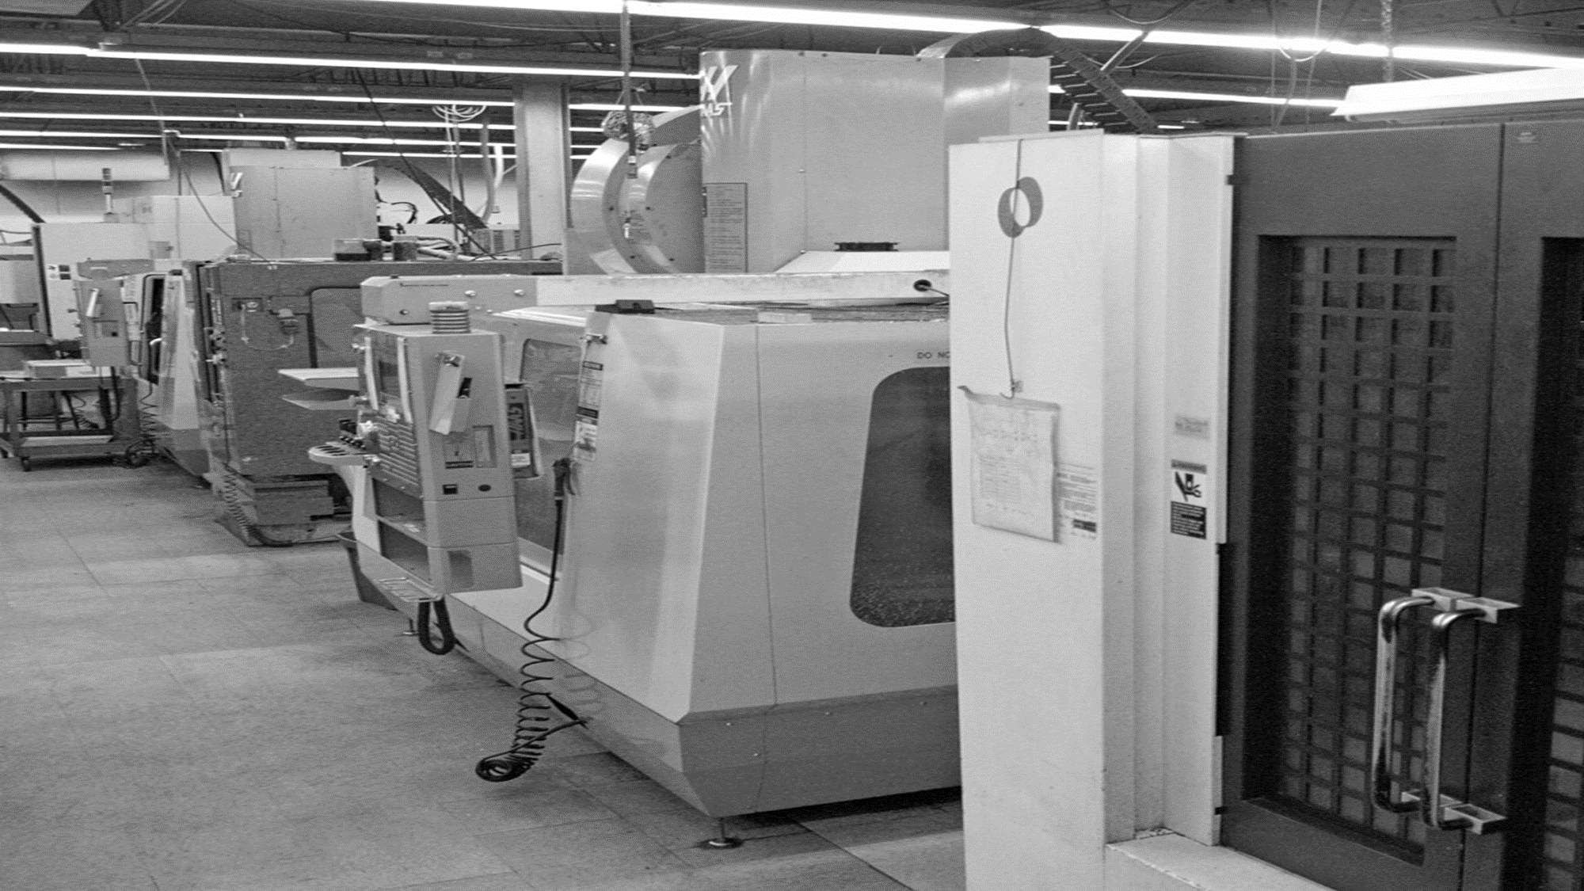
Today’s topics
OSHA Regulations
Machine Guarding Assessments
Equipment Safeguarding & Best Practices
Comprehensive Protection from Amputations

Slide 5
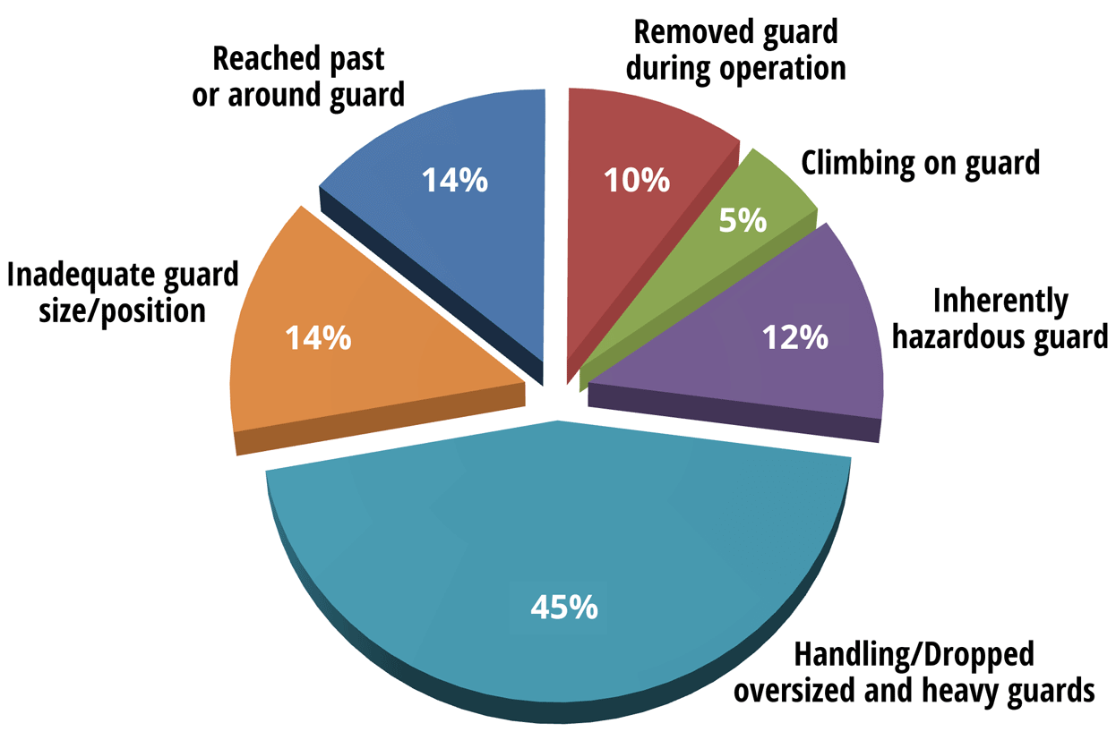
Why is Machine Guarding Important?
Crushed hands and arms, severed fingers and limbs, lacerations and abrasions
The list of possible machinery-related injuries is long and horrifying.
Fatalities due to contact with objects and equipment increased 4.7 percent from 705 fatalities in 2021 to 738 in 2022. This is the highest count for this event category since 2018. Machinery was the source of 199 fatalities within this category (BLS)
Nearly 50 percent of work-related amputations occur in manufacturing plants. (OSHA)
Causes of Machine Guarding Injuries
Notes:
Severe injuries result from contact with live equipment that does not have proper machine guarding, such as lacerations and abrasions, crushed hands and arms, amputations to finders and limbs, and in the worst case scenario, death.
Machine guarding prevents people who operate or work near live equipment from coming into contact with moving machine parts or flying debris generated during equipment operation. Proper Safeguards are essential in protecting people form preventable injuries
Nearly 50% of amputations occurring at work occur in manufacturing plants. Many of these are due to machine guarding issues.
Let’s take a look at causes of machine guarding injuries.

Slide 6
OSHA Citations
1,644 citations in fiscal year 2023 (10th most commonly cited)
Raised up from 1,370 in fiscal year 2022
Instance-by-Instance Citations
2024 Inflation Penalty Increases
Serious Other-than-Serious Posting Requirements | $16,131
Failure to Abate | $16,131 per day beyond abatement date
Willful or Repeated | $161,323 per violation
Notes:
Let’s discuss OSHA citations and how this could impact your company.
In fiscal year 2023, OSHA issued 1,644 citations for machine guarding. This was an increase from fiscal year 2022 which was a total of 1,370 citations
In both years, Machine Guarding was in the top 10 for most commonly cited standards.
In 2023, OSHA enacted directives to be much more aggressive under the Biden Administration than the previous White House. The agency has stepped up enforcement efforts and sought higher penalties when possible. Part of these increased enforcement efforts include that ability to cite for instance-by-instance situations. OSHA stated that these new enforcement guidelines are designed to “make its penalties more effective in stopping employers from repeatedly exposing workers to life-threatening hazards or failing to comply with certain workplace safety and health requirements.”
Instance-by-Instance citations applies for cases where the agency identifies “high-gravity” serious violations of OSHA standards specific to certain conditions where the language of the rule supports a citation for each instance of non-compliance. These conditions include lockout/tagout, machine guarding, permit-required confined space, respiratory protection, falls, trenching and cases with other-than-serious violations specific to recordkeeping.
The change is intended to ensure OSHA personnel are applying the full authority of the Occupational Safety and Health Act where increased citations are needed to discourage non-compliance.
What does this mean for companies, OSHA could cite for each instance they identify a machine guarding issue at the facility.
OSHA has also increased the penalty amounts due to inflation. For 2024,

Slide 7
Why is Machine Guarding Important?
Many hazards are created by moving machine parts.
Exposure to machine operator and other employees in the work area:
Nip points
Rotating parts
Flying chips and sparks
Safeguards are essential for protecting workers from preventable injuries.
Notes:
I’d like to share a few experiences I had with machine guarding that have always stuck with me.
Hand amputation in a wood shop
Finger de-gloving in printing industry
Finger tip amputation in a food manufacturing plant
What haunts me even more is when she described to me her return home after treatment. She is a single mother and she had to face her sons. They could immediately tell something was wrong- why is mom in bed? Why isn’t she giving me one of her big bear hugs? She recalled hiding her bandaged hand under the covers so they wouldn’t see. And the crying they all did as she had to calmly tell her young boys what happened.

Slide 8
OSHA Regulations related to Machine Guarding
1910 Subpart O - Machinery and Machine Guarding
1910.211 - Definitions.
1910.212 - General requirements for all machines.
1910.213 - Woodworking machinery requirements.
1910.214 - Cooperage machinery. Reserved
1910.215 - Abrasive wheel machinery.
1910.216 - Mills and calenders in the rubber and plastics industries.
1910.217 - Mechanical power presses.
1910.218 - Forging machines.
1910.219 - Mechanical power-transmission apparatus.
1910 Subpart P - Hand and Portable Powered Tools and Other Hand-Held Equipment
1910.243 - Guarding of portable powered tools.
1904 Subpart E- Reporting Fatality, Injury and Illness Information to the Government
1910 Subpart A- General
Workplace free of hazards that can cause severe injury or illness
Notes:
There are performance standards in ANSI B11 (Machine Guarding) or. ISO 13849.1 (Safety of Machinery).

Slide 9
OSHA's National Emphasis Program (NEP) on
Amputations in Manufacturing Industries
Effective 12/10/2019 for five years
Targets businesses with:
High inspection numbers with violations related to "focus five"
High BLS rates and amputations
High employer-reported amputation numbers
Programmed and unprogrammed inspections
Complaints and referrals alleging potential exposures to amputation hazards that could result in injury must be handled by an inspection

Slide 10
OSHA's National Emphasis Program (NEP) on
Amputations in Manufacturing Industries
Five Focus OSHA Standards
29 CFR 1910.212- General requirements for machines
29 CFR 1910.213- Woodworking machinery
29 CFR 1910.217- Mechanical power presses
29 CFR 1910.219- Mechanical power-transmissions
29 CFR 1910.147- Control of Hazardous Energy

Slide 11
How to identify amputation hazards
Job Hazard Analysis (JHA)/ Job Safety Analysis (JSA)
A technique that focuses on job tasks as a way to identify hazards before they occur
Focuses on the relationship between the worker, the task, the tools, and the work environment
Machine Guarding Assessment (MGA)
Focused technique to identify areas of machines and equipment that have substandard or missing equipment safeguarding
Pre-Job Machine Setup Checklist
Process where operators will verify that all machine guards are properly installed and functioning
Preventative Maintenance Program
PM process to test check and test guards on equipment
Notes:
JHA Definition from OSHA pub 3071
JHAs look at each job step, the associated hazards, and controls to reduce hazards to a safe level.
Broad- encompasses not only guarding, but PPE usafe, ergonomics, surrounding tasks that can impact person completing the job, etc.

Slide 12
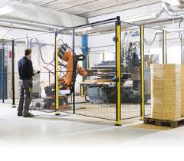
When to conduct Machine Guarding Assessments
All current equipment
Any new / incoming equipment prior to start-up
After any major equipment changes
Includes:
Large equipment and processes (e.g., production lines and conveyors, production equipment) and
Independently operated and smaller equipment (e.g., table saws, drill presses, bench grinders, lathes, powered hand tools, machining equipment, woodworking equipment, etc.)

Slide 13
Where to look- Recognizing Amputation hazards
Hazardous Mechanical Components
Hazardous Mechanical Motions
Hazardous Activities
Point of operation
Power-transmission apparatus
Other moving parts
Rotating motion
Reciprocating motion
Transversing motion
Cutting action
Punching action
Shearing action
Bending action
In-running nip points
Machine inspection
Normal production operations
Clearing jams
Machine adjustments
Cleaning of machine
Lubricating of machine parts
Scheduled and unscheduled maintenance

Slide 14
Where Machine Hazards Occur
Point of operation
Point of operation
Power transmission
Operating controls
The point where work is performed on the material, such as cutting, shaping, boring, or forming of stock.
The point of operation is typically the most hazardous part of the machine.
Notes:
Point of operation
The point of operation is that point where work is performed on the material, such as cutting, shaping, boring, or forming of stock. The point of operation is typically the most hazardous part of the machine.

Slide 15
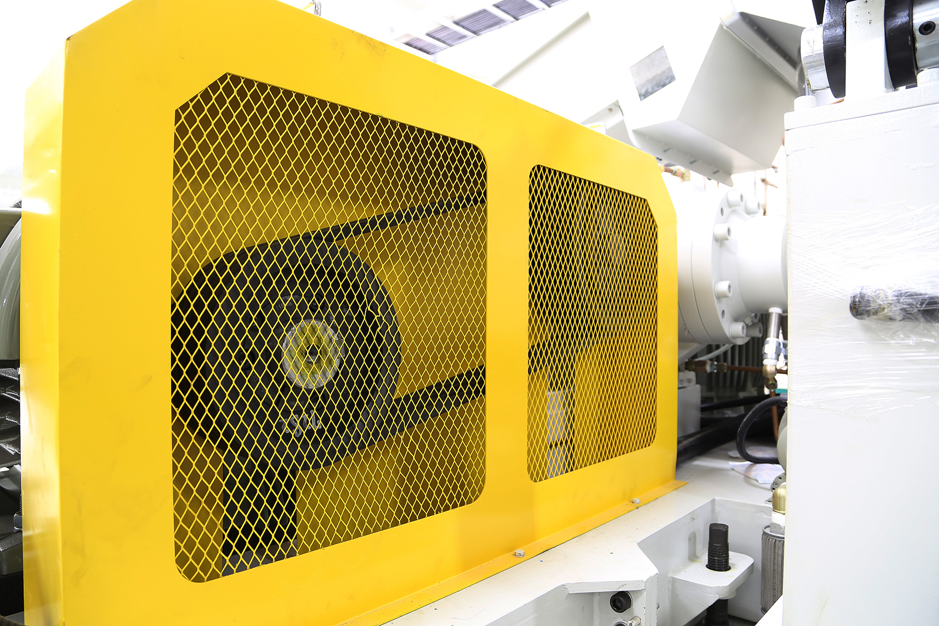
Where Machine Hazards Occur
Point of operation
Power transmission
Power transmission
Operating controls
All components of the mechanical system that transmit energy to the part of the machine performing the work.
Notes:
Power transmission apparatuses
Power transmission apparatuses are all components of the mechanical system that transmit energy to the part of the machine performing the work. These components include flywheels, pulleys, belts, connecting rods, couplings, cams, spindles, chains, cranks, and gears.

Slide 16
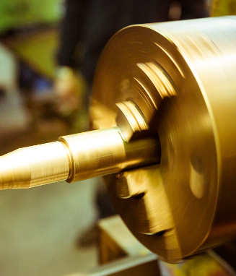
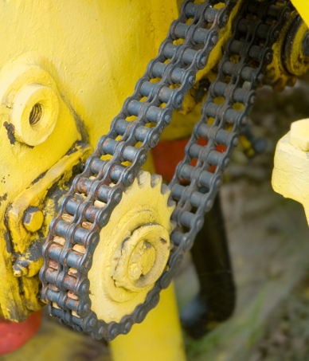
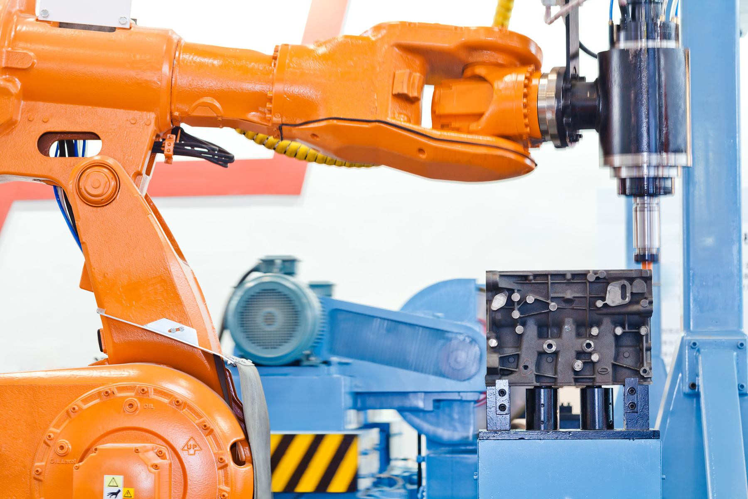
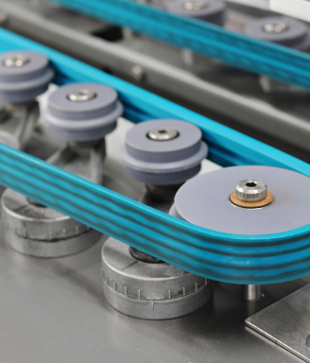
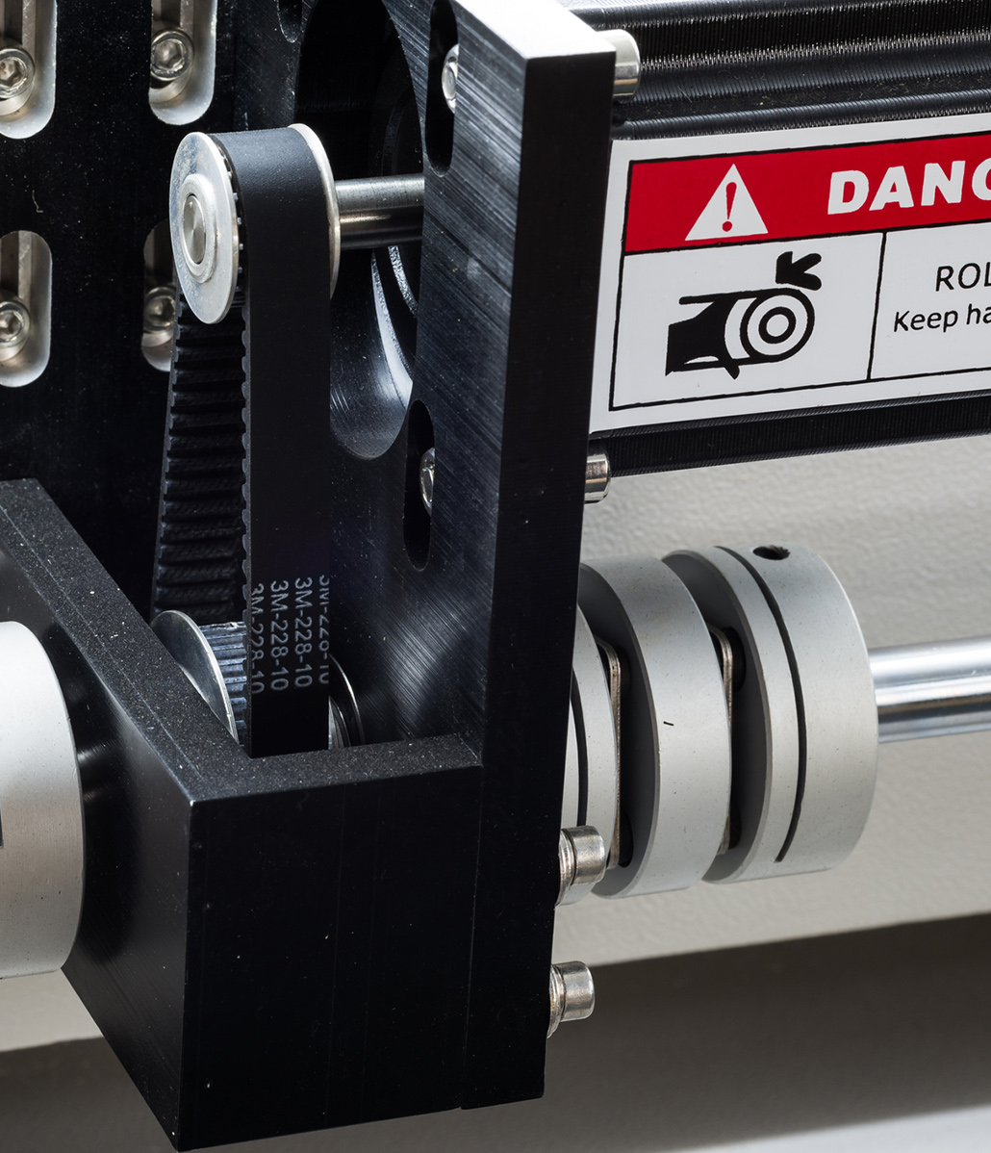
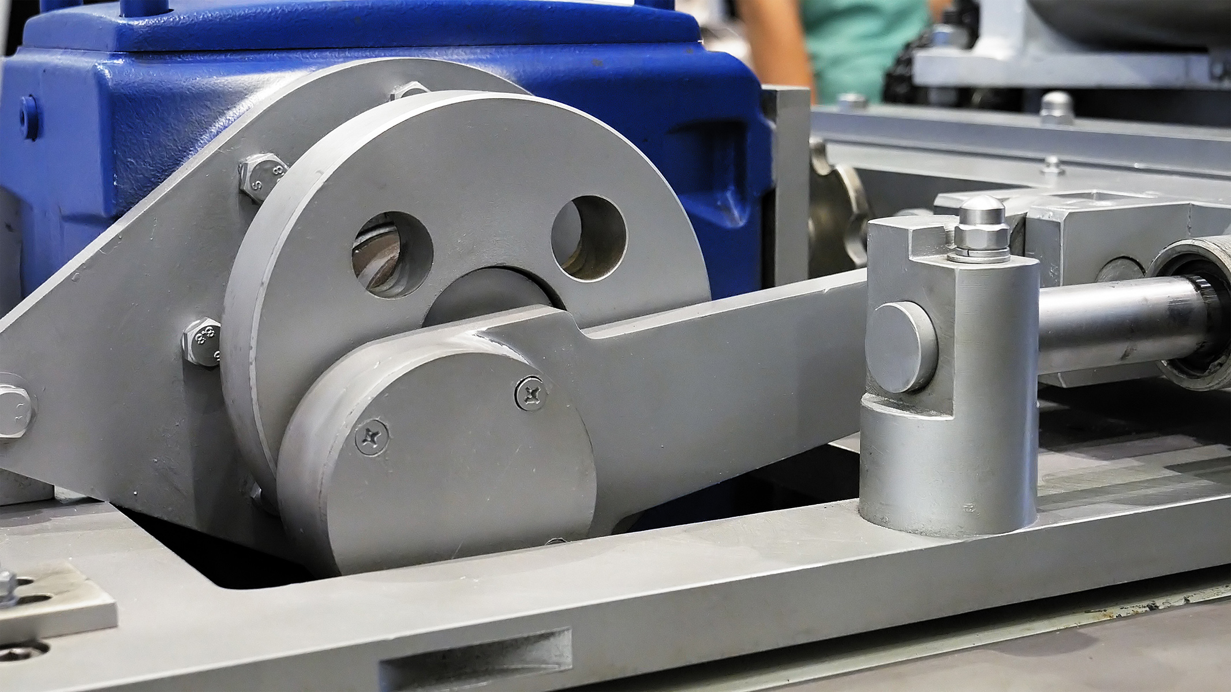
Power Transmission
Power transmission apparatuses include:
Flywheels and pulleys
Connecting rods and couplings
Belts
Cams and cranks
Spindles
Gears and chains
Notes:
The power transmission apparatuses of a machine are the mechanical parts that work with the power source to transmit energy to the part of the machine performing the work. Hazards of the power transmission apparatus include grabbing, nipping, or striking body parts or clothing.
Power transmission apparatuses include:
Flywheels and pulleys
Pulleys
Connecting rods and couplings
Belts
Cams and cranks
Spindles
Gears and chains

Slide 17
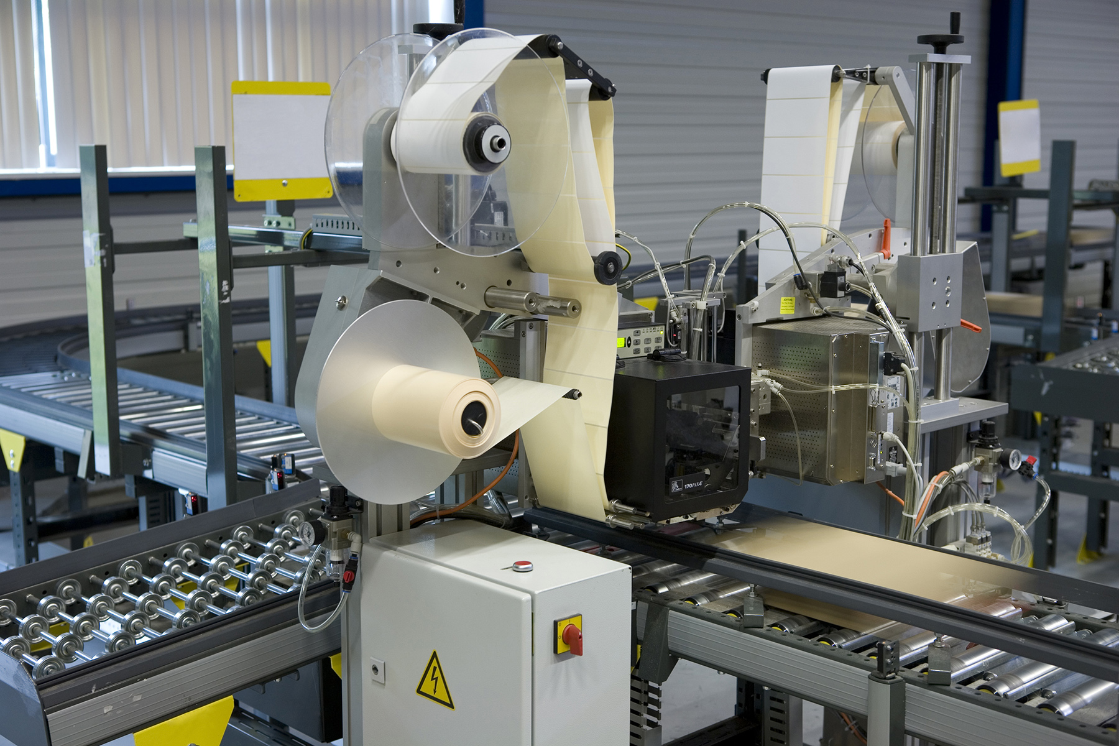
Where Machine Hazards Occur
Point of operation
Power transmission
Operating controls
All parts of the machine that move while the machine is working.
Can include reciprocating, rotating, and transverse moving parts, as well as feed mechanisms and auxiliary parts of the machine.
Notes:
Operating controls
Operating controls or other moving parts are all parts of the machine that move while the machine is working. These can include reciprocating, rotating, and transverse moving parts, as well as feed mechanisms and auxiliary parts of the machine.

Slide 18
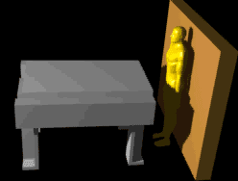
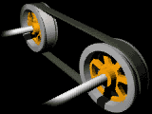
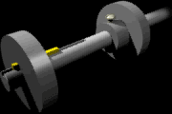
Hazardous Motions
Rotating Motion
Reciprocating Motion
Transversing Motion
Notes:
Rotating motion can be dangerous; even smooth, slowly rotating shafts can grip hair and clothing, and through minor contact, force the hand and arm into a dangerous position. Injuries due to contact with rotating parts can be severe
Reciprocating motions may be hazardous because, during the back-and-forth or up-and-down motion, a worker may be struck by or caught between a moving and a stationary part.
Transverse motion (movement in a straight, continuous line) creates a hazard because a worker may be struck or caught in a pinch or shear point by the moving part.

Slide 19
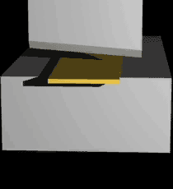
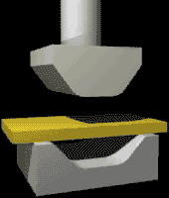
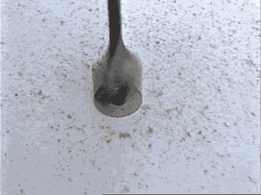
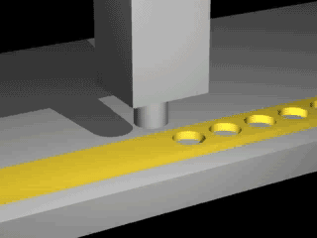
Hazardous Motions
Cutting
Punching
Shearing
Bending
Notes:
Cutting action may involve rotating, reciprocating, or transverse motion. The danger of cutting action exists at the point of operation where finger, arm and body injuries can occur and where flying chips or scrap material can strike the head, particularly in the area of the eyes or face. Such hazards are present at the point of operation in cutting wood, metal, and other materials. Examples of mechanisms involving cutting hazards include bandsaws, circular saws, boring and drilling machines, turning machines (lathes), or milling machines.
Punching action results when power is applied to a slide (ram) for the purpose of blanking, drawing, or stamping metal or other materials. The danger of this type of action occurs at the point of operation where stock is inserted, held, and withdrawn by hand. Typical machines used for punching operations are power presses
Shearing action involves applying power to a slide or knife in order to trim or shear metal or other materials. A hazard occurs at the point of operation where stock is actually inserted, held, and withdrawn. Examples of machines used for shearing operations are mechanically, hydraulically, or pneumatically powered shears.
Bending action results when power is applied to a slide in order to draw or stamp metal or other materials. A hazard occurs at the point of operation where stock is inserted, held, and withdrawn. Equipment that uses bending action includes power presses, press brakes, and tubing benders.

Slide 20
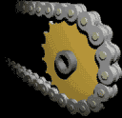
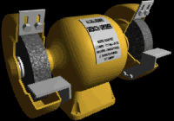
Hazardous Motions
Nip Points aka Pinch Points
Points on the machine where:
Parts move toward each other
or
When one part moves past a stationary object
Examples:
Intermeshing gears, rolling mills, calenders
Belt & pulleys, chain & sprocket
Flywheels, screw conveyors

Slide 21
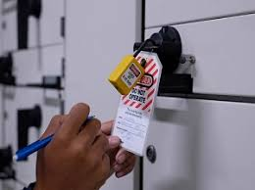
How to Control equipment hazards and avoid amputations
Effective Machine Safeguarding
Primary Safeguarding
Secondary Safeguarding
Effective Energy Control (lockout/tagout) Program
Lockout/tagout where safeguards are rendered ineffective or do not protect employees from hazardous energy during servicing and maintenance operations
Cleaning, Unjamming, or Job Setup SOPs
Safe procedures for these processes
Notes:
Guards provide physical barriers that prevent access to danger areas. To be effective, guards must be strong and fastened by any secure method that prevents the guard from being inadvertently dislodged or removed. Guards typically are designed with screws, bolts and lock fasteners and usually a tool is necessary to unfasten and remove them. Not designed to obstruct operator’s view.
Safeguarding devices either prevent or detect operator contact with the point of operation or stop potentially hazardous machine motion if any part of an individual’s body is within the hazardous portion of the machine. Both types of safeguards need to be properly designed, constructed, installed, used and maintained in good operating condition to ensure employee protection.

Slide 22
Primary Safeguarding Methods- two methods
Guards
Safeguarding devices
Provide physical barriers that prevent access to danger areas
Must be strong
Fastened by secure method that prevents the guard from being inadvertently dislodged or removed
Designed with screws, bolts and lock fasteners
Usually a tool is necessary to unfasten and remove
Not designed to obstruct operator’s view
Either:
Prevent or detect operator contact with the point of operation or
Stop potentially hazardous machine motion if any part of an individual’s body is within the hazardous portion of the machine
Must be properly designed, constructed, installed, used, and maintained in good operating condition

Slide 23
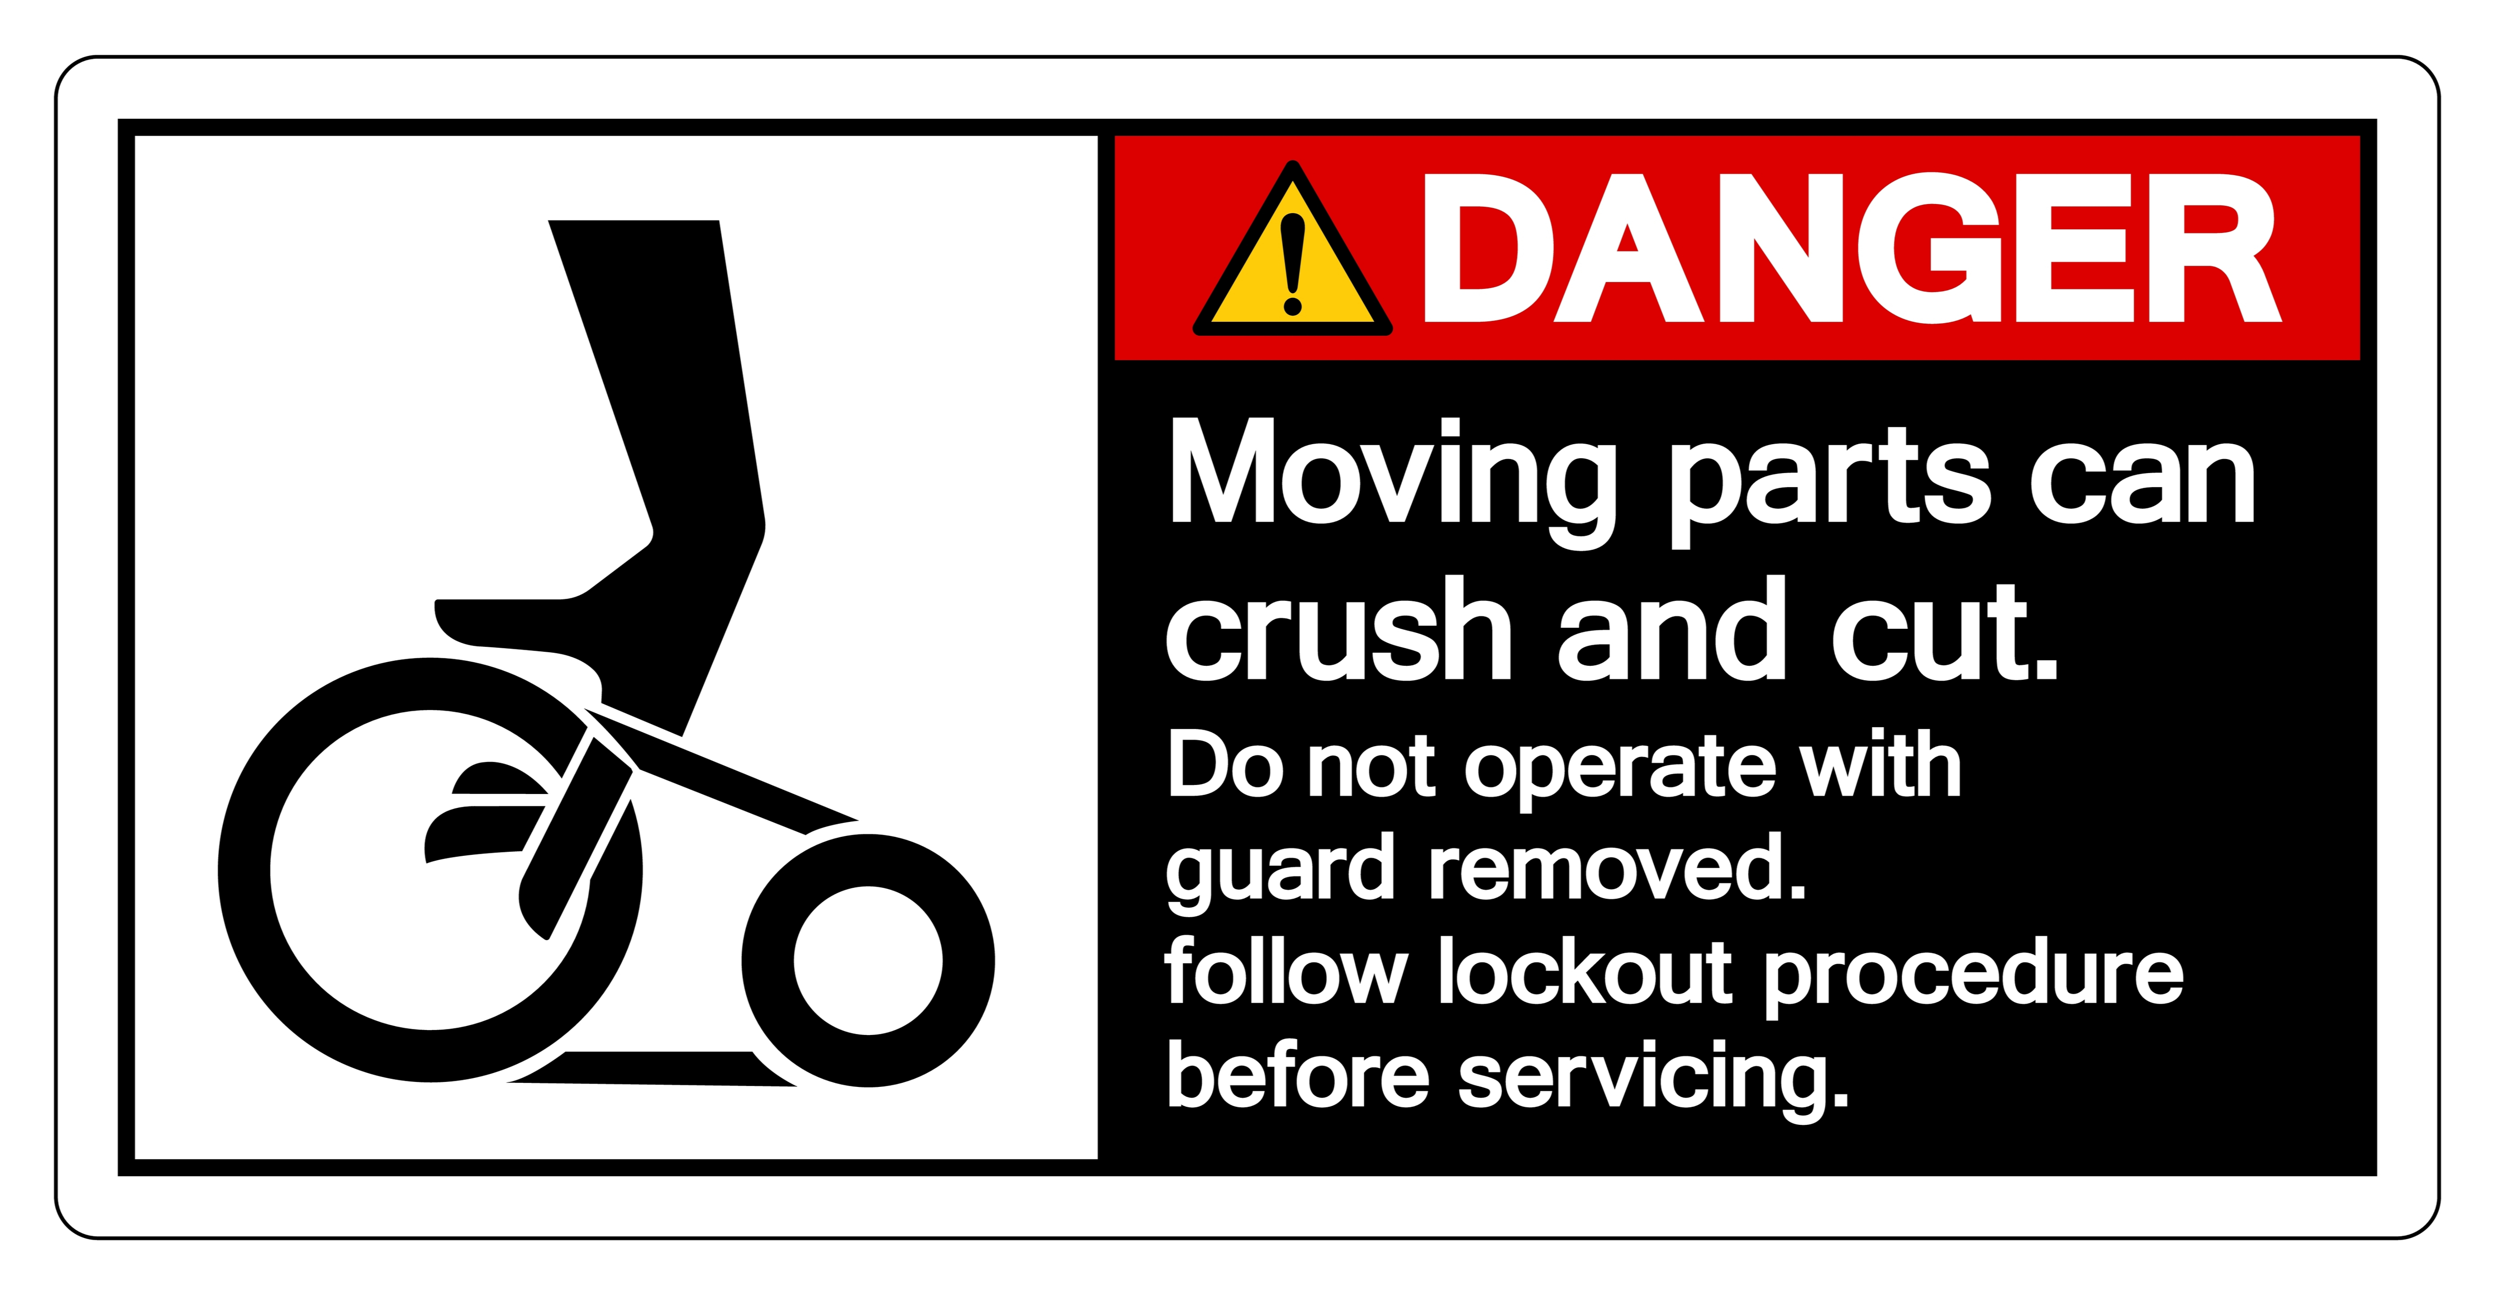
Secondary Safeguarding Methods
Provide lesser degree of employee protection
Do not prevent access to hazardous machine areas
Used in combination with primary, or when primary is infeasible.
Includes detection safeguarding devices, awareness devices, safeguarding methods, safe work procedures.
Probe detection, awareness/warning devices, e-stops, safe distance, hand-feed tools, foot controls, signage, procedures, training

Slide 24
Primary Equipment Safeguarding
Guards
Safeguarding Devices
Fixed
Adjustable
Self-adjusting
Interlocking barrier guards
Pullback devices
Restraint devices
Presence- sensing devices
Pressure-sensing mats
Two-hand controls
Two-hand trip

Slide 25
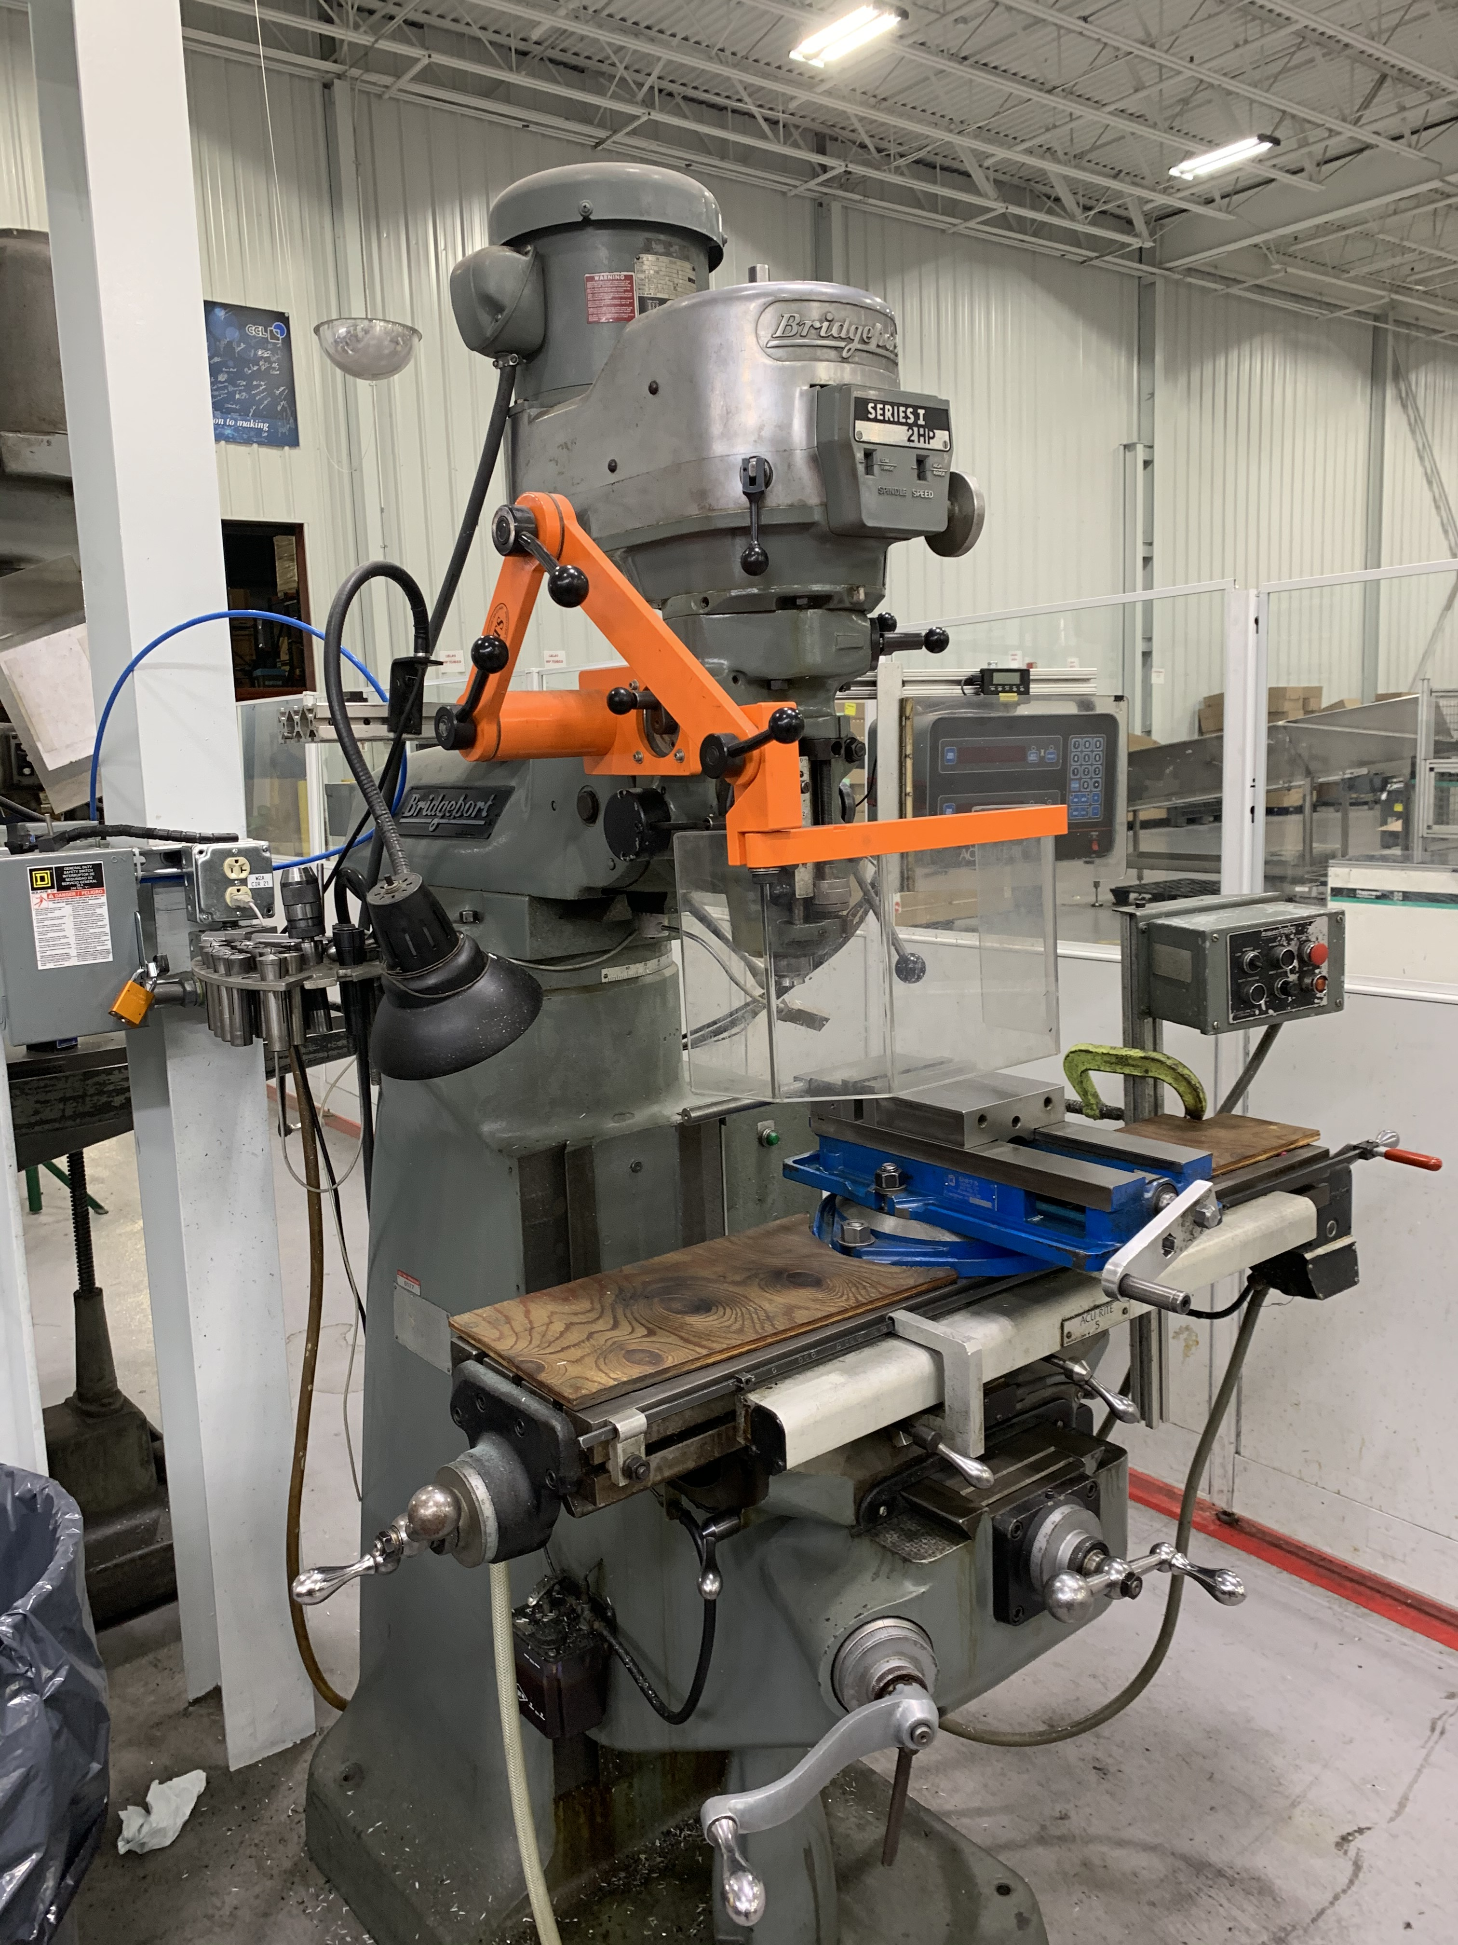
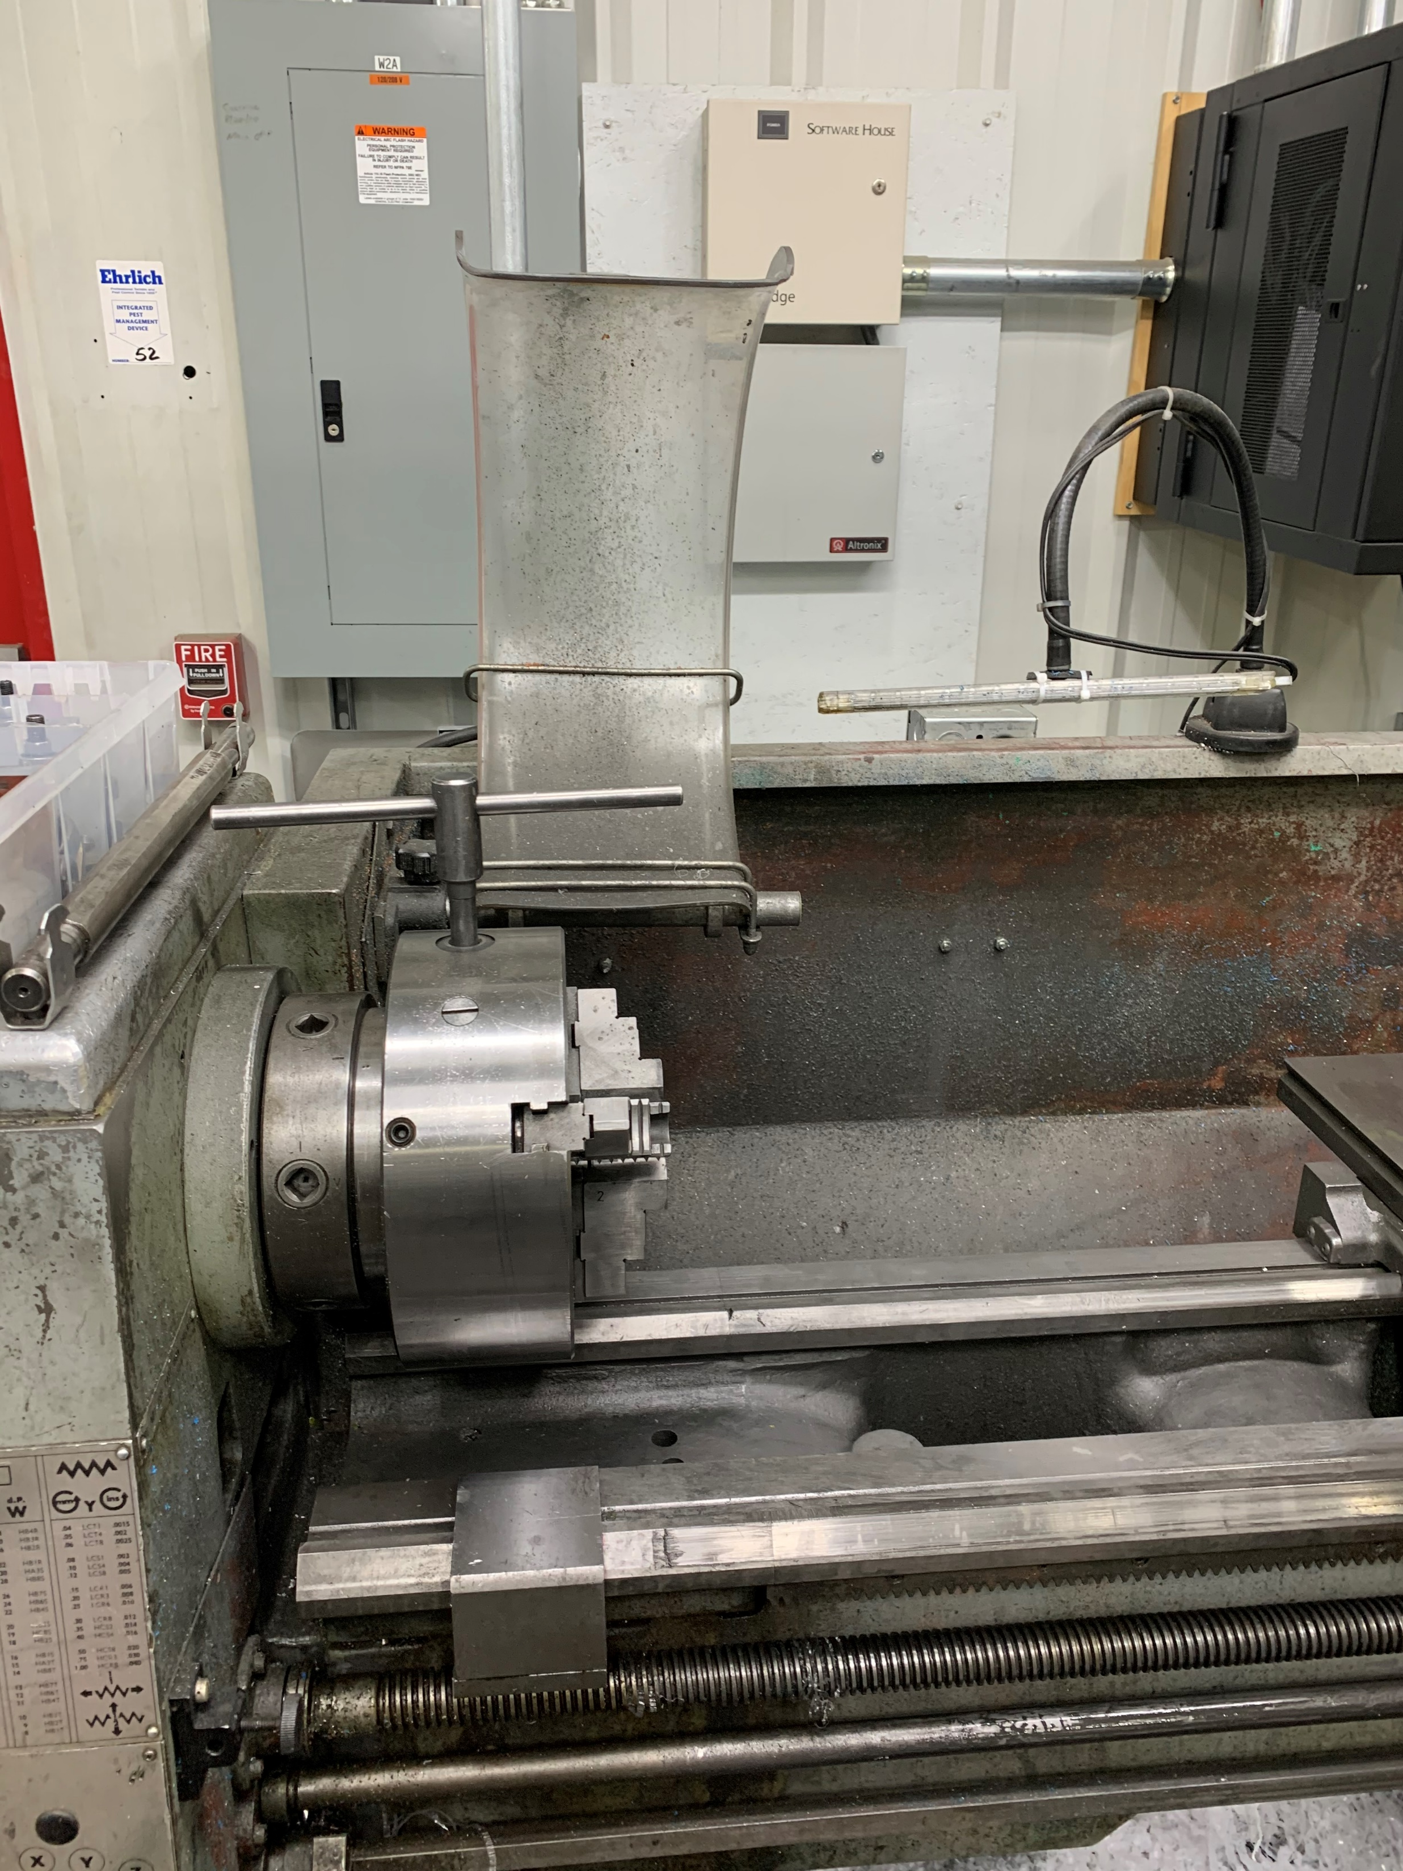
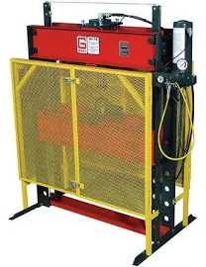
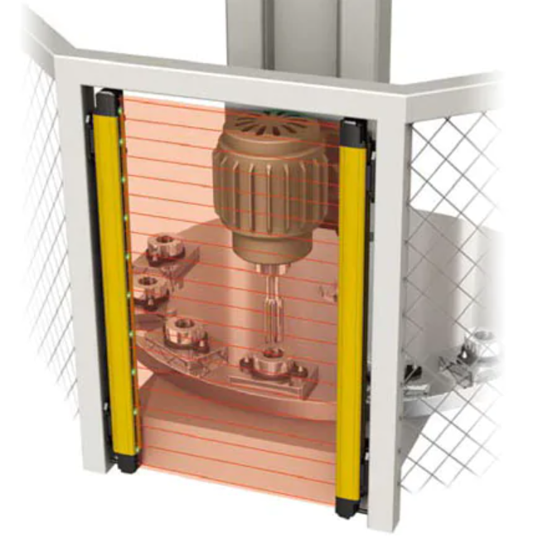
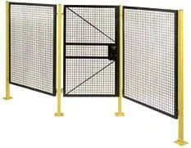
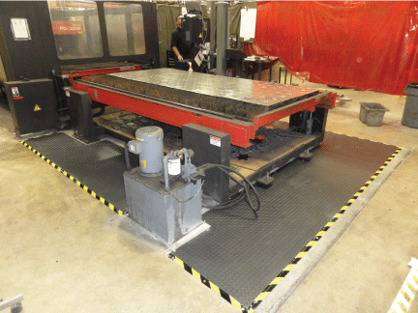
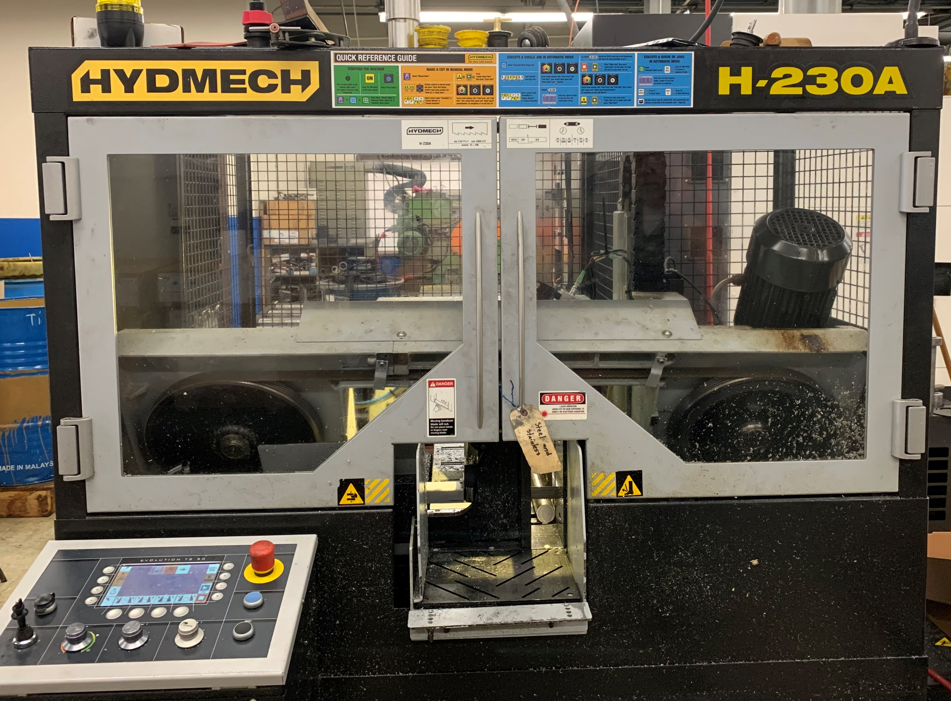
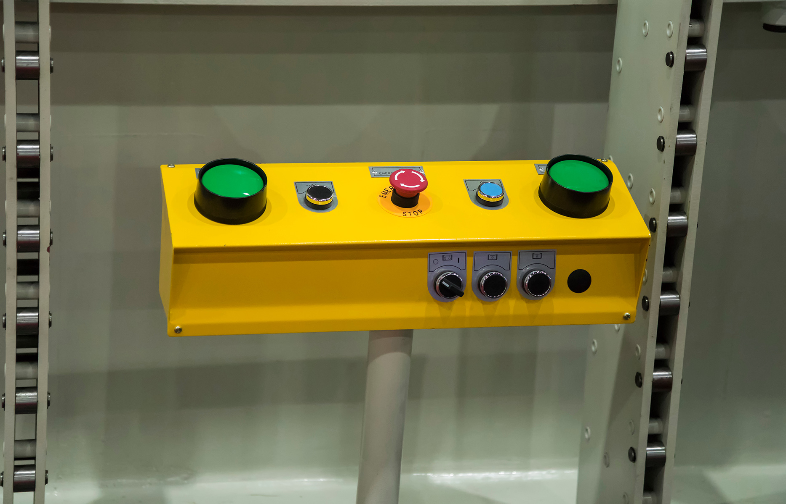
Types of Guarding & Devices
Fixed barrier guards (preferred)
Adjustable or self-adjusting barrier guards
Perimeter guarding
Interlocking devices
Presence-sensing devices
Pressure-sensing devices
Two-handed operating devices
Combination
Notes:
There are several types of guarding and devices that can be used to protect personnel.
-Fixed barrier guards- are attached to the equipment at the point of operation to prevent contact with a hazard by a person at or near the location where work is performed upon the material being processed.
Adjustable or self-adjusting barrier guards are point of operation barrier guards that can be moved or adjusted to accommodate the material being worked on.
Perimeter guarding- is A free-standing engineered guard that prevents access to an area around equipment and, therefore, the associated hazards of the equipment. In addition to preventing access, a Perimeter Guard is placed at a sufficient distance from the equipment hazard(s) to prevent contact by any part of the body.
Additionaly, there are several types of safeguarding devices including:
Interlocking devices
Electronic safety devices
Presnce sensing devices, such as light curtains, sensors, or scanners that stop the equipment if the barrier is broken
Pressure sensing devices, such as pressure mats that detect a person approaching the equipment when stepped on, and stop the equipment and
Two hand operating devices
Many times, a combination of guarding and devices may be needed to adequately protect personnel from equipment hazards.

Slide 26
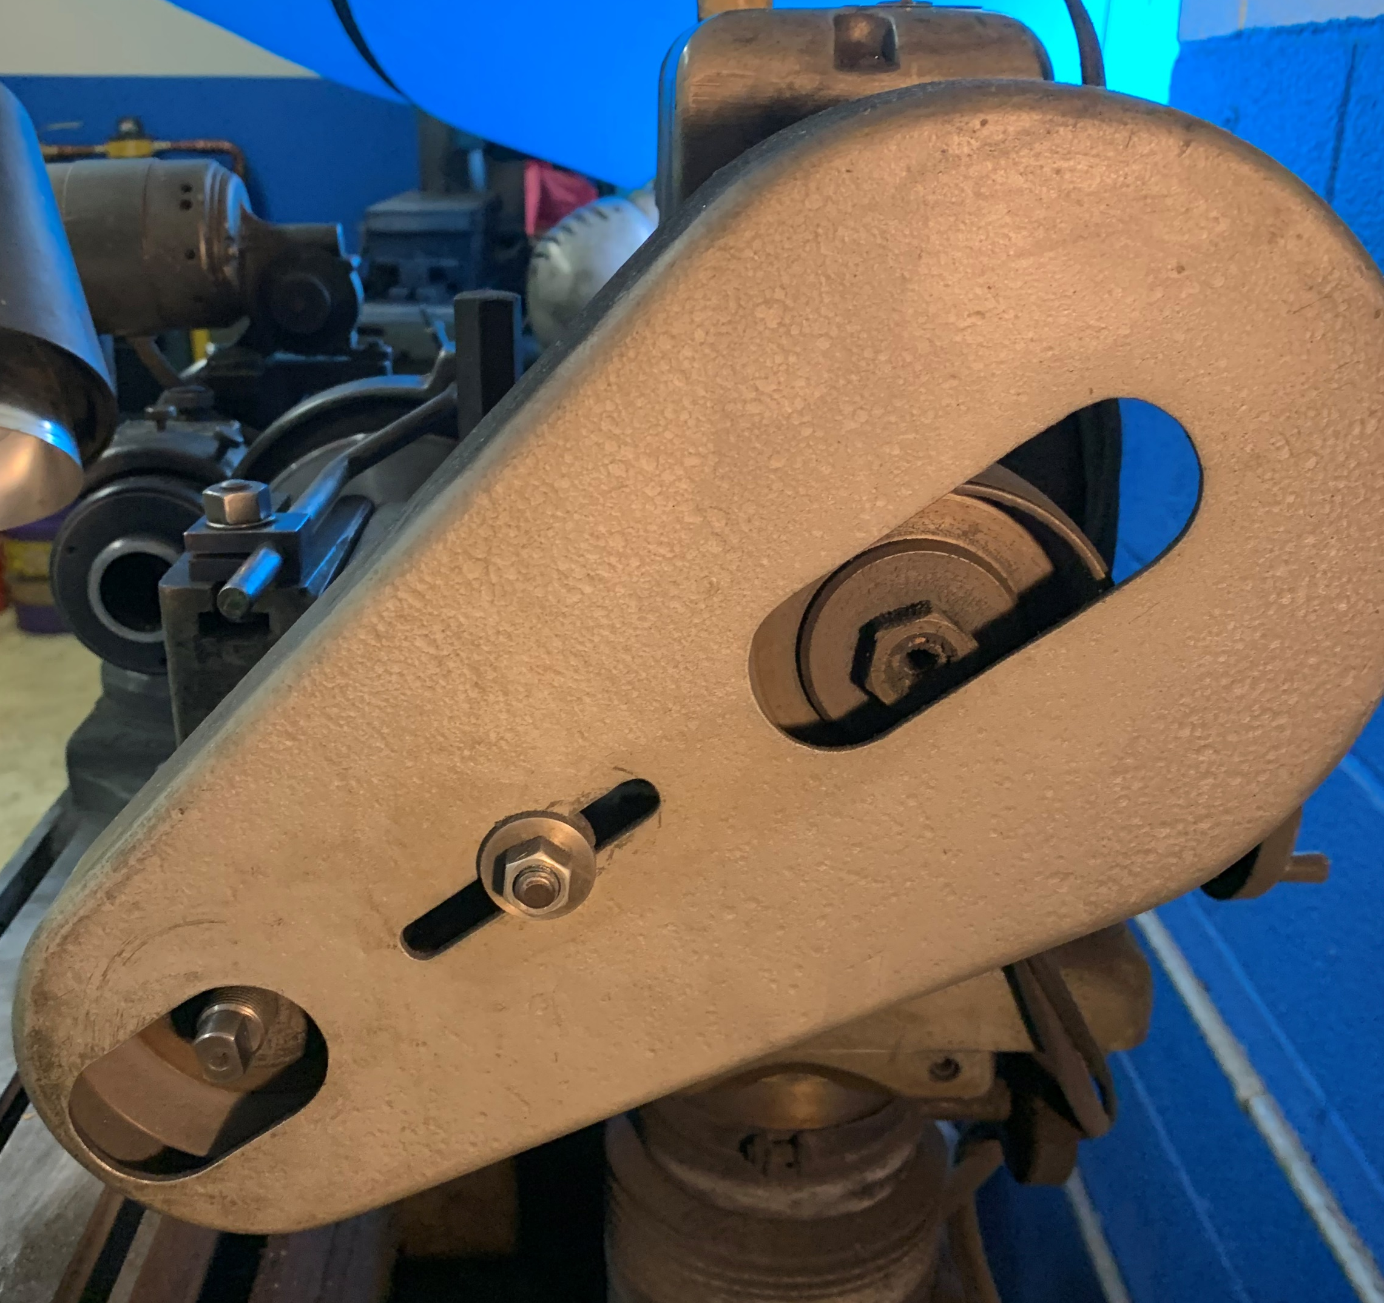
Effective Guarding & A-U-T-O
Must not be able to reach:
Around
Under
Through
Over
a guard and contact the hazard.
Notes:
For a guard to be considered effective, it must be designed to physically prevent a person—or any part of their body—from contacting the equipment hazard and flying debris. A good way to tell if a guard is designed and installed properly is to remember the AUTO principle.
A person must not be able to contact an equipment hazard by reaching around, under, through, or over the guard.
If access to moving parts is achievable through one of these actions, the guard would not be considered sufficient, and should be replaced with an properly designed guard.
Additionally, overhead hazards 7 feet or less above a walking or working surface must also be guarded.
Guarding may not be removed or bypassed during operation of the equipment.

Slide 27
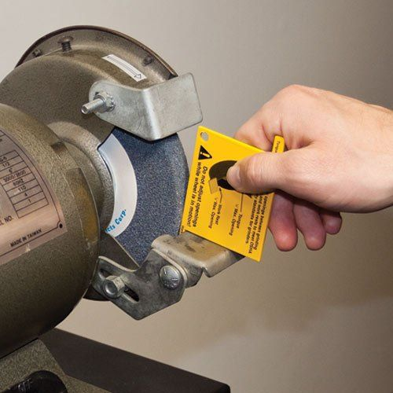
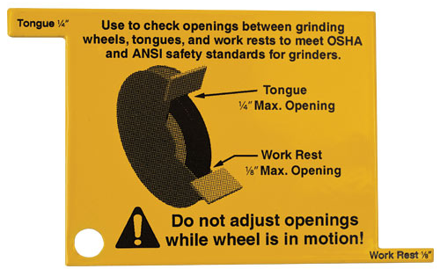
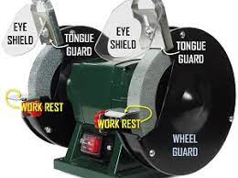
Bench Grinder
Ensure guarding around abrasive wheel bench grinders are set properly

Slide 28
Additional Guarding Considerations
When the periphery of the blades of a fan is less than seven (7) feet above the floor or working level, the blades must be guarded. The guard must not have openings larger than one-half (½) inch. [29 CFR 1910.212(a)(5)]
A machine designed for a fixed location must be securely anchored to prevent walking or moving. [29 CFR 1910.212(b)]
Eye and face protection must be provided to each employee when exposed to eye or face hazards from flying particles. [29 CFR 1910.133(a)]

Slide 29
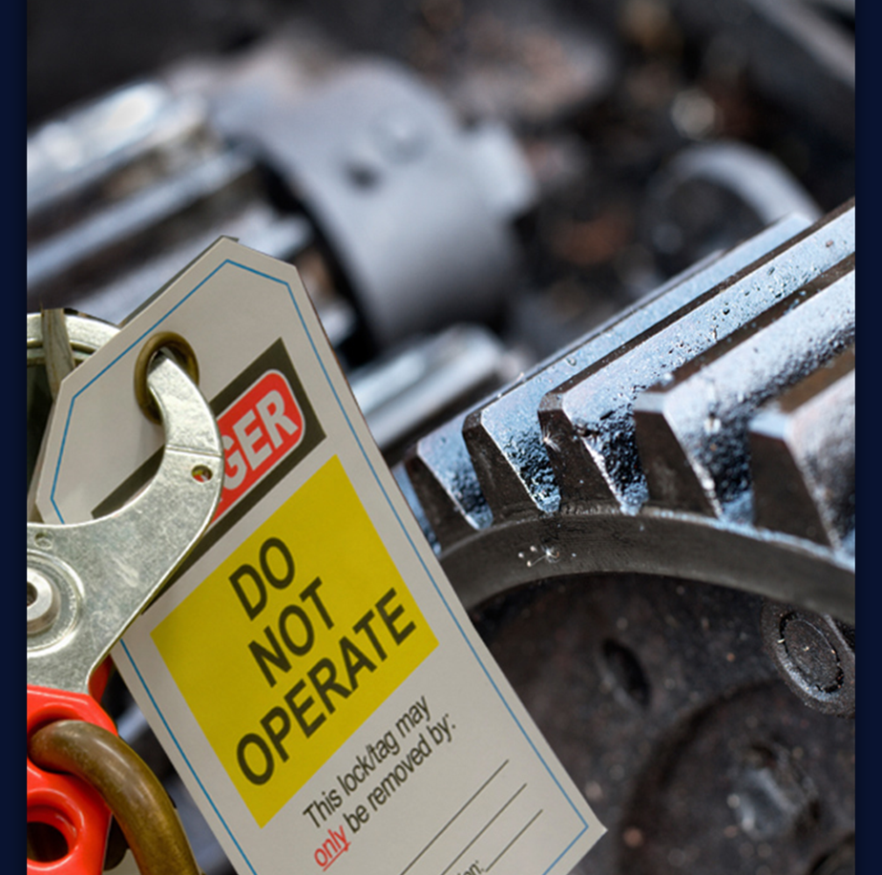
LOTO and Exception
Machine safeguarding must be supplemented by an effective energy control (lockout/tagout) program
Protection from hazardous energy sources during machine servicing and maintenance work activities.
There are some servicing activities (e.g., lubricating, cleaning, releasing jams, making machine adjustments) that are minor in nature and are performed during normal production operations.
It is not necessary to lockout/ tagout a machine if the activity is routine, repetitive and integral to the production operation provided there is an alternative control method used that affords effective protection from the machine’s hazardous energy sources.

Slide 30
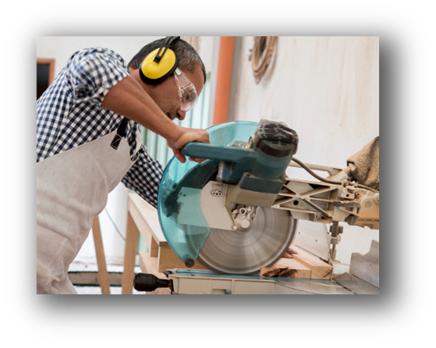
Work Practices And Training
Develop inspection & maintenance schedule
Develop PPE Requirements
No gloves around rotating parts
Develop good work practices & procedures for work with and around machines
Develop training program
Ensure reporting structure is in place
Notes:
Work Practices and procedures
-No loose hair, closthes or dangling objects
-how to hold materials and work pieces, aids
-Where to stand
-When to shut off- not leave running

Slide 31
Safeguarding Points to Remember
Understand the OSHA requirements for general machine guarding, as well as equipment specific requirements
Conduct JHAs and Machine Guarding Assessments
Identify guarding gaps and implement corrections
Ensure Hazardous Energy Program and procedures are in place
Develop work practices and training programs to support

Slide 32
Reference Tools
OSHA NEP on Amputations in Manufacturing Industries
https://www.osha.gov/sites/default/files/enforcement/directives/CPL_03-00-022.pdf
OSHA Publication 3170
https://www.osha.gov/sites/default/files/publications/osha3170.pdf
OSHA Machine Guarding e-tool
https://www.osha.gov/etools/machine-guarding

Slide 33
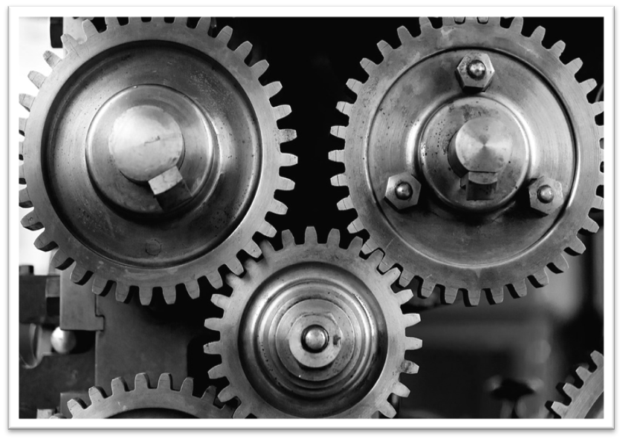
Connect with us for a 15 minute consultation.

Slide 34
Get in Touch: www.Complianceplace.com mschneider@complianceplace.com

Slide 35
Questions?
Thank you for joining us.

