Slide 1

OSHa’s Top 10 Citations: Fiscal Year 2024
Are you prepared?

Slide 2

today’s presenter
MARK Vaillancourt
Manager, Health & Safety Services

Slide 3
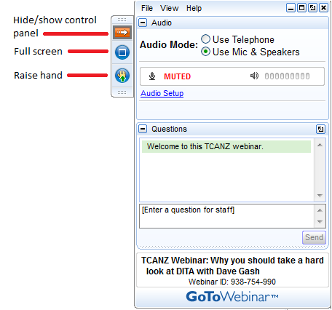
Housekeeping
This presentation is being recorded and will be shared.
Everyone will be muted to prevent background noise.
Use the question button to log your question.

Slide 4
Agenda
OSHA’s most frequently cited General Industry and Construction Standards
Standards that apply to most organizations
Common pitfalls in maintaining compliance programs
Compliance Tools
  Strategic safety plan
  Training matrix
  Document retention protocols

Slide 5

General Industry most frequently cited standards
Fall Protection, General
Hazard Communication
Ladders
Respiratory Protection
Control of Hazardous Energy (Lockout/Tagout)
Powered Industrial Trucks (Forklifts)
Fall Protection (Training)
Scaffolding
PPE: Eye & Face
Machinery and Machine Guarding

Slide 6
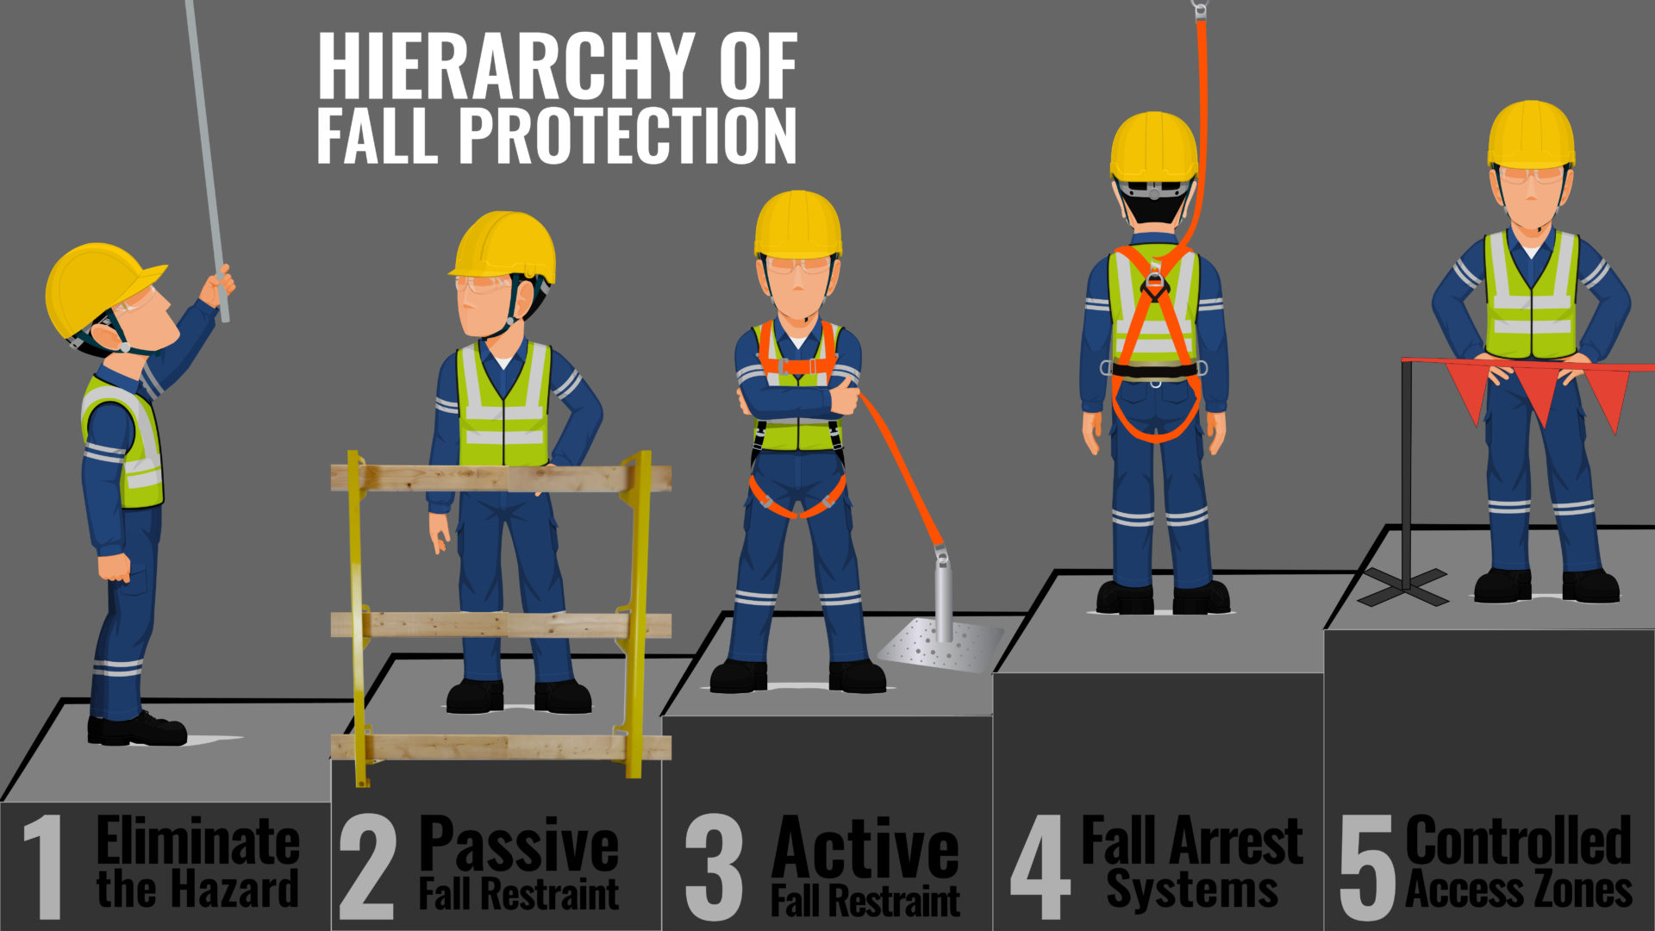
Fall Protection
What’s required
  Job hazard analysis
  Eliminate the fall hazard
  Guarding
  Personal arrest
  Training!
  Equipment inspections
  Housekeeping (slips/falls)

Slide 7

Hazard Communication
What’s required:
Written policy
Safety Data Sheets (SDS) maintained
Employee training
Chemical labeling including secondary container labels
Non routine tasks

Slide 8
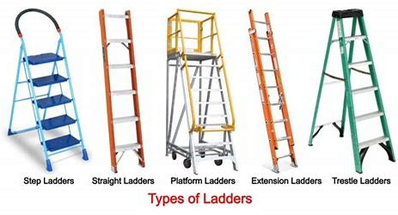
Ladders
What’s required:
  Proper ladder for task
    Height
    Load
  Inspections
  Training
  Proper use

Slide 9
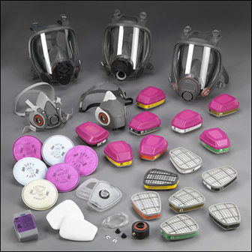
Respiratory protection
What’s required:
  Written policy
  Medical evaluations
  Employee training
  Fit testing
  NIOSH approved respirators
  Cartridge changeout schedule
  Voluntary use protocols

Slide 10
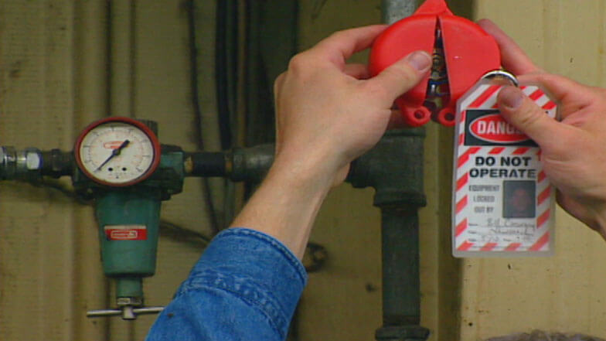
Lockout/tagout
What’s required:
  Written policy
  Equipment-specific LOTO procedures
  Affected employee training
  Authorized employee training
  Annual periodic audits

Slide 11

Forklifts
What’s required:
  Operator training program
  Operator evaluations
  Pre-shift inspection protocols
  Protocols for loading/unloading tractor trailers
  Safe driving on site

Slide 12

Scaffolding
What’s required:
  Proper equipment
  Competent person
  Inspection
  Training

Slide 13
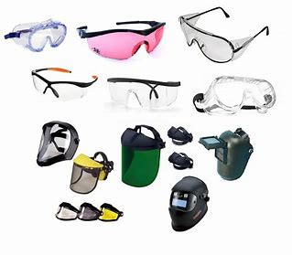
PPE: Eye & Face Protection
What’s required:
  PPE Hazard Assessment
    Include eye and face
  PPE Selection
  Proper training

Slide 14
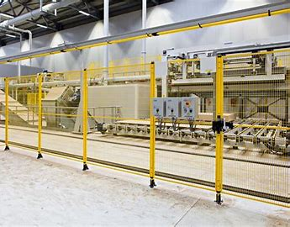
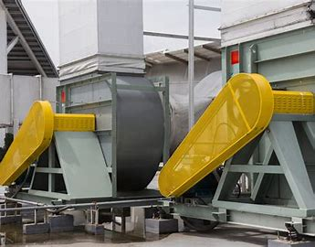

MACHINERY & Machine Guarding
What’s required:
  Equipment analysis for hazard
  Proper guarding
  Guarding in place
  Training

Slide 15
Compliance pitfalls
Policies / Record Retention
Training
Policies
  Policies are outdated
  Polices don’t meet the standards
  Policies not adhered to
Access to records
  Records are not readily available
  Only one person knows how to access certain records
New Hire Training
  Doesn’t cover all required topics
Ongoing Training
  Doesn’t cover all required topics
  Make-up sessions not completed
  Training documentation doesn’t’ meet requirements
Online Training
  Canned programs don’t cover site specifics

Slide 16
compliance tools

Slide 17
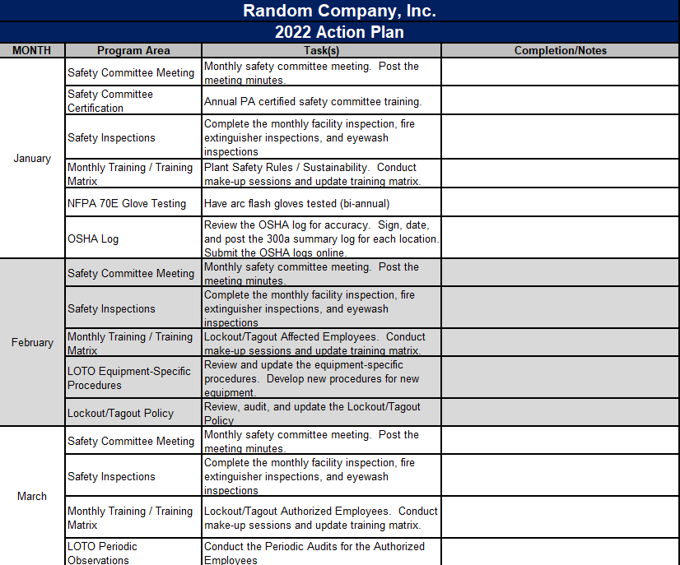
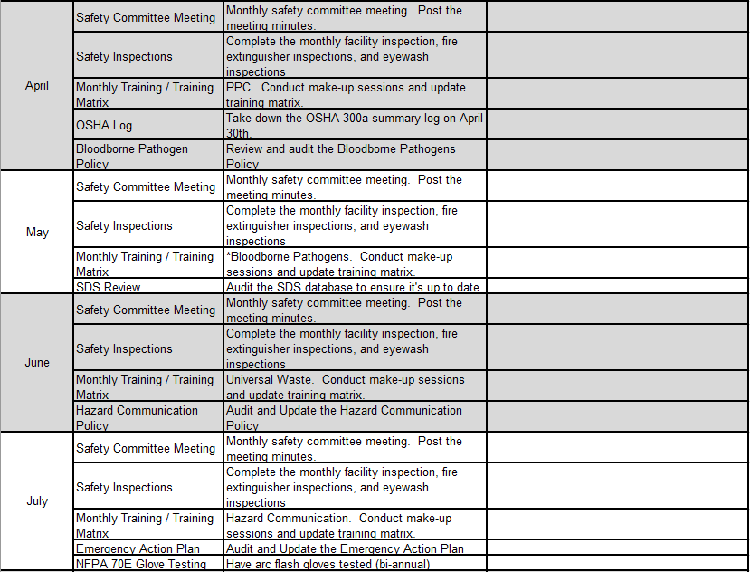
Strategic Planning

Slide 18
Training Matrix
2021 Training Matrix
Employee Name | Emergency Action Plan / Fire Extinguishers | Hazard Communication | Lockout/Tagout Affected | Lockout/Tagout Authorized | PPE / Hearing Conservation | Bloodborne Pathogens | First Aid / CPR / AED | NFPA 70E | Forklift
Frequency | Annual | Annual | Annual | Annual | Annual | Annual | Every 2 Years | Every 3 Years | Every 3 Years
Due Date | February | March | April | May | June | July | Recert Due Date Listed | Recert Due Date Listed | Recert Due Date Listed
Employee 1 | 2/21/2021 | 3/17/2021 | 4/20/2021 | N/A |  |  | 7/20/2022 | N/A | 5/22/2022
Employee 2 | 2/21/2021 | 3/17/2021 | 4/20/2021 | N/A |  | N/A | N/A | N/A | 3/13/2023
Employee 3 | 2/21/2021 | 3/17/2021 | 4/20/2021 | 5/12/2021 |  |  | 7/20/2022 | 10/21/2022 | 10/9/2023
Employee 4 | 2/21/2021 | 3/17/2021 | 4/20/2021 | N/A |  | N/A | N/A | N/A | N/A
Employee 5 |  | 3/17/2021 | 4/20/2021 | N/A |  | N/A | N/A | N/A | 3/13/2023
Employee 6 | 2/21/2021 | 3/17/2021 | 4/20/2021 | 5/12/2021 |  |  | 7/20/2022 | 10/21/2022 | N/A
Employee 7 | 2/21/2021 |  | 4/20/2021 | N/A |  | N/A | N/A | N/A | 5/22/2022
Employee 8 | 2/21/2021 | 3/17/2021 | 4/20/2021 | N/A |  | N/A | N/A | N/A | N/A
Employee 9 | 2/21/2021 | 3/17/2021 | 4/20/2021 | N/A |  |  | 7/20/2022 | N/A | 3/13/2023

Slide 19
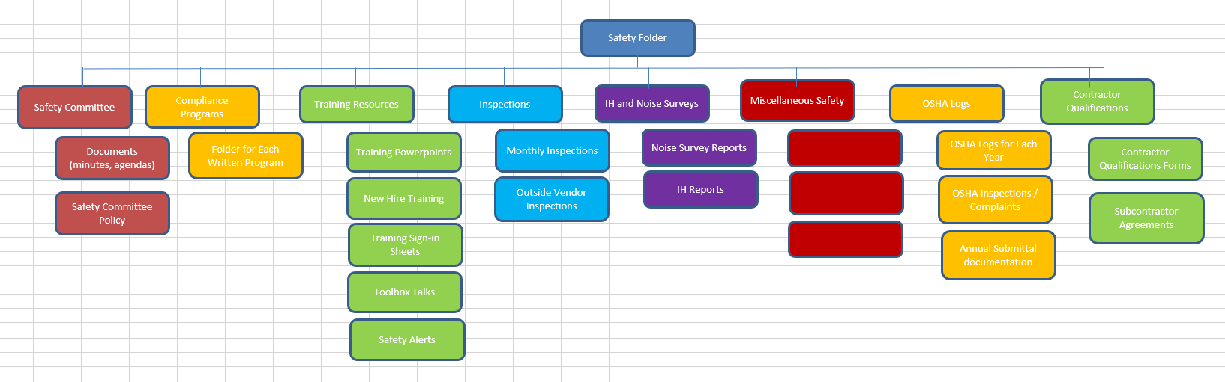
Document Retention

Slide 20
Summary
OSHA is ACTIVE!
Develop a strategic plan each year
  Workplace assessments and policies reviewed annually
Maintain an employee training matrix
Keep up with training – Annual and New Hire
Develop protocols for proper document retention
Seek help!

Slide 21

Questions?
Thank You!

