Slide 1
Heat Stress PREVENTION AND CONTROL

Slide 2

Today’s Webinar

Slide 3


OUR TEAM for today’s presentation
DREW CANTOR, CIH
PROJECT MANAGER, Industrial hygiene services
Erin Rymsa
DIRECTOR, TRAINING SERVICES CMI

Slide 4
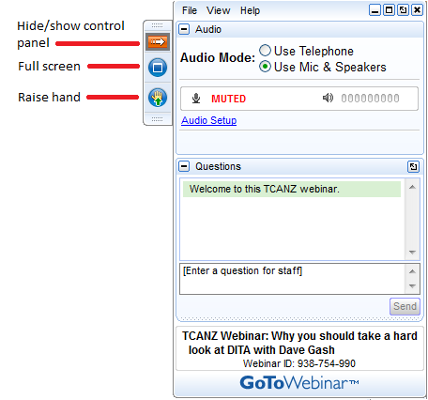
Housekeeping
This presentation is being recorded and will be shared.
Everyone will be muted to prevent background noise.
Use the question button to log your question.

Slide 5
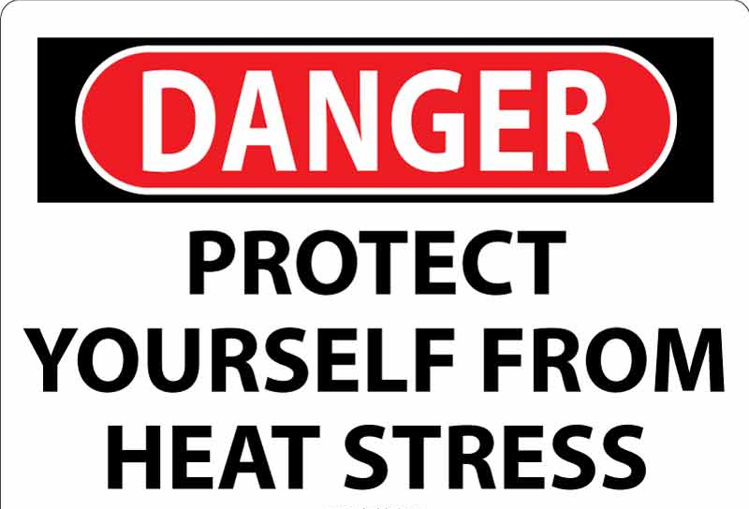
Today’s Topics
Overview of Heat Related Illnesses
Current Regulations and Guidelines
Controlling Workplace Exposures
Heat Injury and Illness Prevention Plan (HIIPP)

Slide 6
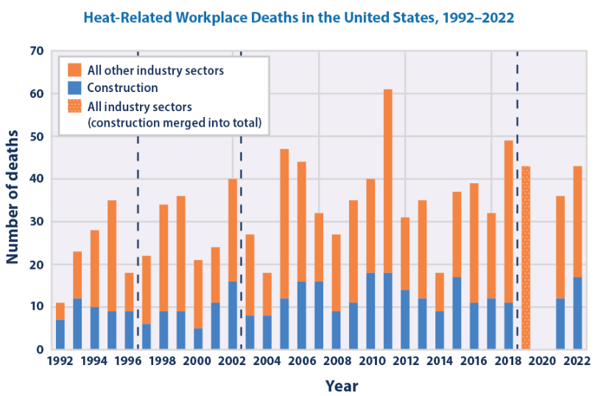
Heat Related Illnesses: The Issue
Heat is the leading cause of weather-related deaths in the US, and average environmental temperatures are rising
Annual average of 34 heat related occupational fatalities between 1992 and 2022
    Possible underreporting due to undocumented workers and misclassified deaths occurring off the job
Construction industry is disproportionately affected
Heat related illnesses cost the US economy billions of dollars annually
Largely avoidable through simple and effective measures

Slide 7
Heat Related Illnesses: Signs and Symptoms
Heat Related Illness | Signs and Symptoms
Heat Rash (Prickly Heat) | Red bumps/irritation on skin
Heat Syncope | Dizziness/fainting
Heat Cramps | Muscle spasms and pain
Heat Exhaustion | Fatigue, irritability Heavy sweating and thirst Nausea and dizziness Elevated body temperature
Heat Stroke | Confusion, slurred speech Unconsciousness, seizure Uncontrolled rise in body temperature Fatal if not treated

Slide 8
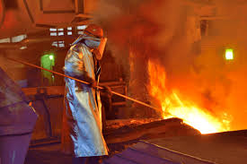
Heat Related Illnesses: Risk Factors
Ambient environmental conditions (air temperature, humidity, air movement)
Exposure to direct sunlight and heat-generating processes
Clothing and PPE (coverage and permeability)
Level of physical work activity
Individual risk factors (age, health status, medication/drug use)
Acclimatization
    Up to 70% of outdoor fatalities occur within the first few days of work in hot environments

Slide 9
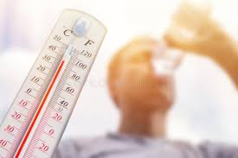
Evaluating Risk of Heat Related Illness
GOOD: Air Temperature
    Simple and easy to measure
    Does not account for radiant heat, humidity, air movement and other factors
BETTER: Heat Index
    Factors in heat and humidity
    Does not take into account radiant heat, air movement and other factors
BEST: Web Bulb Globe Temperature (WBGT)
    Takes into account temperature, humidity, air movement, radiant heat
    Requires specialized instruments for measurements
    Not easily correlated to temperature and heat index

Slide 10
Evaluating Risk of Heat Related Illness
National Weather Service

Slide 11

Regulations and Exposure Guidelines: Federal OSHA
Currently no Federal OSHA Standard related to heat illnesses, citations under General Duty Clause
Federal OSHA Heat Injury and Illness Prevention in Outdoor and Indoor Work Settings
    Proposed rule published in 2024, public hearings beginning in June 2025
    80 °F “Initial Heat Trigger” requires employers to take action
Current National Emphasis Programs (NEPs)
    Outdoor and Indoor Heat-Related Hazards – Targets construction/outdoor activities and other industries with heat exposure
    Warehousing and Distribution Center Operations – Targets warehousing operations where heat exposure is present

Slide 12
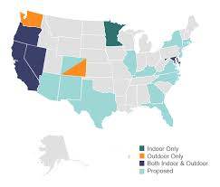
Regulations and Exposure Guidelines: State OSHA Plans
Various state OSHA plans have implemented regulations
    California
    Colorado
    Maryland
    Minnesota
    Oregon
    Washington
Each state applies to different industries/workplaces and uses different “trigger criteria”
Other states have proposed heat regulations through the Department of Labor

Slide 13
Regulations and Exposure Guidelines: State OSHA Plans
State | Indoor/Outdoor | Industries Covered | Trigger Criteria
California | Outdoor | All, but only select industries covered by high heat requirements | 80 °F 95 °F
Colorado | Indoor/Outdoor | Agriculture | 80 °F 95 °F
Maryland | Indoor/Outdoor | All | 80 °F (Heat Index) 90 °F (Heat Index)
Minnesota | Indoor | All | 77 °F – Heavy Work 80 °F – Moderate Work 86 °F – Light Work
Oregon | Indoor/Outdoor | All | 80 °F (Heat Index) 90 °F (Heat Index)
Washington | Outdoor | All, except firefighters | 80 °F 90 °F 100 °F

Slide 14
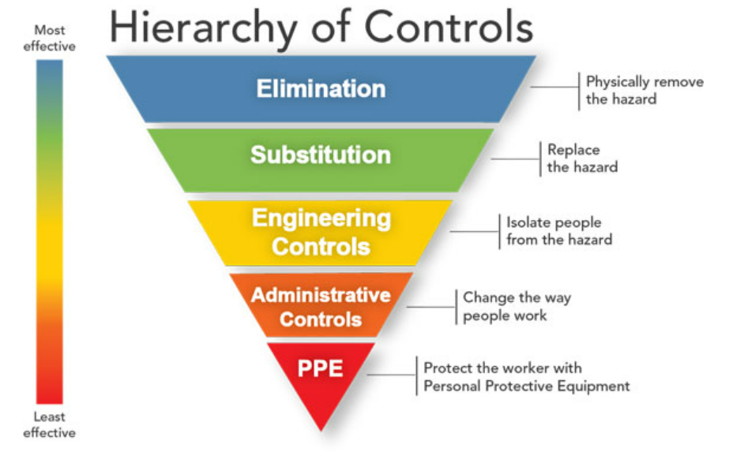
Exposure Controls

Slide 15
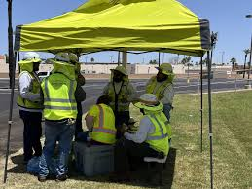
Exposure Controls
Elimination/Substitution
    Eliminate heat sources or find a way to perform tasks in a controlled environment
    Reduce physical demands of work through equipment or automation
Engineering Controls
    Provide shading
    Install air conditioning (spot or general) or misting
    Install fans for air movement and evaporative cooling
    Use reflective materials to redirect radiant heat
    Insulate equipment to minimize heat transfer

Slide 16
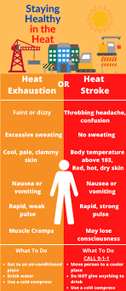
Administrative Controls
Employee and management/supervisory training
Establish work/rest intervals
Establish hydration/water intake guidelines
Acclimatization periods
Add additional personnel to spread out workload and allow for frequent rotation
Postpone non-essential work and schedule work during cooler periods (start times, split shifts, night shifts)
Use “buddy” system to avoid exposure to lone workers
Heat Injury and Illness Prevention Plan (HIIPP)

Slide 17
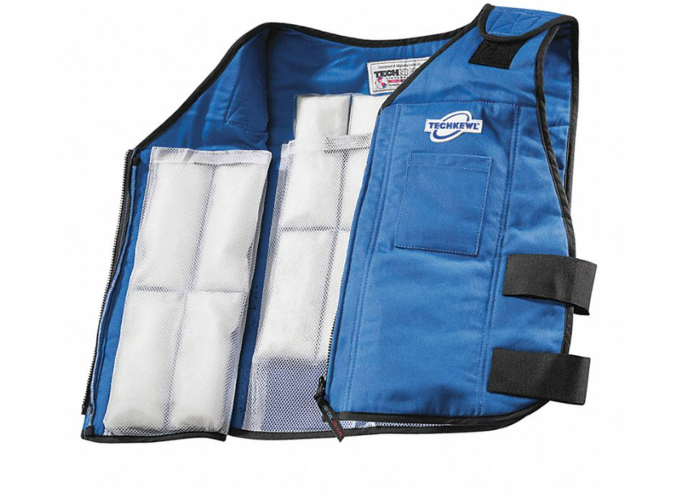
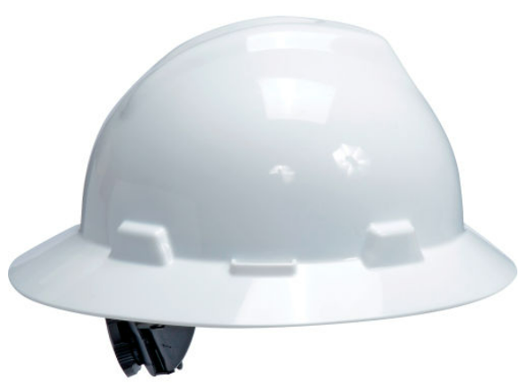
Personal Protective Equipment
Full-brim hats
UV protective sunglasses and clothing
Cooling vests or neck wraps
Reflective clothing
Breathable outerwear
Sunscreen

Slide 18

Heat Injury and Illness Prevention Plan (HIIPP)
Written plan for planning and controlling workplace exposures when high temperatures are expected:
    Advanced planning
    Hydration and drinking water
    Access to shade and other engineering controls
    Acclimatization
    Administrative controls and work/rest schedule
    Observations and monitoring
    First aid and emergency response
    Training

Slide 19
HIIPP: Advanced Planning
Identify and document heat generating tasks/operations
Eliminate/substitute/engineer out heat sources, where possible
Use weather forecasts and other tools (OSHA-NIOSH) to predict excessive heat conditions and provide real-time monitoring
Establish work schedules and work/rest
Provisions for shading, cooling and hydration
Identify unacclimatized or “at risk” employees
Prepare for observations/monitoring and emergency response
Communicate daily plans with management and employees

Slide 20
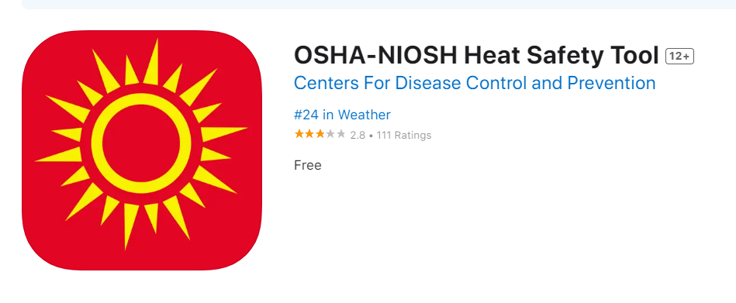
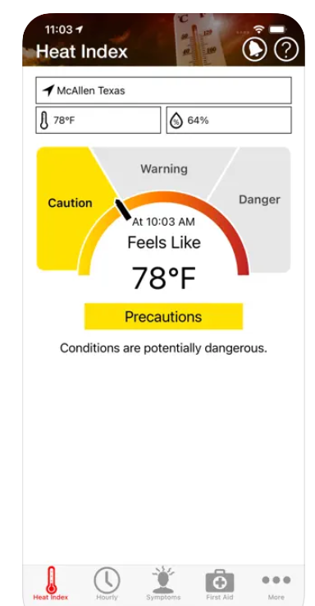
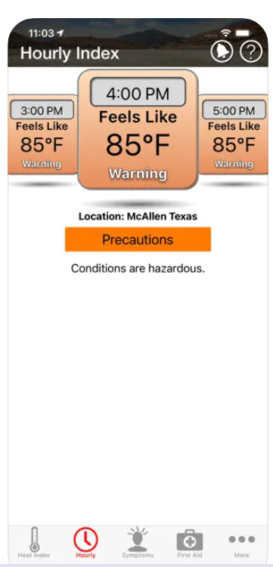
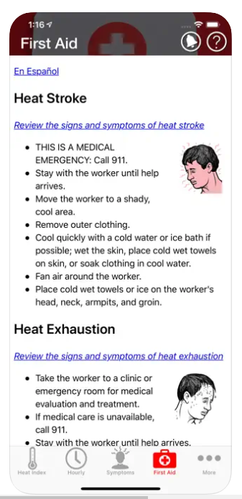
OSHA-NIOSH App

Slide 21
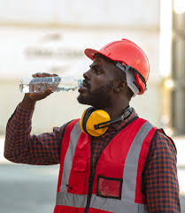
HIIPP: Hydration and Drinking Water
Provisions must be made to provide a continuous supply of cool drinking water
A minimum of 1 quart of water/person per hour for the shift
Heavy sweating can deplete electrolytes, so electrolyte containing drinks or additives are helpful
Instruct employees on signs/symptoms of dehydration (thirst, less frequent urination, dark urine, fatigue)
Avoid caffeinated energy drinks and other beverages
Hourly fluid intake should not exceed 1.5 quarts per hour or 12 quarts per day

Slide 22


Fluid Loss Chart
Source: https://www.ncbi.nlm.nih.gov
Notes:
The main point to take from this slide is the fact that symptoms can occur with only 2% fluid loss

Slide 23
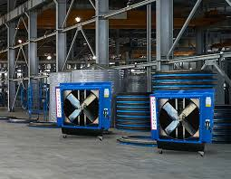
HIIPP: Shade and Engineering Controls
For outdoor work, plan for shaded areas
    Provide mechanical cooling and air movement (open air, fans, misting and/or air conditioning)
    As close as practical to the working areas
    Large enough to allow seating for employees on rest/break periods
Ensure that engineering controls are in place and functioning prior to starting work
    Ventilation and mechanical cooling
    Shielding and insulation

Slide 24
HIIPP: Acclimatization
Acclimatization is the temporary adaptation of the body to work in heat after being gradually exposed. Acclimatization peaks within 4 to 14 days of work exposed to at least 2 hours per day of heat.
Unacclimatized employees are at a higher risk of heat related illnesses
Use a gradual schedule for acclimatizing new employees or existing employees who are not accustomed to heat exposure
    Day 1: 20% of the typical heat exposure
    Increase exposure by 20% each subsequent day
    Increased acclimatization may be required for very heavy work in extreme heat

Slide 25
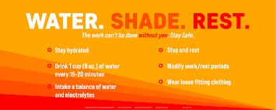
HIIPP: Administrative and Work/Rest
Appropriate work/rest schedules based on
    Environmental conditions (temperature, humidity, radiant heat)
    Acclimatized vs. unacclimatized workers
    The level of workload
    Types of PPE/clothing worn
Rest periods should be in shaded areas with hydration and cooling
Under very high temperature conditions, unacclimatized workers may need to avoid certain high intensity tasks altogether
Plan work schedules accordingly

Slide 26
Work / Rest Schedules and Water Intake
Heat Risk Category |  | Effective WBGT | LIGHT WORK |  | MODERATE WORK |  | HEAVY WORK
 |  |  | Minutes of Work/Rest per Hour | Water Intake (Quart/Hr.) | Minutes of Work/Rest per Hour | Water Intake (Quart/Hr.) | Minutes of Work/Rest per Hour | Water Intake (Quart/Hr.)
Low/ Minimal Risk | Unacclimatized Acclimatized | 78 to 79.9 °F | 50 / 10 Min Continuous | ½ ½ | 40 / 20 Min Continuous | ¾ ¾ | 30 / 30 Min 50 / 10 Min | ¾ ¾
Caution | Unacclimatized Acclimatized | 80 to 84.9 °F | 40 / 20 Min Continuous | ½ ½ | 30 / 30 Min 50 / 10 Min | ¾ ¾ | 20 / 40 Min 40 / 20 Min | 1 1
Moderate | Unacclimatized Acclimatized | 85 to 87.9 °F | 30 / 30 Min Continuous | ¾ ¾ | 20 / 40 Min 40 / 20 Min | ¾ ¾ | 10 / 50 Min 30 / 30 Min | 1 1
High Risk | Unacclimatized Acclimatized | 88 to 90 °F | 20 / 40 Min Continuous | ¾ ¾ | 10 / 50 Min 30 / 30 Min | ¾ ¾ | Avoid 20 / 40 Min | 1 1
Very High to Extreme | Unacclimatized Acclimatized | >90 °F | 10 / 50 Min 50 / 10 Min | 1 1 | Avoid 20 / 40 Min | 1 1 | Avoid 10 / 50 Min | 1 1
Adapted from: 1) USGS Survey Manual, Management of Occupational Heat Stress, Chapter 45, Appendix A 2) Manual of Naval Preventive Medicine, Chapter 3: Prevention of Heat and Cold Stress Injuries 3) OSHA Technical Manual Section III: Chapter 4 Heat Stress 4) National Weather Service Tulsa Forecast Office, Wet Bulb Globe Temperature

Slide 27
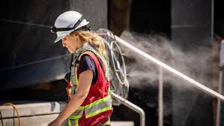
HIIPP: Observations and Monitoring
Designate supervisors for the ongoing monitoring of environmental conditions and worker health/wellbeing
Monitor real-time temperature and forecasts
Identify acclimatized/unacclimatized workers and adhere to work/rest schedules
Monitor availability of supplies (including water)
Continual observation and monitoring of employees
    Get to know workers and if they are at an elevated risk
    Watch for exhibiting signs/symptoms
    Be mindful of employees working alone
    Implement first aid or emergency response as necessary

Slide 28
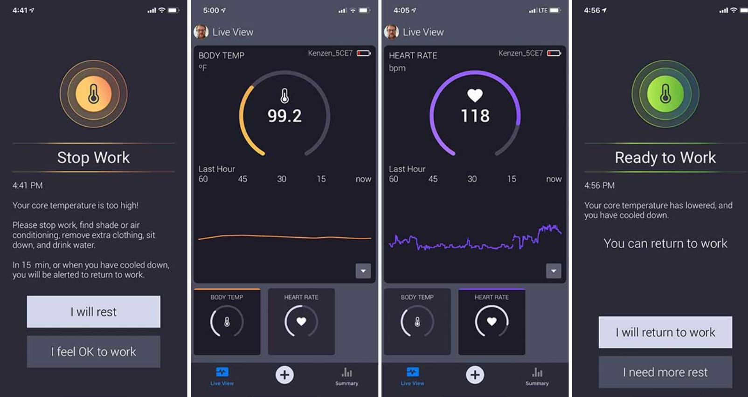
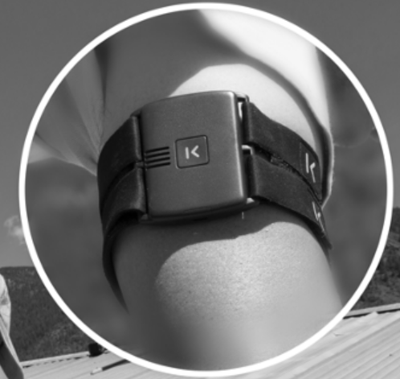
Monitoring and Wearable Technology
Body temperature
Hydration
Pulse
Blood Pressure

Slide 29
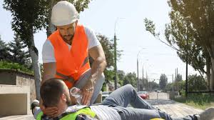
HIIPP: First Aid and Emergency Response
All supervisors and employees to be trained in heat stress prevention, first aid, and emergency response procedures before starting work
If employees exhibit signs/symptoms:
    Remove them from the high heat environment to a cool or shaded area
    Render appropriate first aid or summon emergency services, as needed

Slide 30
First Aid and Emergency Response (Examples)
Condition | Symptoms | First Aid or Emergency Response
Heat Stroke | Hot, dry skin or profuse sweating Seizures Loss of consciousness (coma) Very high body temperature Confusion/dizziness/slurred speech Death if not treated immediately | Immediately call 911 and notify a supervisor Move worker to a cool shaded area and remove outer clothing Circulate the air around employee Cool the worker using methods such as: Soaking their clothes with water Spraying or showering them with water Fanning their body
Heat Exhaustion | Heavy sweating Extreme weakness or fatigue Dizziness, confusion, nausea, headaches Clammy, moist skin Pale or flushed complexion Decreased urine output Slightly elevated body temperature Thirst | Have them rest in a cool and shaded area Have them sip water or other cool, nonalcoholic beverages frequently Have them take a cool shower, bath, or sponge bath Use cool compresses to cool the employee Take the employee to a clinic if necessary
Heat syncope (fainting) | Light-headedness Dizziness Fainting | Sit or lie down in a cool place when they begin to feel symptoms Slowly drink water, clear juice, or a sports beverage

Slide 31
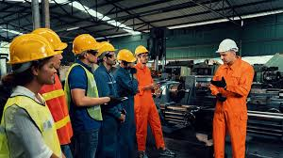
HIIPP: Training
All affected management, supervisors and employees must receive training on all aspects of the program
Managers and supervisors must be fully aware of:
    Planning supplies and resources (including water and shade)
    Schedules and staff resources
    Emergency plans
Supervisors and workers must be trained on:
    Early signs and symptoms
    Ongoing communication
    Work/rest schedules
    How to seek assistance

Slide 32

Tips from the Professionals
Now is the time to develop or review your HIIPP
Everyone has a role in preventing heat related illnesses
Advanced planning and preparation are the key
Communicate early and often
Know your employees and when they need help
Stay flexible and prepare for changing conditions

Slide 33
Questions?

Slide 34
THANK YOU!

