Slide 1
Sustainability Environmental, Social, Governance (ESG)

Slide 2


Presenter
Kristian witt
Vice president, environmental SERVICES
kwitt@complianceplace.com
267-303-9319

Slide 3
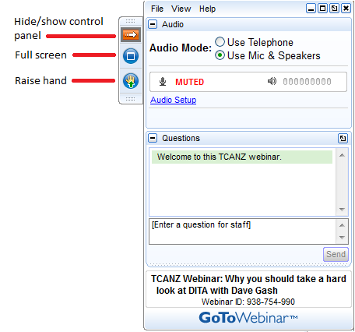
Housekeeping
This presentation is being recorded and will be shared.
Everyone will be muted to prevent background noise.
Use the question button to log your question.

Slide 4
Today’s topics
What is Sustainability/ESG?
Are you required to participate?
What are typical areas of focus?
Developing a plan?
Who in your company should be involved?
Develop Key Performance Indicators
Success Stories
What’s Next?

Slide 5

What Is sustainability/ESG?
Sustainability: A business approach that focuses on creating long-term value by managing a company’s environmental, social, and governance impacts in a responsible, efficient, and future-oriented way. It is broader than ESG reporting, and it goes beyond “being green” — it’s about running the business so it remains competitive, resilient, and trusted over time.
What is ESG: Framework to measure a company's impact on
  E - environment
  S - society
  G - how transparent and accountable it is
Used as an investing tool
Mandatory Reporting Global Markets
Recalibrates Risk
Notes:
Only post link if going to it during webinar
https://www.epa.gov/npdes/authorization-status-epas-construction-and-industrial-stormwater-programs

Slide 6
How did we get here?
The Corporate Responsibility started in the 1950s
1987 World Commission on Environment and Development Report
2006 Principles for Responsible Investment
2011 Jean Rogers founded the Sustainability Accounting Standards Board (SASB)
2015-2017 UN Sustainability Goals, Global Reporting Initiative (GRI), and The Compact for Responsive and Responsible Leadership
Current Status
Notes:
Howard Bowen’s book “Social Responsibilities of the Businessman.

Slide 7
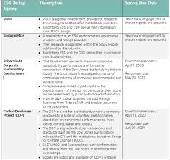
Do I need to be involved and Why
Most Likely at some level
  Corporate Reporting
  Customer Surveys
  Rating Platforms
    EcoVadis
    CDP
    And more
  ESG reporting is a Global Effort
  Important customers may demand it
Notes:
Construction sites
Manufacture/Industrial Facilities who’s Standard Industrial Classification (SIC) Code is one of the following:
24xx A: Timber Products
26xx B: Paper Products
28xx, 3952 C: Chemical Products
29xx D: Asphalt/Roofing 32xx
E: Glass, Clay, Cement 33xx
F: Primary Metals 10xx
G: Metal Mining 12xx
H: Coal Mines
13xx I: Oil and Gas
14xx J: Mineral Mining
HZ K: Hazardous Waste
LF L: Landfills
5015 M: Auto Salvage Yards
5093 N: Scrap Recycling
SE O: Steam Electric Facilities
40xx, 41xx, P: Land Transportation
42xx, 4311, 5171
44xx Q: Water Transportation
37xx R: Ship/Boat Building, Repair
45xx S: Air Transportation
TW T: Treatment Works (WWTPs)
20xx, 21xx U: Food Products
22xx, 23xx, 31xx V: Textile Mills
2434, 25xx W: Furniture and Fixtures
27xx X: Printing, Publishing
30xx, 39xx Y: Rubber, Misc. Plastics
3111 Z: Leather Tanning/ Finishing
34xx, 39xx AA: Fabricated Metal Products
35xx, 37xx AB: Transportation Equip.
357x, 38xx, 36xx AC: Electronic, photo goods
Sometimes both industrial and construction

Slide 8
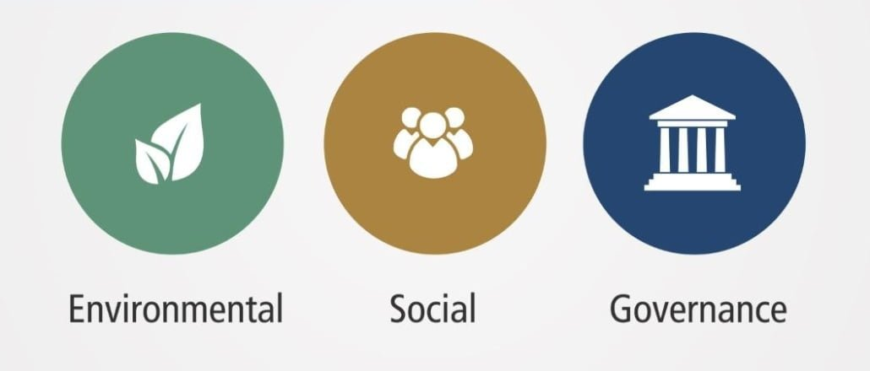
Environmental
A Company’s impact on the planet
Use of Natural Resources
Bio Diversity
Carbon emissions as well as Criteria and Hazardous Air Pollutants
Solid Waste
Water use and wastewater
Energy

Slide 9
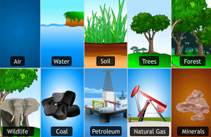
Environmental – Natural Resources
Renewable Energy Sources
Reduce and recycling programs
Alternative Raw Materials
Control Technologies
Hazardous Materials
Product End of Life
Consumption Optimization

Slide 10
Environmental – Biodiversity
Variety and Variability on Life
Impact of operations on species
Loss poses a risk to the environment
Habitat Destruction
Invasive Species
Not straightforward
Outside resource and support will be needed

Slide 11
What is your Carbon Foot Print and more
Greenhouse Gas Emissions
  Scope 1 – Direct – Combustion, Refrigerant Leaks, Process emissions
  Scope 2 – Indirect – Energy Consumption
  Scope 3 – Supply Chain Upstream and Downstream
    15 Categories
Other air emissions and reduction efforts

Slide 12

Waste Management
Reduce
Reuse
Recycling
Recovery
Employee Training

Slide 13

Water
Water Consumption
Recycling
Discharge Volume
Contamination
Stormwater No Exposure
Treatment

Slide 14

Energy
Consumption
Renewable Energy
Efficiency
Renewable Credits
Related to Carbon foot print

Slide 15
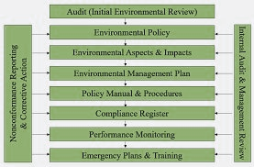
Other environmental
ISO14001
EMS
Responsible Care
ECO Certifications

Slide 16
social Topics
Employee Relations
Worker Conditions
Training
Supply Chain labor practices
Diversity Sustainability
Legal Requirements
Notes:
Multi-Sector General Permit (MSGP)– Most Popular
Two types of General Permits – Construction and Industrial
Construction General Permit is separate from any local requirements.
Construction General Permit require for disturbances greater that 1 acre
May be less than 1 acre if the plan is ultimately part of a larger project
Preset conditions
Individual Permit
Just what it means - Site-specific Permit
If you cannot comply with the General Permit
Pertains to a single facility
Typical if you have a process water discharge not allowed by the General Permit
Will list specific monitoring and conditions for compliance
Will generally include requirements from the general permit

Slide 17
Worker Conditions
Safe Work Practices
Working Conditions
Labor Relations
DEI
Wages

Slide 18

Worker Training
Waste reduction
Air emissions
Energy conservation
Water conservation
Hazardous materials handling
Health and Safety Risks
Subcontractor/Temp Employees

Slide 19
Governance
How an organization is governed?
Risks and opportunities in decision making
What are the responsibilities of Participants in an organization?
  Board of Directors
  Managers
  Shareholders
  Stakeholders
  Organization Transparency
  It is an indication of Risk in the ability to capitalize on business opportunities.

Slide 20

What now – Develop a Plan
Establish your ESG Team
  Cross functional
Identify Key ESG issues
  What factors are most relevant
    Carbon Footprint
    Waste
    Labor
  Engage Stakeholders
    Internal and Stakeholders
  Establish most impactful ESG issues
Set ESG Goals and KPIs
Action Plan
Notes:
Individual Required – If the site cannot comply with all GP regulations
Lack of BMP’s
Off-site discharges above limitations
Discharges into a designated/restricted stream (High Quality or above a federal Tier [Tier 3])
A point source or sector specific discharge that is prohibited by regulation
Impact the surrounding environment (i.e. endangered species or critical habitat)
Non-Stormwater discharges intentionally introduced by the facility.
Possible site-specific numeric effluent limitations were established.
Know your operation and know your permit requirements.

Slide 21
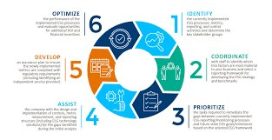
What now – Develop a Plan cont.
Implement and Integrate
  Company Policies
  Operations must incorporate ESG into business decisions, processes, SOPs
  Company Culture
  Engage and train employees
Track Progress
  Monitor against KPIs
  Adjust
  Report
Continuous Improvement
  Living Effort
  Bench mark against industry standards

Slide 22
Who is involved
ESG Lead
EHS
HR
Purchasing
Finance
IT
External Advisors/ Consultants

Slide 23
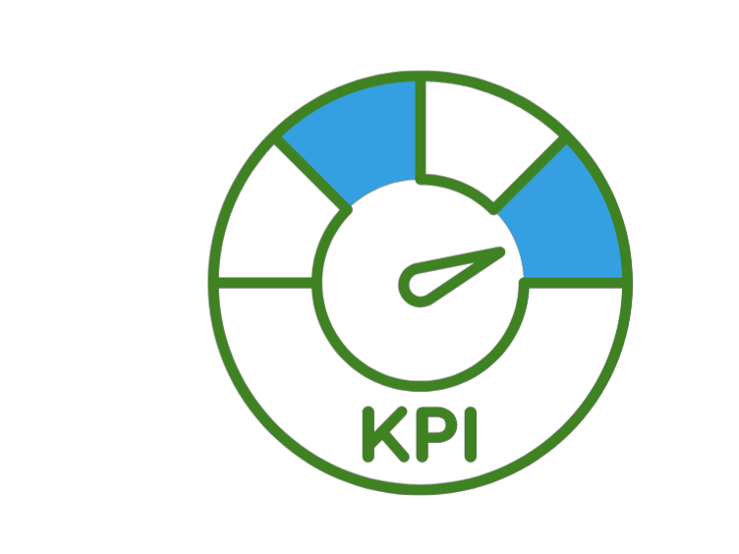
Key Performance Indicators
Establish Smart Goals and KPIs
GHG emissions – next year, all energy purchased will be renewable.
Water – All water will be recycled in 5 years
Waste – Reduce waste by 50% Zero hazardous waste.
Bio Diversity – Protect habitat and reduce deforestation
Health and Safety incident Reduction
Increase Training hours

Slide 24

Compliance Management International
Sustainability Successes
  Interface, Inc. – Net-Zero Carpet Tiles​
  Industry: Flooring/Manufacturing​
  Success: Interface set out to become the world’s first environmentally sustainable and restorative company.​
  Highlights:​
    - Reduced GHG emissions by 96% for its carpet tile products.​
    - Created the world’s first carbon negative carpet tile (2020)

Slide 25
Compliance Management International
Sustainability Successes
  Unilever – Sustainable Living Plan​
  Industry: Consumer Goods​
  Success: Unilever’s plan integrates sustainability into its core business.​
  Highlights:​
    - Cut CO₂ emissions from manufacturing by 65% since 2008.​
    - Helped over 1 billion people improve health and hygiene.​
    - 67% of agricultural raw materials are sustainably sourced

Slide 26
Compliance Management International
Sustainability Successes
  UPS ORION: Improve transportation efficiency​
  Industry: Package Delivery and Logistics​
  Success: UPS adopted an AI system called ORION which is a route optimizer that aims to minimize the number of turns during the delivery​
  Highlights:​
    - Saved 10 million gallons of fuel per year,​
    - Decreased carbon footprint by 100,000 metric tons per year

Slide 27
Compliance Management International
Sustainability Successes
  AB InBev​
  Industry: Beverage​
  Success: Pushed sustainability in its supply chain.​
  Highlights:​
    - 100% of electricity purchased in their U.S. operations now comes from renewables​
    - Reduced water usage by over 20%.

Slide 28
Current Status of ESG
Investor interest remains high
Company disclosure pressures
Seen as a measure of operational risks and long-term value creation
Company reporting is widespread – 90% of S&P 500 companies issue ESG reports.

Slide 29
What to look out for
Greater fragmentation and push-back is the USP
Pairing down the focus
Slower integration into operations
May see States such as California require certain company disclosures.

Slide 30
Questions?
Thank You.

Slide 31
Get in Touch: kwitt@complianceplace.com www.Complianceplace.com

