Slide 1

ehs Recordkeeping essentials for 2026
Is your organization ready?

Slide 2


OUR TEAM for today’s presentation
Chris maye, p.e.
Project DIRECTOR, Environmental Services
Michael schneider, CSP
DIRECTOR, health & safety Services

Slide 3

Housekeeping
This presentation is being recorded and will be shared.
Everyone will be muted to prevent background noise.
Use the question button to log your question.

Slide 4

Today’s Topics
OSHA Recordkeeping Requirements
Annual Environmental Reports
Training Documentation
Keeping on Track
New Tools

Slide 5

Let’s Start with OSHA
Injury Records
Training Records
Written Programs & Policies
Inspections
Medical Surveillance Records

Slide 6

Employee Rights
A safe workplace
Access to records:
- OSHA citations
- Annual workplace injury logs
- Medical records, tests that measure hazards
Notes:
Employers must establish a method for employees to immediately report injuries or illnesses and inform employees of this method.
Employees, former employees, their personal representatives, and their authorized employee representatives have the right to access the OSHA injury and illness records, with some limitations.
Employers must establish “reasonable procedures” for employees to report work-related injuries and illnesses promptly and accurately.
When a request is made for a copy of the OSHA 300 Log, a copy must be provided by the end of the next business day. You cannot make changes to the OSHA 300 Log such as crossing off employee names for privacy. You cannot charge for the copies when initially requested.
You may not enter the employee’s name on the OSHA 300 Log if the case involves a privacy concern. Instead, enter “privacy case” in the space normally used for the employee’s name. You must keep a separate, confidential list of the case numbers and employee names for privacy concern cases so the cases can be updated and information provided to the government if requested.
Privacy concern cases include injury or illness to intimate parts of the body or the reproductive system, injury or illness from sexual assault, mental illness, HIV infection, hepatitis, tuberculosis, needlestick injuries, or other illnesses if employee voluntarily requests that his or her name not be entered on the log.

Slide 7

Recordkeeping Forms
OSHA 301 Injury and Illness Incident Report
OSHA 300A Summary of Work-Related Injuries and Illnesses
OSHA 300 Log of Work-Related Injuries and Illnesses
Notes:
Record a one- or two-line description of the injury or illness on the OSHA 300 Log within 7 calendar days of the incident. Also include the identity of the employee (unless a privacy case), when and where the incident occurred, the type of injury or illness, body parts affected, and the object or substance that directly caused the injury or illness. Classify the incident according to the most serious outcome and identify it as an injury or an illness.
The OSHA 300A Summary of Work-Related Injuries and Illnesses form is used to summarize the information from the OSHA 300 Log. You must post the 300A form every year from February 1 through April 30.
The OSHA 301 Injury and Illness Incident Report is used to investigate the incident. Complete a 301 form for each recordable injury or illness within 7 calendar days of the incident.
You may use other equivalent forms as long as the form contains the same information, is readable and understandable, and is completed using the same instructions as the OSHA form it replaces. Records may also be kept electronically as long as forms can be obtained when required.

Slide 8

Reporting to OSHA
Report death within 8 hours
Provide recordkeeping documents within 4 hours
BLS injury and illness survey
In-patient hospitalization, amputation, or loss of an eye within 24 hours
Several reporting options
Notes:
You are required to report to OSHA within 8 hours any work-related fatality. Deaths from motor vehicle accidents do not have to be reported to OSHA, but they must be recorded. A death from a heart attack must be reported to OSHA, and OSHA will determine if an investigation is required.
You are required to provide any of the documentation required by the standard to OSHA authorized representatives within 4 business hours after the request is made. Documents requested might include OSHA 300 Logs, Summary Forms, and OSHA 301 Forms.
If you receive an injury and illness survey form from the BLS, it must be completed and returned within 30 calendar days or the date stated on the survey. Not every employer will receive a survey each year. Even if your company is normally exempt from recordkeeping requirements, you must still return the completed survey.
For any in-patient hospitalization, amputation, or eye loss, you must report the incident within 24 hours of learning about it.
You have three options for reporting the event:
Calling or visiting the nearest OSHA area office during normal business hours;
Calling the 24-hour OSHA hotline at 800-321-OSHA or 800-321-6742; or
Using OSHA’s online form at https://www.osha.gov/report.html

Slide 9
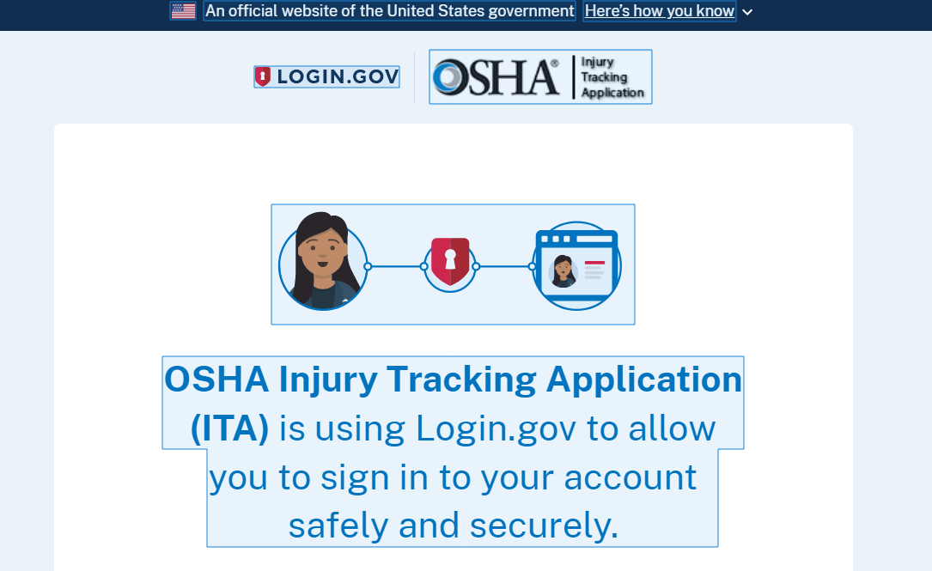
Online Submission
Establishments with 250 or more employees electronically submit OSHA 300 log, 300A, and 301
Establishments with 20 to 249 employees in certain industries electronically submit 300A
Employers must submit required data by March 2 each year

Slide 10


Slide 11

New requirements
High Risk Industries >100 Employees
- Farming & Food/Beverage Manufacturing
- Leather, Plastics, Rubber, Wood
- Metal Manufacturing
- Cars, Boats, House Supply Manufacturing
- Hospitals, Healthcare
- Waste Collection/Management
-Amusement, Entertainment
- Etc etc etc

Slide 12

Retention and Updating of Records
Retain records for 5 years
Record newly discovered injuries or illnesses
Record changes in the classification of previously recorded incidents
Notes:
The OSHA 300 Log, the privacy list, the annual summary, and the OSHA 301 forms must all be maintained for at least 5 years following the end of the calendar year covered by the records.
During the 5-year retention period, the OSHA 300 Logs must be updated to reflect any new or changed information. Annual summary forms do not have to be updated to reflect the changed OSHA 300 Log. The OSHA 301 forms also do not need to be updated with new information.
Update the OSHA 300 Logs to record any newly discovered injuries or illnesses.
Update the OSHA 300 Logs to record any changes in the classification of previously recorded incidents. An employee with an injury that previously only required a job restriction may have to go in for surgery that requires some time away from work. This record must be updated to reflect the new classification as a “days away from work” case.

Slide 13


ANNUAL ENVIRONMENTAL REPORTING
GOVERNMENT COMPLIANCE
  Hazardous Materials Inventory (Tier II)
  Waste (Hazardous, Residual…)
  Air Emissions
  Wastewater/Stormwater Discharge
CORPORATE REPORTING
  GHG (Portion of Ecovadis, CDP, etc.)
  Utility Usage (Sustainability/EMS)
  Intensity Calculations
  Customer-specific aspects
Notes:
You are required to report to OSHA within 8 hours any work-related fatality. Deaths from motor vehicle accidents do not have to be reported to OSHA, but they must be recorded. A death from a heart attack must be reported to OSHA, and OSHA will determine if an investigation is required.
You are required to provide any of the documentation required by the standard to OSHA authorized representatives within 4 business hours after the request is made. Documents requested might include OSHA 300 Logs, Summary Forms, and OSHA 301 Forms.
If you receive an injury and illness survey form from the BLS, it must be completed and returned within 30 calendar days or the date stated on the survey. Not every employer will receive a survey each year. Even if your company is normally exempt from recordkeeping requirements, you must still return the completed survey.
For any in-patient hospitalization, amputation, or eye loss, you must report the incident within 24 hours of learning about it.
You have three options for reporting the event:
Calling or visiting the nearest OSHA area office during normal business hours;
Calling the 24-hour OSHA hotline at 800-321-OSHA or 800-321-6742; or
Using OSHA’s online form at https://www.osha.gov/report.html

Slide 14


ENVIRONMENTAL REPORTING dATA
BUT FIRST: Administrative/Change Management
  On-line reporting, any changes to Certifying personnel? If so…
    Look to change online accounts, privileges, new account setup, etc.
  Any changes to reporting mechanism (new on-line system, updated submittal addresses, forms, etc.)
  Any changes to process/permitted units, and how this impacts each report/program
  Any changes to site ownership
Tier II/Hazardous Materials Inventory
  Quantity – Assumptions/basis sheet update
    Spot check physical inventory
    Forktruck/pallet jack inventory
    Tanks, containers, other storage; confirm assumptions
    Any new hazardous materials??
  Chemical
    Current SDS with hazards
    Comparison to EHS/Reporting Thresholds
    Changes to reportable thresholds
Notes:
Record a one- or two-line description of the injury or illness on the OSHA 300 Log within 7 calendar days of the incident. Also include the identity of the employee (unless a privacy case), when and where the incident occurred, the type of injury or illness, body parts affected, and the object or substance that directly caused the injury or illness. Classify the incident according to the most serious outcome and identify it as an injury or an illness.
The OSHA 300A Summary of Work-Related Injuries and Illnesses form is used to summarize the information from the OSHA 300 Log. You must post the 300A form every year from February 1 through April 30.
The OSHA 301 Injury and Illness Incident Report is used to investigate the incident. Complete a 301 form for each recordable injury or illness within 7 calendar days of the incident.
You may use other equivalent forms as long as the form contains the same information, is readable and understandable, and is completed using the same instructions as the OSHA form it replaces. Records may also be kept electronically as long as forms can be obtained when required.

Slide 15

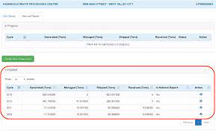
ENVIRONMENTAL Reporting DatA
Waste Reporting
  Lookup Manifest Data at RCRAInfo (hazardous only)
  Obtain data from waste vendor & compare to manifest data by wastestream
  Compare to data on site (do you maintain an on-going log?)
  Confirm waste handling codes and disposal codes
  Enter data in online report or electronic form
  Gather data for other elements of reporting, as applicable:
    Hazardous Secondary Material (HSM)
    Other special cases
  BEST PRACTICE: Confirm waste profiles are current, Form SI
  data
Notes:
You are required to report to OSHA within 8 hours any work-related fatality. Deaths from motor vehicle accidents do not have to be reported to OSHA, but they must be recorded. A death from a heart attack must be reported to OSHA, and OSHA will determine if an investigation is required.
You are required to provide any of the documentation required by the standard to OSHA authorized representatives within 4 business hours after the request is made. Documents requested might include OSHA 300 Logs, Summary Forms, and OSHA 301 Forms.
If you receive an injury and illness survey form from the BLS, it must be completed and returned within 30 calendar days or the date stated on the survey. Not every employer will receive a survey each year. Even if your company is normally exempt from recordkeeping requirements, you must still return the completed survey.
For any in-patient hospitalization, amputation, or eye loss, you must report the incident within 24 hours of learning about it.
You have three options for reporting the event:
Calling or visiting the nearest OSHA area office during normal business hours;
Calling the 24-hour OSHA hotline at 800-321-OSHA or 800-321-6742; or
Using OSHA’s online form at https://www.osha.gov/report.html

Slide 16

ENVIRONMENTAL Reporting DatA
Air Emissions Reporting
  Address/incorporate equipment changes (new, removed)
  Onsite fuel use (natural gas bills, fuel deliveries)
  Process Material use (raw material purchase, metering, etc.)
  Process Operation (hours, widgets made, etc. by month)
    Engine Hours - By Type (emergency, exercise, etc.)
    Processing time(s)
  Emission Calculations
    Confirm any new materials used in processes
    Confirm emission factors; update if testing occurred
  BEST PRACTICE – Configure on-going spreadsheet for emission statement summary, and incorporate changes.
Notes:
You are required to report to OSHA within 8 hours any work-related fatality. Deaths from motor vehicle accidents do not have to be reported to OSHA, but they must be recorded. A death from a heart attack must be reported to OSHA, and OSHA will determine if an investigation is required.
You are required to provide any of the documentation required by the standard to OSHA authorized representatives within 4 business hours after the request is made. Documents requested might include OSHA 300 Logs, Summary Forms, and OSHA 301 Forms.
If you receive an injury and illness survey form from the BLS, it must be completed and returned within 30 calendar days or the date stated on the survey. Not every employer will receive a survey each year. Even if your company is normally exempt from recordkeeping requirements, you must still return the completed survey.
For any in-patient hospitalization, amputation, or eye loss, you must report the incident within 24 hours of learning about it.
You have three options for reporting the event:
Calling or visiting the nearest OSHA area office during normal business hours;
Calling the 24-hour OSHA hotline at 800-321-OSHA or 800-321-6742; or
Using OSHA’s online form at https://www.osha.gov/report.html

Slide 17





ENVIRONMENTAL REPORTING DATA
Wastewater/Stormwater
  Sampling Results
  Metering data or water bills
  Weather data/inspections
Other Corporate Reports
  Electricity Consumption (Scope 2 GHG)
  Data already collected for other reports, reformatted for specific report
  BEST PRACTICE – Develop summary file noting data sources
Notes:
Under new provisions to the recordkeeping rules:
Establishments with 250 or more employees (including part-time, seasonal, or temporary workers) at any time during the previous calendar year, must electronically submit information from three OSHA injury and illness recordkeeping forms (300 log, 300A annual summary, and 301 incident report) to OSHA on an annual basis.
Also, establishments with 20 to 249 employees in certain industries (listed in appendix A of the rules) must electronically submit information from their 300A form on an annual basis. Following is how it will phase in.
By July 1, 2017, establishments with 250 or more employees, as well as establishments with 20 to 249 employees, must electronically submit their 300A annual summaries for injuries and illnesses in 2016.
By July 1, 2018, establishments with more than 250 employees must electronically submit all three OSHA forms (300, 300A, and 301) for injuries and illnesses for calendar year 2017. By this date, establishments with 20 to 249 employees must electronically submit their 300A for 2017 incidents.
And beginning in 2019, these establishments must electronically submit the required information by March 2 (for example, by March 2, 2019, for the information covering 2018).

Slide 18
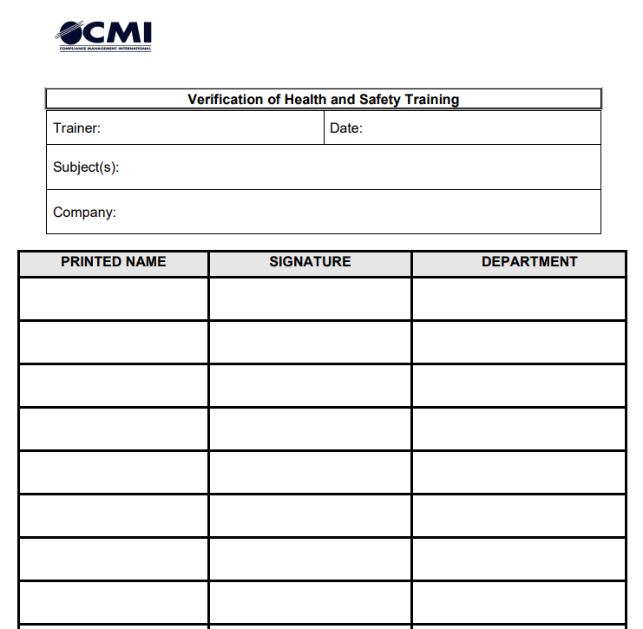
Training Records
Name
Date
Topics Discussed
Signature
Name of Trainer
Retain for the time of employee’s employment with the company.

Slide 19
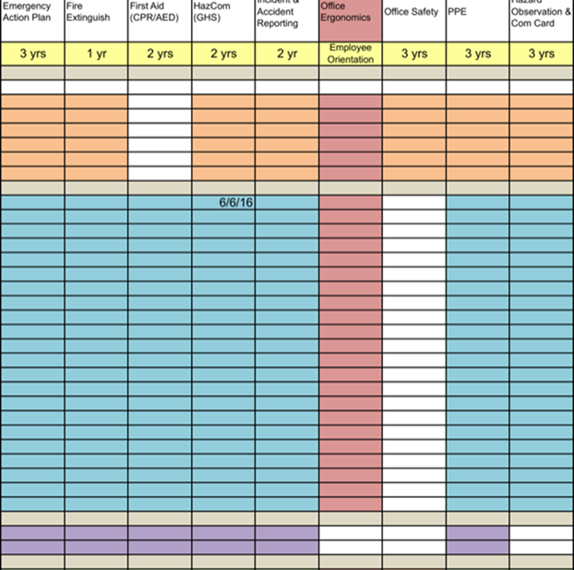
Training Matrix
Shows that OSHA Programs have been evaluated
Applicable job titles have been determined
Training Frequency Noted
Course Descriptions

Slide 20
Health & Safety Program Records
Emergency Action Plan | 1910.38
Process Safety Management of Highly Hazardous Chemicals | 1910.119
Hazardous Waste Operations and Emergency Response | 1910.120
Respiratory Protection | 1910.134
Permit-Required Confined Spaces | 1910.146
The Control of Hazardous Energy (Lockout/Tagout) | 1910.147
Employee Alarm Systems | 1910.165
Powered Industrial Trucks | 1910.178
Electric Power Generation, Transmission and Distribution | 1910.269
Electrical Safety-Related Work Practices | 1910.333
Subpart Z: Specific Chemical Substances | 1910.1000 to 1910.1018, 1910.1025 to 1910.1029 and 1910.1043 to 1910.1096
Bloodborne Pathogens | 1910.1030
Hazard Communication | 1910.1200
Occupational Exposure to Hazardous Chemicals in Laboratories | 1910.1450

Slide 21


Health & Safety Program Records
Permit-Required Confined Spaces
  Employers are required to retain canceled entry permits for a minimum of one year.
  They should also be reviewed within one year following each entry.
Hazard Communication
  Each safety data sheet (SDS) must be retained for 30 years beyond the duration of employment for all exposed employees.
  Employers must also retain copies of all SDSs for every chemical currently being used.

Slide 22
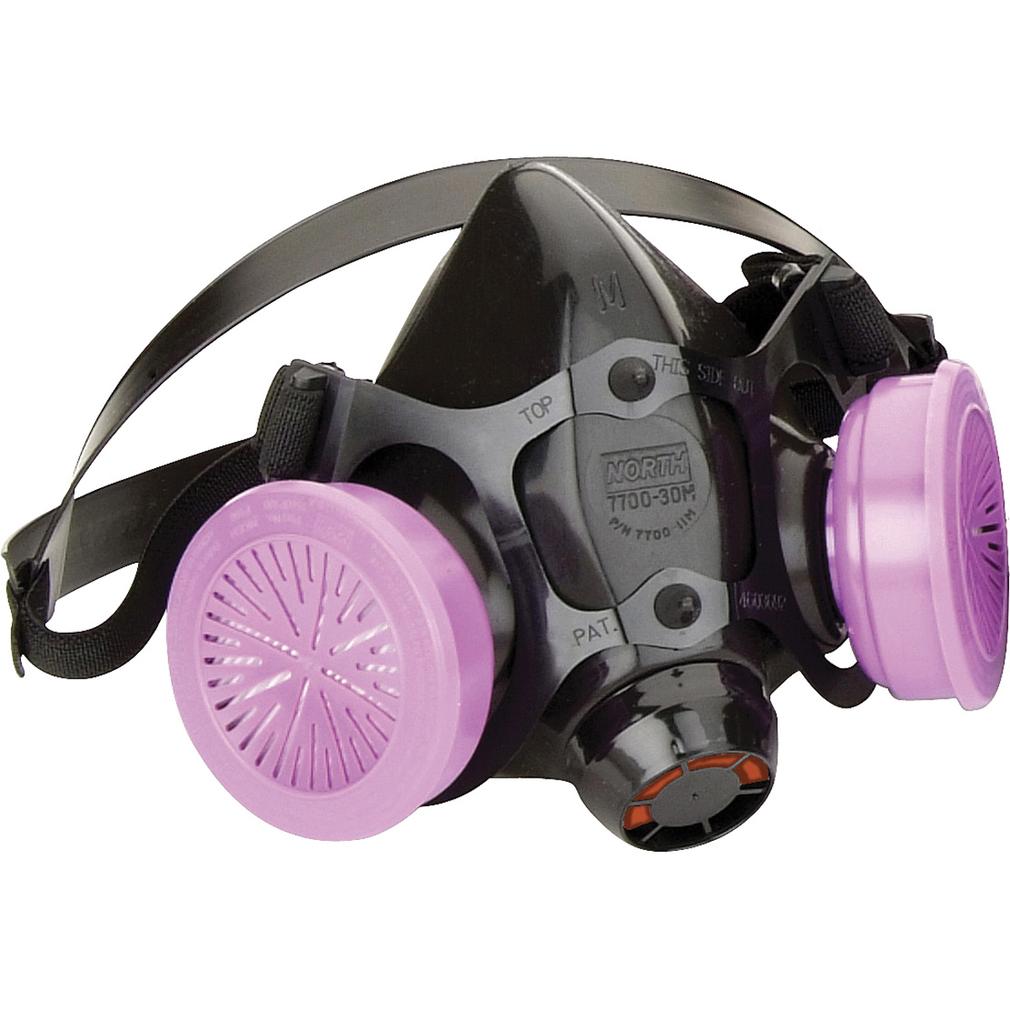


Health & Safety Program Records
Respiratory Protection
  Retain records pertaining to employee medical evaluations for 30 years past the final date of employment.
  Retain results from the most recent fit-test should also be recorded and maintained until the results of the next test have been collected.
Bloodborne Pathogens
  OSHA employs the “duration of employment plus 30 years” for employee exposure records.
Lockout Tagout
  Maintain logs verifying that periodic inspections by authorized employees are being performed at least once per year.
  Logs should be maintained for a minimum of one year or until a new log is validated and certification is issued.

Slide 23


Health & Safety Program Records
Hearing Conservation
  OSHA recommends that employers retain noise exposure measurement records for a minimum of two years
  Audiometric test records should be retained for the duration of employment
Personal Protective Equipment
  There are several written certifications regarding hazard assessment and employee training that must be retained for the duration of a worker’s employment.
  PPE records for individual employees should also be retained until the employee is no longer employed.

Slide 24
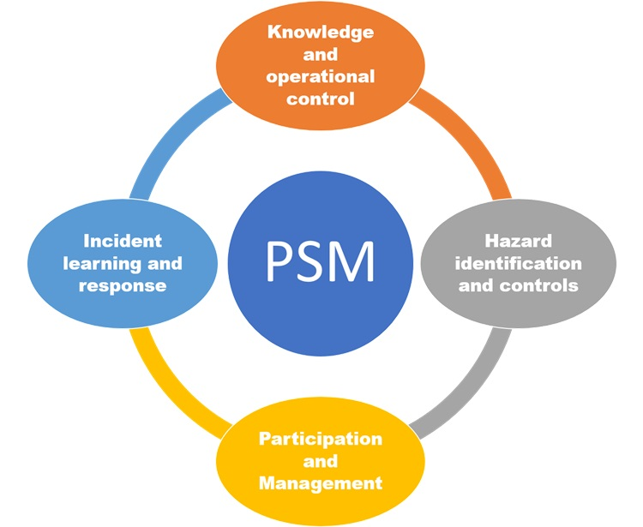
Process Safety Management (PSM)
OSHA requires process hazard analyses (PHAs), related employee records, and verification records to be retained for the duration of the covered process or the employee’s tenure.
Process safety information (PSI) documents used for developing, maintaining, auditing, and managing processes should also be retained for as long as the process is being used.
Save incident investigations covered by the PSM standard for at least five years as well as the two most recent compliance audit reports.
Failure to comply with these retention policies could result in a citation, fine, or penalty.

Slide 25
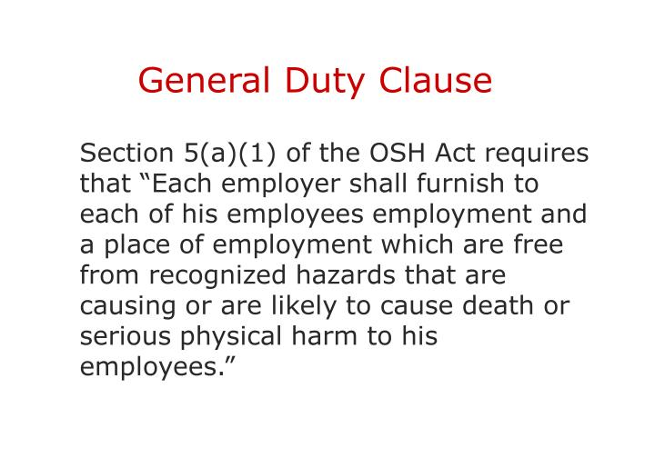
General Duty Clause Document Retention
The best practice for General Duty Clause document retention is to retain any training records dealing with “recognized hazards” for the duration of employment, including:
The written policy
Training records
Disciplinary documents for policy violations

Slide 26
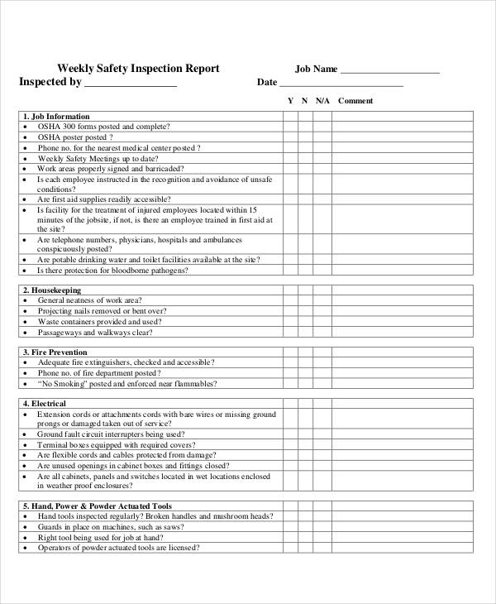

Inspection records
Fire extinguishers
Emergency Lighting
Emergency Eyewash & Showers
Overhead Crane, Hoists and Slings
Powered Industrial Trucks
Labels on Equipment
Internal Requirements
Waste Inspections
Tank Inspections (internal & external)

Slide 27
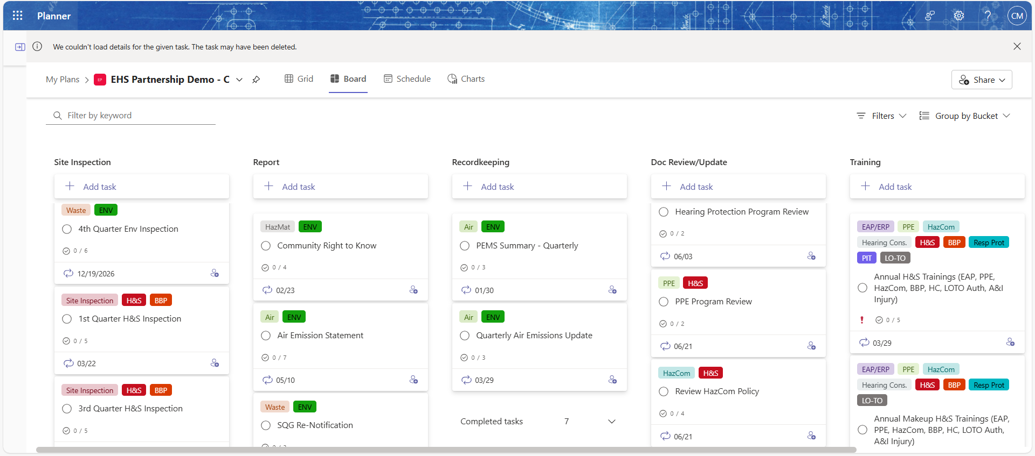
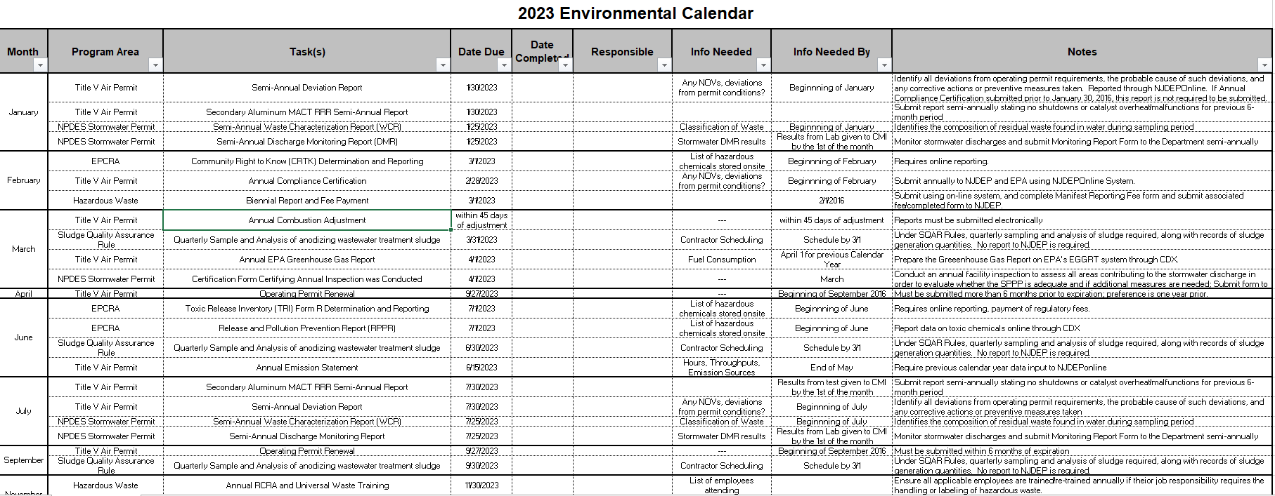

PLANNING AHEAD
Training to Complete (and records)
Inspections (and records) to prepare
Calendar of Action Items to Complete
On-Going Records to Compile
Reporting to the government
BEST PRACTICE – Use a calendar,
and update each year!
Notes:
Do you understand the information presented in the previous slides?
Are there any questions regarding affected employers, recordkeeping forms, electronic submission of records, employees recorded, reporting to the government, and employee rights?

Slide 28
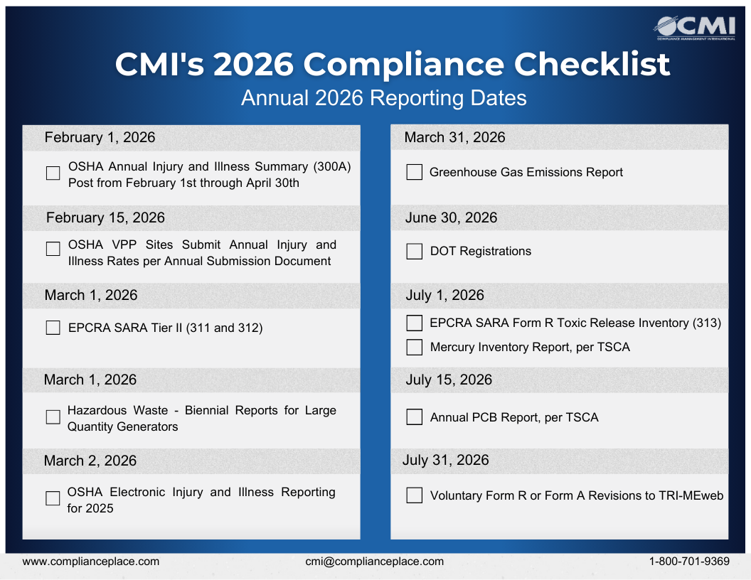

Slide 29
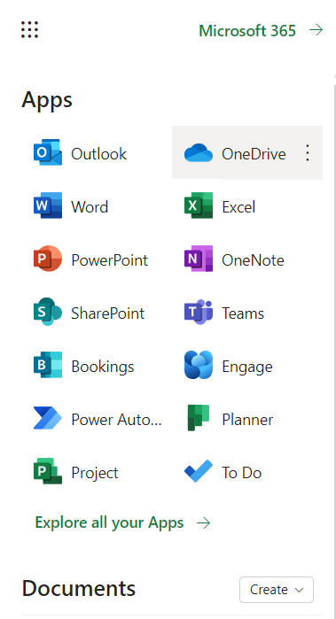
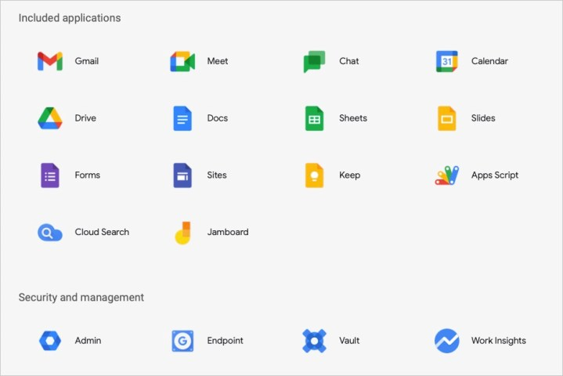
NEW TOOLS
Consider use of online tools for:
  Forms (inspections)
  File Maintenance [Records] (Sharepoint/OneDrive/Drive)
  Calendar/Schedule [Reports/submissions] (Planner, Jamboard)
  Collaboration/Delegation (Planner/Teams, Sites/Meet)
Notes:
Do you understand the information presented in the previous slides?
Are there any questions regarding affected employers, recordkeeping forms, electronic submission of records, employees recorded, reporting to the government, and employee rights?

Slide 30
Questions?
Thank you for joining us.

Slide 31
Connect with us for a complementary 15 minute consultation.

Slide 32
Get in Touch: www.Complianceplace.com mschneider@complianceplace.com cmaye@complianceplace.com

