Slide 1

Fall Protection in focus
Real-world prevention

Slide 2



OUR TEAM for today’s presentation
MARK Vaillancourt, CSP, CHST
Manager, Construction Safety Services
Cole campbell, B.S., CSP
Regional manager – EHS Services

Slide 3
Housekeeping
This presentation is being recorded and will be shared along with the PowerPoint slides after the webinar is over.
Everyone will be muted to prevent background noise.
Use the question box to log your question on the top right of your screen. Questions will be answered at the end of the presentation.

Slide 4
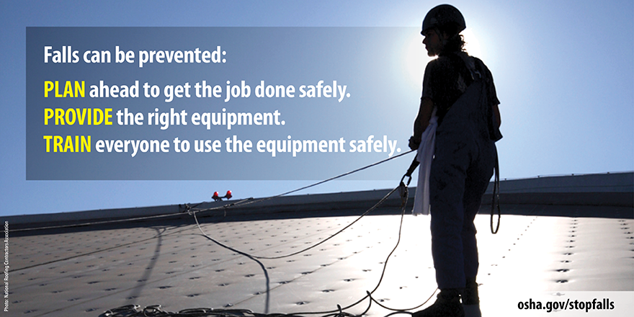
Today’s topics
The Fall Protection Standards
Where Most Falls Happen
Planning Ahead

Slide 5
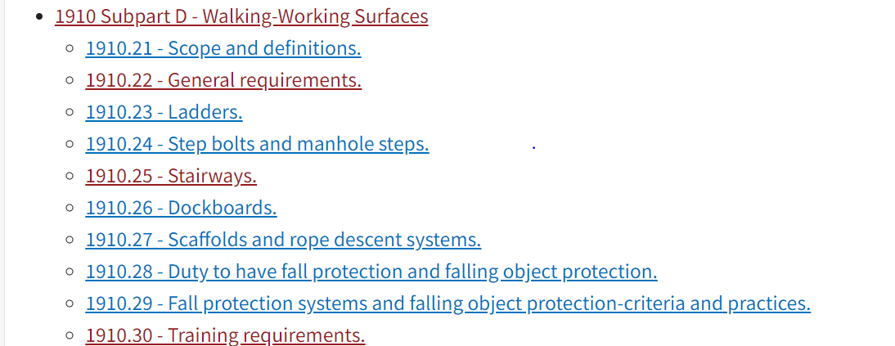
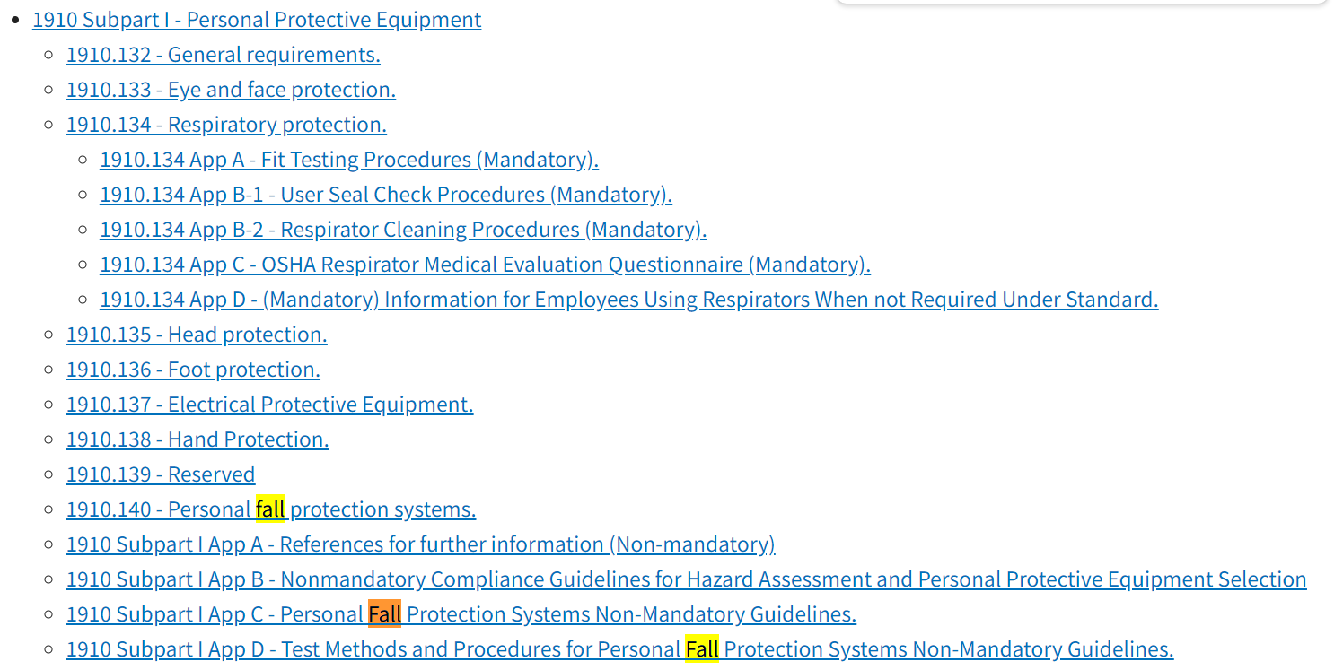
1910 vs 1926 Regulations
1910 – General Industry
Subpart D- Walking Working Surfaces AND Subpart I – Personal Protective Equipment

Slide 6
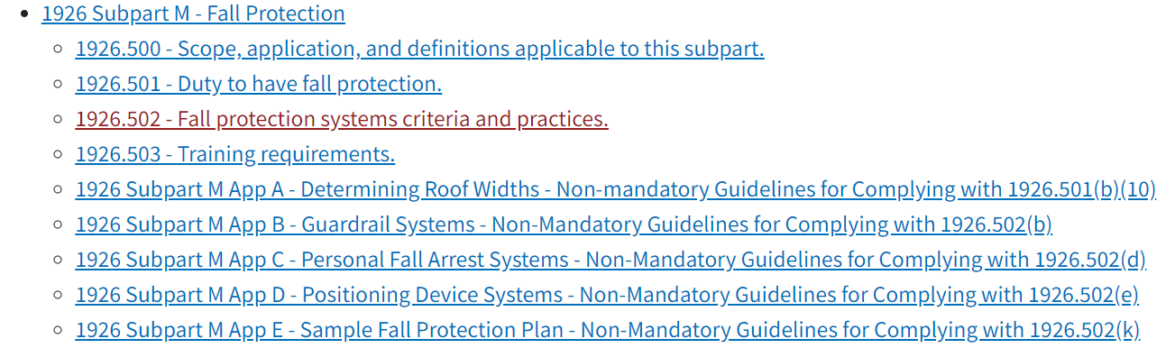
1910 vs 1926 Regulations
1926 – Construction
Subpart M is dedicated to Fall Protection

Slide 7
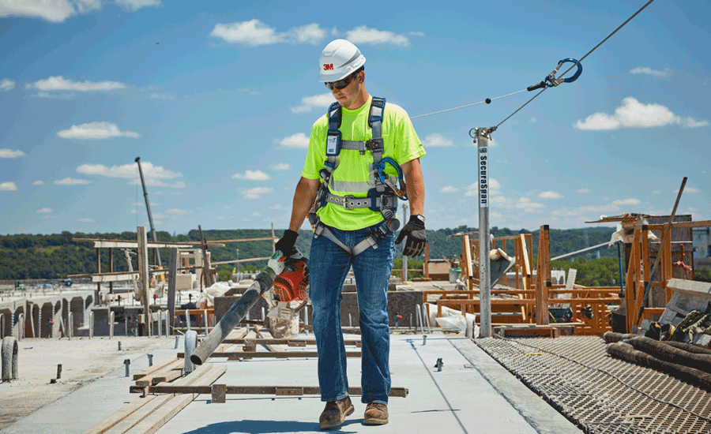
Fall Protection Requirements
6 Feet
4 Feet
Construction (OSHA 1926): Must have in place if working at or above
General Industry (OSHA 1910): Must have in place if working at or above
Notes:
four feet in general industry workplaces, five feet in shipyards, six feet in the construction industry and eight feet in longshoring operatio

Slide 8
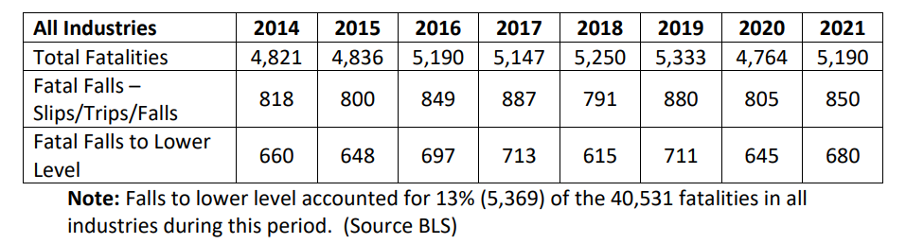
Why is Fall protection Important?
AVERAGE is 5,066/ Year
Notes:
Falls are among the most common causes of serious work related injuries and deaths. Employers must set up the work place to prevent employees from falling off of overhead platforms, elevated work stations or into holes in the floor and walls

Slide 9
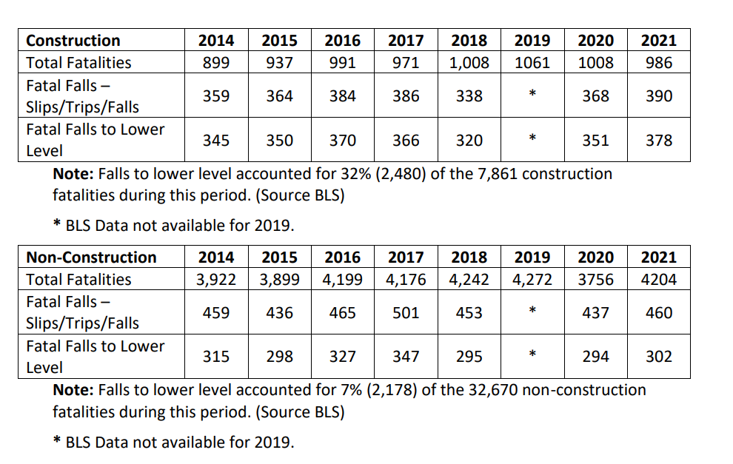
Why is Fall protection Important?
AVERAGE is 983/ Year
AVERAGE is 4,083/ Year
Notes:
Very sever injuries result from contact with live equipment that does not have proper machine guarding, such as lacerations and abrasions, crushed hands and arms, amputations to finders and limbs, and in the worst case scenario, death.
Machine guarding prevents people who operate or work near live equipment from coming into contact with moving machine parts or flying debris generated during equipment operation. Proper Safeguards are essential in protecting people form preventable injuries

Slide 10
What about OSHA inspections?
From 2014 to 2021 the following occurred:
Nearly 31% (77,782) of the 247,798 inspections OSHA conducted during this period had a fall emphasis.
Roughly 65% (81,721) of the 126,253 inspections OSHA conducted in the construction industry during this period had a fall emphasis.
Roughly 9% (11,357) of the 121,634 inspections OSHA conducted during this period in general industry had a fall emphasis.
What Does This Tell Us?
The focus of OSHA needed an adjustment.
Employers needed to get serious about fall prevention.

Slide 11

OSHA's National Emphasis Program (NEP) on Falls
Effective 5/1/2023 OSHA Wide
All construction inspections related to falls will be conducted pursuant to this NEP.
For non-construction inspections, this NEP will target the following activities:
Roof Top Mechanical Work/Maintenance | Utility Work/Maintenance (Cable/Electric)
Holiday light installation | Road sign maintenance/Billboards
Power Washing Buildings | Gutter Cleaning
Chimney Cleaning | Window Cleaning
Communication Towers | Arborist/Tree Trimming
Notes:
For other non-construction work activities where a worker is observed working at height, an inspection may be initiated upon approval by area office management. D. If an inspection is not warranted after entering the site and observing work activities, the CSHO will conduct an outreach activity on fall protection and exit the site.

Slide 12

EMPLOYER responsibilities
OSHA requires all employers to:
Provide working conditions that are free of known dangers.
Keep floors in work areas in a clean and, so far as possible, a dry condition.
Select and provide required personal protective equipment at no cost to workers.
Train workers about job hazards in a language that they can understand.

Slide 13
Employee Responsibilities
Inspect, care for and utilize all personal fall protection equipment
Comply with requirements of the program
Immediately report injuries or unsafe conditions
Must understand and be able to evaluate the risks associated with working at heights
Must be trained and competent in the use of fall protection equipment prior to conducting working at heights

Slide 14
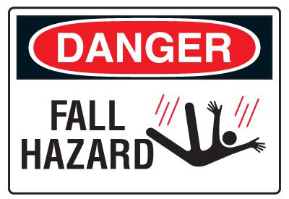
Where is the Danger?
The following hazards cause the most fall-related injuries:
Unprotected sides, wall openings, and floor holes
Improper scaffold construction
Unguarded protruding steel rebars
Misuse of portable ladders

Slide 15
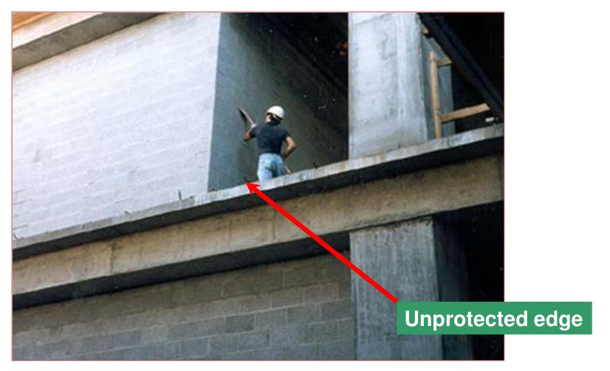
AM I in danger?
Unprotected Sides
Almost all sites have unprotected sides and edges, wall openings, or floor holes at some point during construction. If these sides and openings are not protected at your site, injuries from falls or falling objects may result, ranging from sprains and concussions to death.
How Do I Avoid Hazards?
Cover or guard floor holes as soon as they are created during new construction.
For existing structures, survey the site before working and continually audit as work continues. Guard or cover any openings or holes immediately.
Construct all floor hole covers so they will effectively support two times the weight of employees, equipment, and materials that may be imposed on the cover at any one time.

Slide 16
OSHA Case Studies Unprotected Sides
An employee taking measurements was killed when he fell backward from an unguarded balcony to the concrete 9 1⁄2 feet below.
A roofer, handling a piece of fiberboard, backed up and tripped over a 7 1⁄2 inch parapet. He fell more than 50 feet to ground level and died of severe head injuries.
Two connectors were erecting light-weight steel I-beams on the third floor of a 12-story building, 54 feet above the ground. One employee removed a choker sling from a beam and then attempted to place the sling onto a lower hook on a series of stringers. While the crawler tower crane was booming away from the steel, the wind moved the stringer into the beam the employee was standing on. The beam moved while the employee was trying to disengage the hook, causing him to lose his balance and fall to his death.

Slide 17
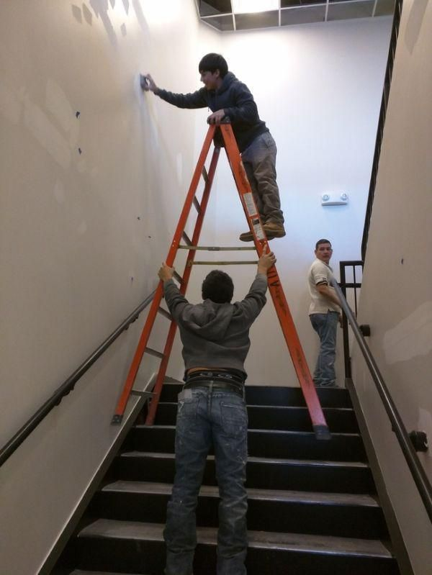
AM I in danger?
Misuse of Portable Ladders
You risk falling if portable ladders are not safely positioned each time they are used. While you are on a ladder, it may move and slip from its supports. You can also lose your balance while getting on or off an unsteady ladder. Falls from ladders can cause injuries ranging from sprains to death.

Slide 18
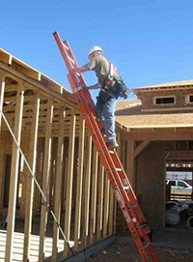
OSHA Case Studies: Misuse of Portable Ladders
An employee was climbing a 10 foot ladder to access a landing which was 9 feet above the adjacent floor. The ladder slid down, and the employee fell to the floor, sustaining fatal injuries. Although the ladder had slip-resistant feet, it was not secured, and the railings did not extend 3 feet above the landing.

Slide 19

How do we avoid the hazards?
PLAN AHEAD TO GET THE JOB DONE SAFELY
When working from heights, employers must plan projects to ensure that the job is done safely. Begin by deciding how the job will be done, what tasks will be involved, and what safety equipment may be needed to complete each task.
When estimating the cost of a job, employers should include safety equipment, and plan to have all the necessary equipment and tools available at the construction site. For example, in a roofing job, think about all of the different fall hazards, such as holes or skylights and leading edges, then plan and select fall protection suitable to that work, such as personal fall arrest systems (PFAS).
Conduct JSAs.

Slide 20
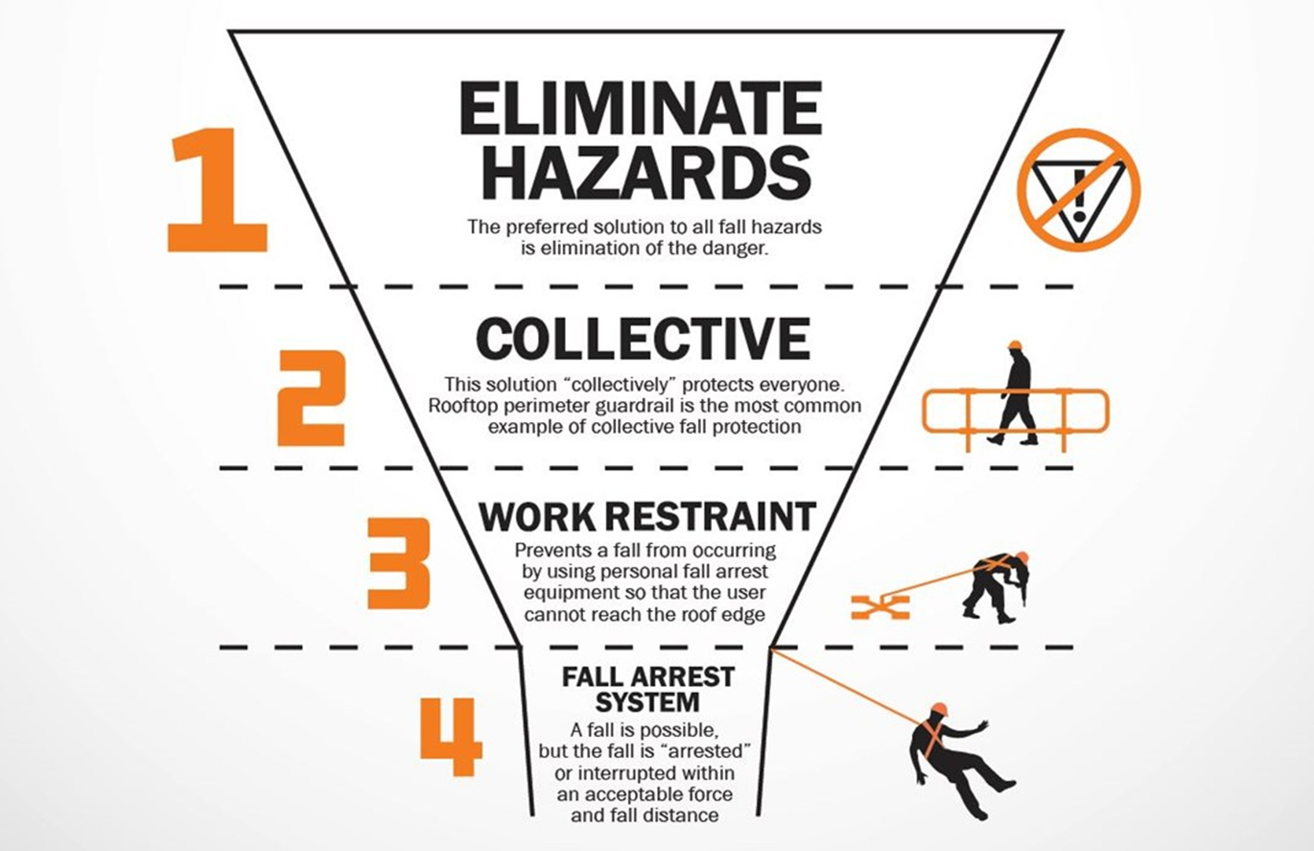
Hierarchy of Fall Protection
Notes:
Hazard Elimination- preferred solution is to eliminate exposure to the fall hazard
Passive Fall Protection- Physical barriers ex: Guardrails around unprotected edges
Fall Restraint Systems- Use PPE to restrict worker’s ranger of movement
Fall Arrest Systems- Use PPE to arrest a fall
Administrative Controls- Least Preferred solution is work practices or procedures that increase workers awareness

Slide 21
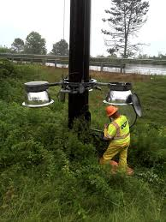
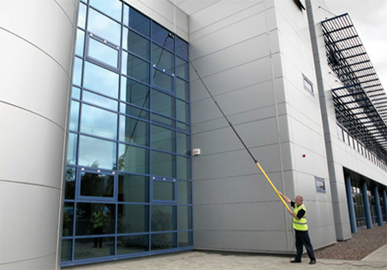
Elimination
The best and safest thing to do is to eliminate the hazard.
In the context of fall prevention and protection this might mean re-designing the work so it can done on ground level.

Slide 22
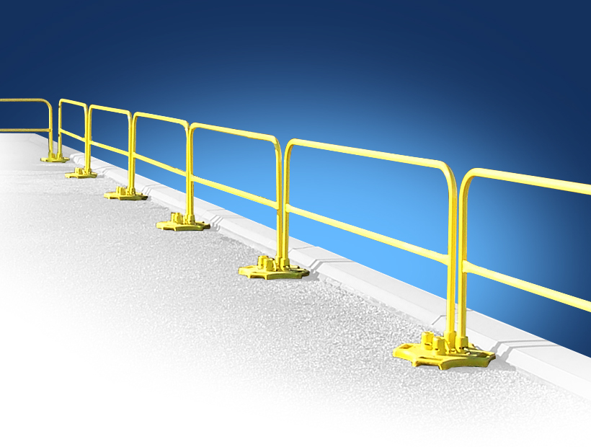
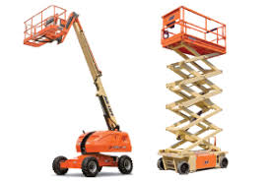
Passive Fall Protection
Using barriers that prevent workers form getting to close to an edge or a similar dangerous, elevated work area.

Slide 23
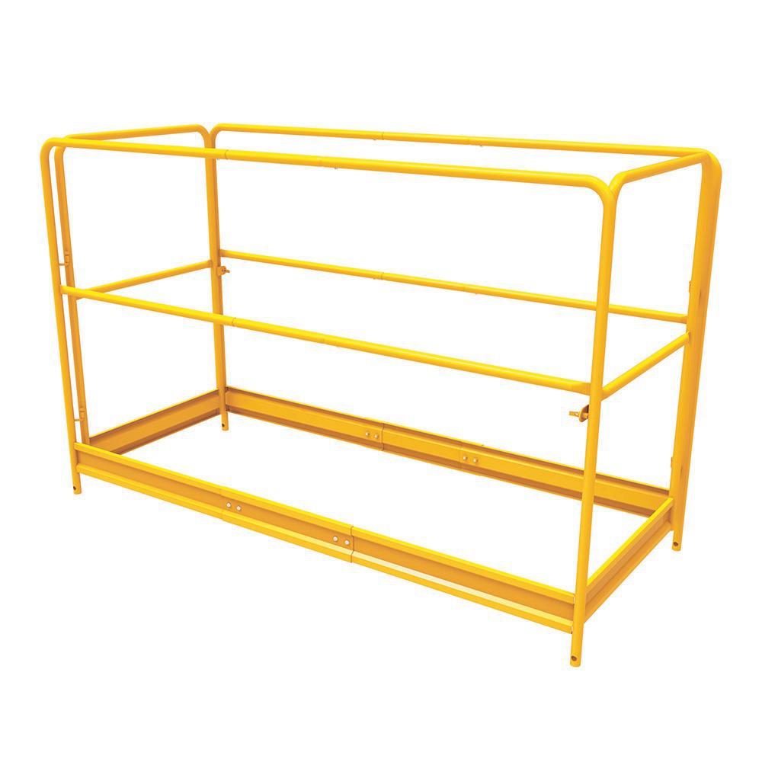
Guardrail Systems
Top rail – 42 inches (+/-3)
Mid-rail – midway
Screens or mesh
Guardrail
Wire rope
Toe Board
21 Inches (+/-)
42 Inches (+/-)
Notes:
Guardrail Systems must meet the following criteria:
The top-rail must be placed 42 +/- 3 inches above the walking/working level.
The mid-rail is located midway between the top-rail and the walking/working level.
Mid-rails, screens, mesh, intermediate vertical members or equivalent intermediate structures, must be installed between the top edge and the walking/working surface when there is no wall or other structure at least 21 inches high.
Screens and mesh must extend from the top-rail to the walking/working level, and along the entire opening between rail supports.
Guardrail systems must be capable of withstanding at least 200 pounds of force applied within 2 inches of the top edge, in any direction and at any point along the edge, and without causing the top edge of the guardrail to deflect downward to a height less than 39 inches above the walking/working level.
Mid rails, screens, mesh, and other intermediate members must be capable of withstanding at least 150 pounds of force applied in any direction at any point along the mid rail or other member.
Top rails and mid rails shall be at least one-quarter inch thick.
Wire rope, if used in constructing guardrails, shall be flagged every 6 ft.
Guardrail systems used for protection at excavations, skylights, and floor openings, shall be erected on all exposed sides.
Toe boards are required for all guardrails on elevated walking/working surfaces when a potential falling object hazard exists. Note: The hazard not only applies to personnel, but includes disruptions to operations, i.e. tools materials, etc. falling into SEPTA’s Right of Way.
Toe boards must be at least 3.5 inches high and be securely fastened.

Slide 24
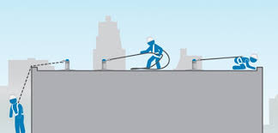
Fall Restraint System
The next level of the hierarchy of controls for fall hazards, which is active fall restraint. This involves having a worker wearing a full-body harness and using a lanyard to attach the harness to a secure anchor point. Worker cannot exceed the leading edge

Slide 25
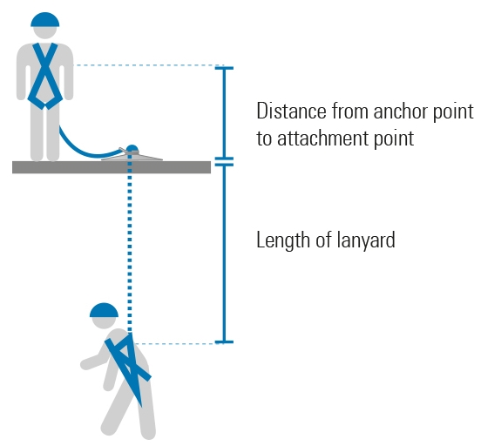
Fall Arrest System
At this next level of the hierarchy, the point is to use the harness, the lanyard and the anchor point to arrest or stop an employees fall once the fall has already occurred.

Slide 26
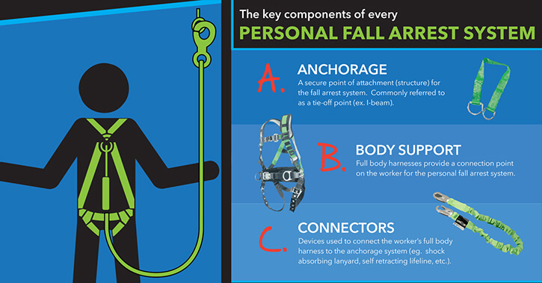
Personal Fall Arrest Systems (PFAS)
Notes:
Typically consists of an anchorage , connecting device and body harness and may include a lanyard, deceleration device, lifeline or a combination of these.
Lets review some of the components of the Personal Fall Arrest System at SEPTA.

Slide 27
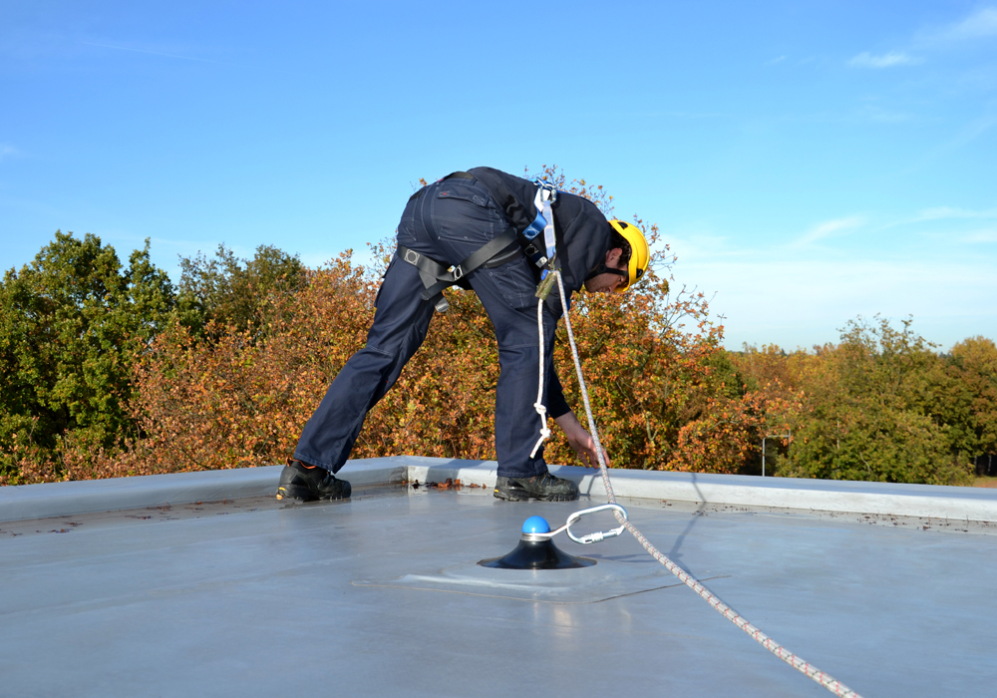
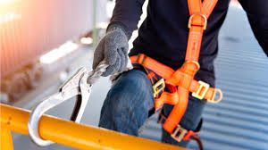
Anchorage Point
Supporting 5,000 lbs. for each worker
Support twice the weight expected
Independent of other support
Work to be supervised by competent person
Notes:
Ask for examples of anchors that have been used and not used.
Anchorage is a secure point of attachment for lifelines, lanyards or deceleration devices. They must meet specific criteria for use with Fall Protection Systems.
Must be capable of supporting 5,000 lbs. for each worker attached to it or designed by a qualified person (not the same as competent person) QUALIFIED Person is someone who by possession of a recognized degree, certificate, or professional standing, or who has extensive knowledge, training, and experience, and has demonstrated the ability to solve or resolve problems relating to the subject matter, work, or project.
A competent person must supervisor the activity. The anchorage point must also be able to support twice the weight expected to be imposed and independent of any anchorage used to support or suspend platforms.
Think of it this way, would you suspend your truck from this anchor point? If not, don’t use it.

Slide 28
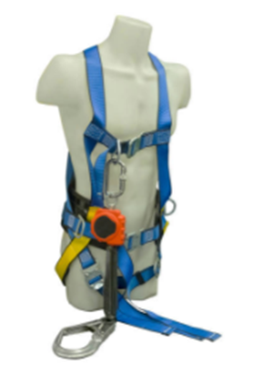
Body Wear or Harness
Notes:
Body harness consists of straps which may be secured about the body in a manner that will distribute the fall arrest forces over at least the thighs, pelvis, waist, chest and shoulders with means for attaching it to other components of the personal fall arrest system. (PFAS)

Slide 29
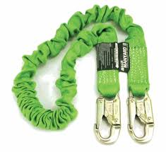
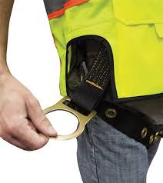
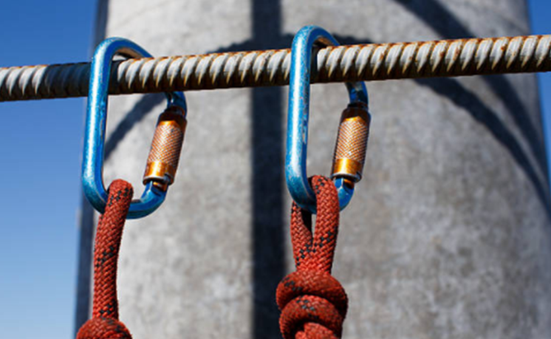
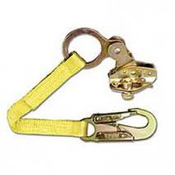
Connecting Devices
Independent or integral component
Critical link to anchorage point
Include:
Carabiner
D-Ring
Snap hook
Lanyard
Notes:
A connector is a device which is used to couple parts of the personal fall arrest system and positioning device systems together. It may be an independent component of the systems such as a carabiner, or it may be an integral component of part of the system – such as a buckle or d-ring sewn into the body harness, or a snap hook spliced or sewn into a lanyard or self-retracting lifeline.
Connecting Device is the critical link which joins the body wear to the anchorage/anchorage point, such as shock-absorbing lanyard, fall limiter, self-retracting lifeline, rope grab, etc.
Carabiner – a connecting device what is used to ensure that the employee remains connected to the system at all times. It provides a link between the anchorage points and lanyards or between harness and lanyards.
D-Ring – a connection point for lanyards or other Fall arrest connection devices that is located in the center of the back of the harness. (DORSAL – relates to the upper side of the back) For special applications, some harnesses may have D rings located near the waist, chest and shoulders.
Snap Hook – A connector comprised of a hood-shaped member with a closed keeper which my be opened to permit the hook to receive an object and when released, automatically closes to retain the object. Snap hooks must be self closing with a self-locking keeper which remains closed and locked, until unlocked and pressed open for either connection or disconnection, thus preventing the opportunity for ROLLOUT to occur.
Note: Rollout is the process by which a snap hook, carabiner unintentionally disengages from another component to which it is attached.
ALSO note: that D-rings, locking snap hooks and carabiners shall all have a minimum tensile strength of 5,000 pounds. Also be proof-tested to a minimum tensile load of 3,600 pounds without cracking, breaking, or suffering permanent deformation.
Lanyard – Is a flexible line of rope, wire rope, or strap which generally has a connector at each end for connecting the body harness to the deceleration device, lifeline or anchorage

Slide 30
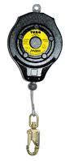
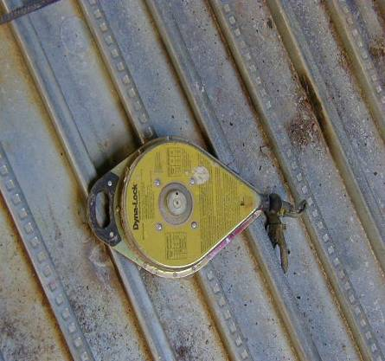
Deceleration Device
Dissipates energy during fall arrest
Limits energy imposed on the body during fall arrest
Include
Lanyard
Lifeline
Retractable or self-retractable
Notes:
Deceleration Device is a mechanism such as a rope, grab, rip-stitch lanyard, specially-woven lanyard, tearing or deforming lanyards, automatic self-retracting lifelines/lanyards, etc. which will dissipate a large amount of energy during a fall arrest, or limit the energy imposed on an employee during fall arrest.
A lifeline is a component consisting of flexible line for connection to anchorages at both ends to stretch horizontally (Horizontal life line) or for a connection to an anchorage at one end to hand vertical (Vertical lifeline). A lifeline also is a means for connecting other components of a personal fall arrest system to the anchorage. Lifelines must be protected against cuts and abrasions. When used on suspended scaffolds or similar work platforms, the horizontal lifeline connection devices must be capable of locking in both horizontal and vertical directions.
Self retracting Lifeline/lanyards is a device containing a drum-wound line which can be slowly extracted from or retracted onto the drum under slight tension during normal worker movement, and which after the onset of a fall, will automatically locks the drum and arrests the fall. The self-retracting lifeline or lanyard ropes and straps must be made of synthetic fibers and shall sustain a minimum tensile load of 3,000 pounds if they automatically limit free fall distance to two feet or less OR sustain a minimum tensile load of 5,000 pounds if they automatically limit free fall to a distance to more than two feet includes rip stitch, tearing and deforming lanyards.

Slide 31
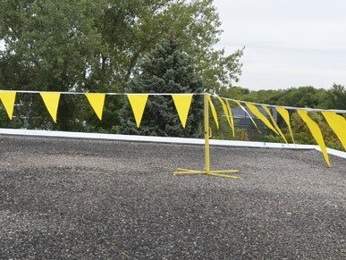
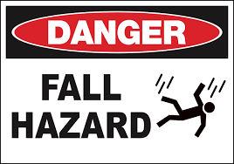
Administrative Controls
Administrative Controls can be a way to alert workers to fall hazards:
Lights
Alarms
Signs

Slide 32
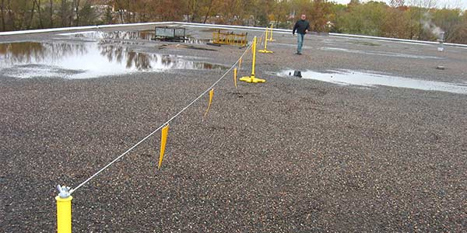
Warning Line Systems
Roofing work – Visual Warning Line
Lowest point (sag)
Stanchions
Flagged
Ropes, wires or chains
Erected at least six feet from edge
Erected at least six feet from edge from the parallel edge and 10 feet from the perpendicular edge
No employee allowed between edge and warning line
If work being performed between warning line and roof edge, employee must be protected from falling
Notes:
A warning line system is used primarily in roofing work and consists of a visual warning line supported by stanchions surrounding the work area.
The lowest point of the line (including sag) shall be 34 to 39 inches from the walking/working surface.
Lines shall be flagged at no more than six (6) foot intervals with high-visibility materials.
Stanchions for warning line systems shall be capable of resisting at least 16 pounds of force.
Ropes, wires or chains must have a minimum tensile strength of 500 pounds.
Warning line systems shall be erected at least six (6) feet from the edge, except in areas where mechanical equipment is in use. When mechanical equipment is in use, warning line systems shall be erected at least six (6) feet from the parallel edge and at least ten (10) feet from the perpendicular edge.
Once erected, with rope, wire, or chain attached, stanchions shall be capable of resisting, without tipping over, a force of at least 16 pounds.
No employees are allowed to be in the area between the roof edge and a warning line unless the employee is performing roofing work in that area and protected from falling.

Slide 33
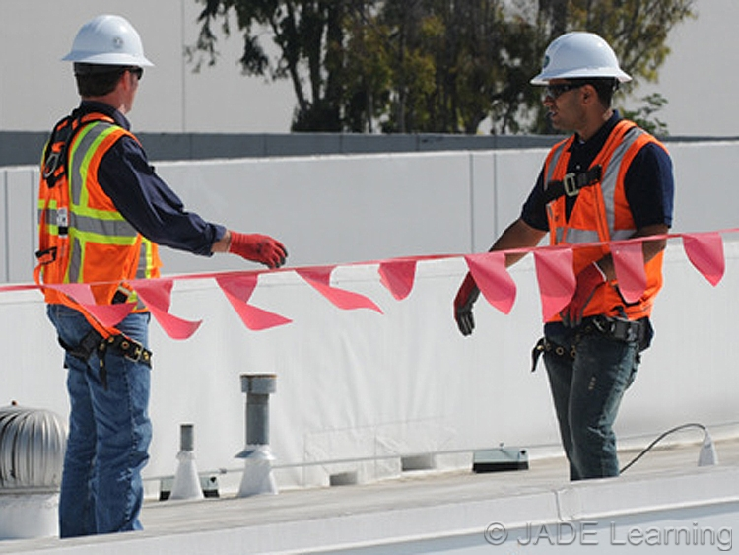
Safety Monitoring System
Roofs with <50 feet wide
Conjunction with a warning line system (low slope roof)
Safety Monitor
Competent person
Advance warning of hazards
Situated on same walking/working surface as workers
Free from distractions visually can see and communicate with workers
Employees
Only those performing work permitted
Supervisor briefing
Employees comply with all warnings and directions of the Safety Monitor
Notes:
As a standalone system of protection for roofing work performed on roofs with a width of 50 feet or less. In conjunction with a warning line system for low slope roofing work.
This method is employed by stationing a competent person with the work crew. This person is responsible for recognizing and warning employees of fall hazards and must be:
A Competent Person.
Capable of giving advance warning to workers of fall hazards for which they are approaching.
Situated on the same walking/working surfaces as the employees and close enough for visual and verbal communication.
Free of any other job duties that may distract them from monitoring.
Only employees engaged in the work being performed under the safety monitoring system can be allowed in the work area.
The Supervisor shall brief all employees entering into the work area and review the method of protection with them.
All employees under a safety monitoring system are required to promptly comply with the warnings and directions of the Safety Monitor.

Slide 34
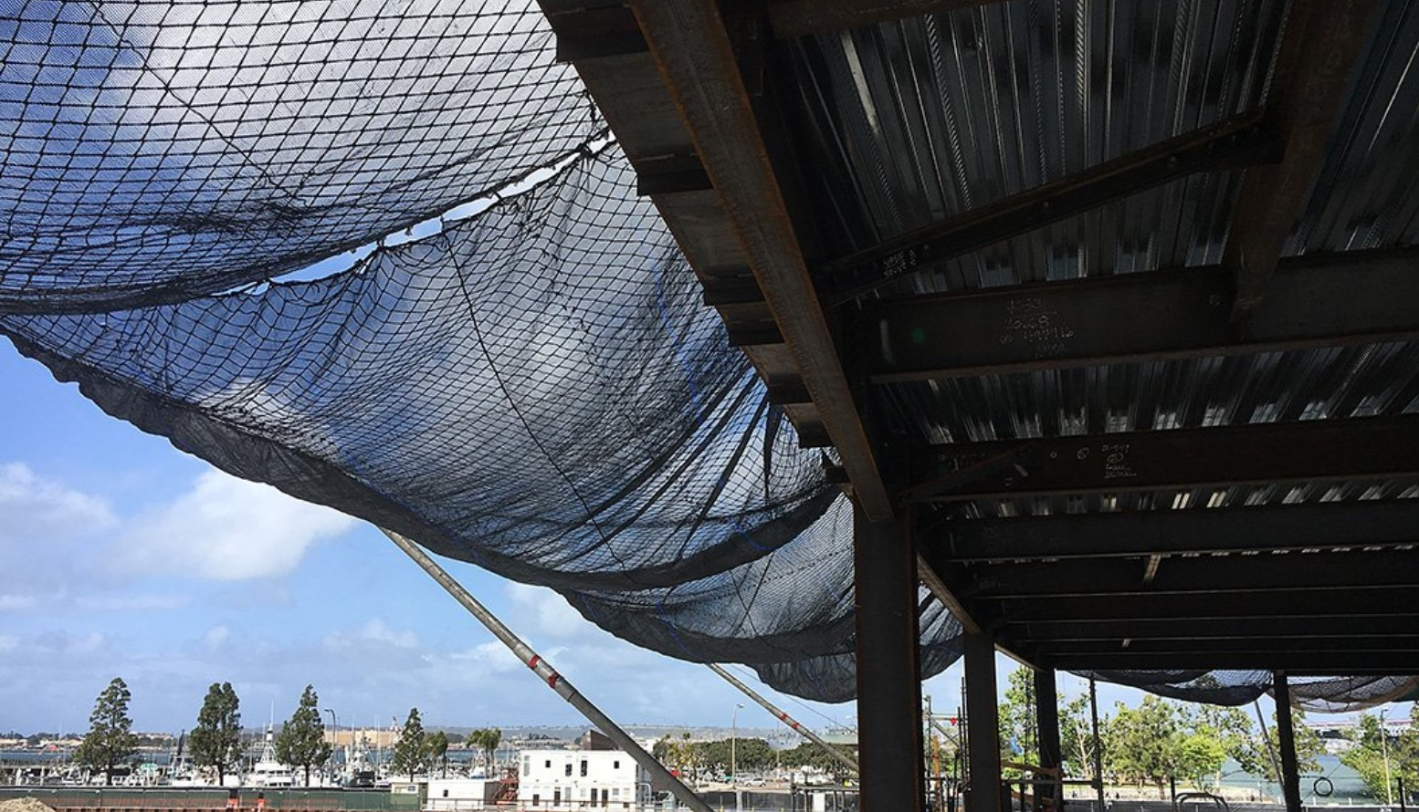
Safety Nets
Installed up to a maximum of 30 feet below walking/ working surface
Fall area is unobstructed
Field tested after installation and at 6 month intervals
Inspections
Fallen objects removal
Notes:
Safety net systems shall be installed as close as possible below the walking/working surface, up to a maximum of 30 feet below the walking/working surface with sufficient clearance to prevent contact with the surface below.
The following guidelines shall be followed when using a safety net system:
All nets shall be in compliance with mesh, mesh crossing, border rope, and connection specifications as described in OSHA 29 CFR 1926, Subpart M.
The potential fall area between the walking/working surface and the netting below shall remain unobstructed.
Safety nets shall be tested in the field immediately after installation and at 6 month intervals using a drop test of 400 pounds, dropped from the same elevation a worker may fall. (System Safety may allow certification by the installer in lieu of the drop test in certain cases.)
Inspect all safety nets immediately after installation and weekly thereafter. In addition, safety nets must be inspected after any alterations or repairs. The inspections must be documented.
Objects that have fallen into safety nets shall be removed as soon as possible and at least before the next work shift.

Slide 35
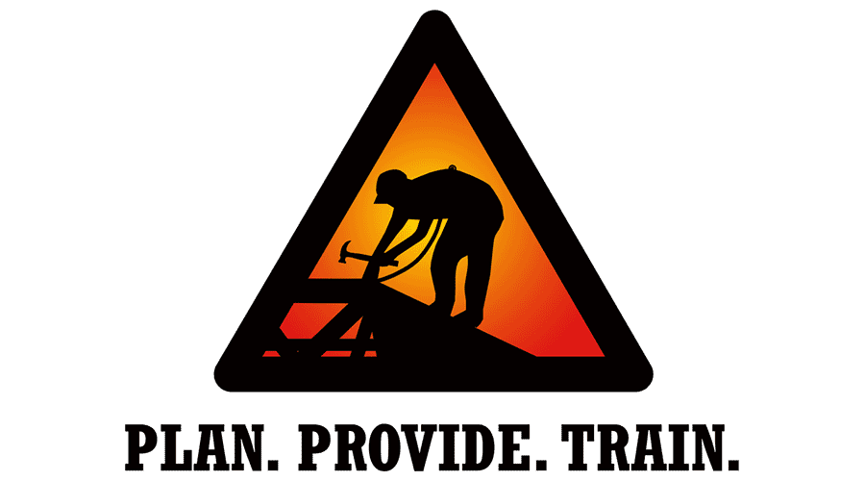
How do we avoid the hazards?
TRAIN EVERYONE TO USE THE EQUIPMENT SAFELY
Every worker should be trained on proper set-up and safe use of equipment they use on the job. Employers must train workers in recognizing hazards on the job.

Slide 36
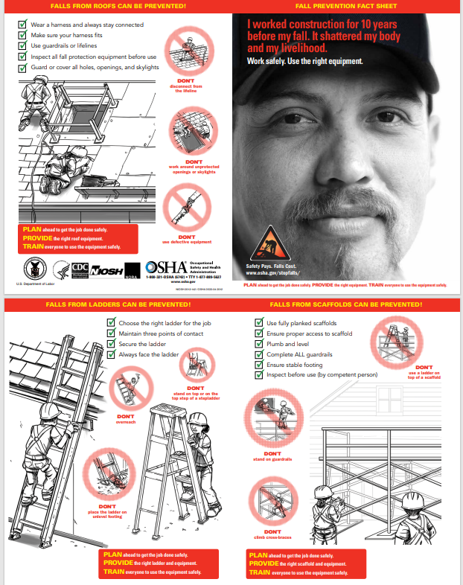
Reference Tools

Slide 37

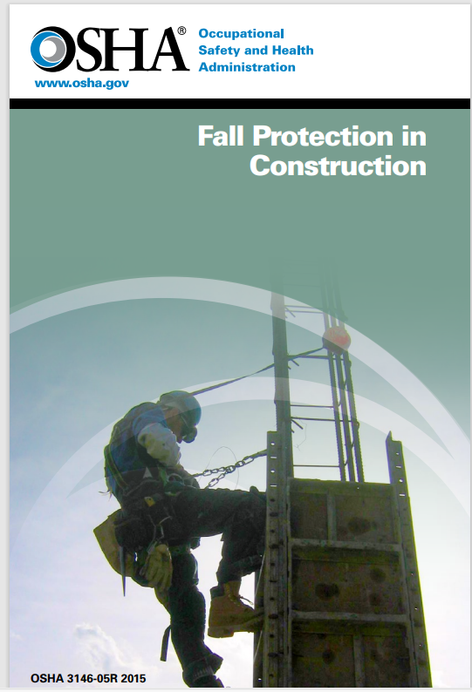
Reference Tools

Slide 38
Get in Touch: www.Complianceplace.com mvaillancourt@complianceplace.com ccampbell@complianceplace.com

Slide 39
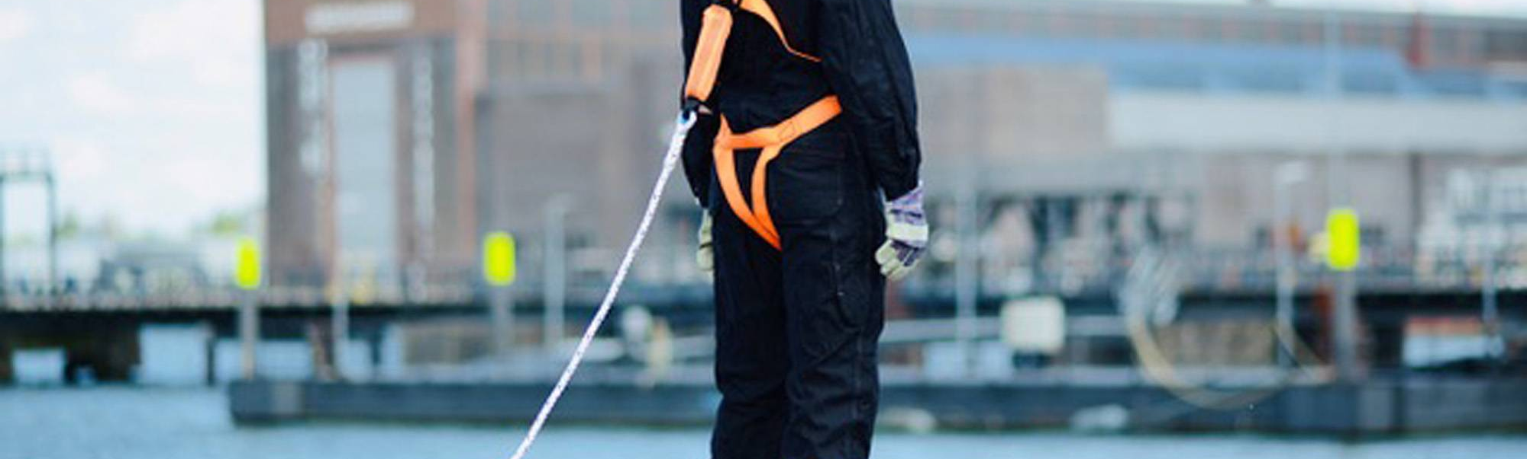
Questions?
Thank you for joining us.

