Slide 1

Machine guarding
Best Practices & OSHA Standards

Slide 2

Speaker for today’s presentation
Rebecca Caffrey, CSP
Manager, Health & Safety Services

Slide 3
Housekeeping
Housekeeping
This presentation is being recorded and will be shared along with the PowerPoint slides after the webinar is over.
Everyone will be muted to prevent background noise.
Use the question box to log your question on the top right of your screen. Questions will be answered at the end of the presentation or through email follow up.

Slide 4
Today’s topics
OSHA Regulations
Machine Guarding Assessments
Equipment Safeguarding & Best Practices
Comprehensive Protection from Amputations

Slide 5
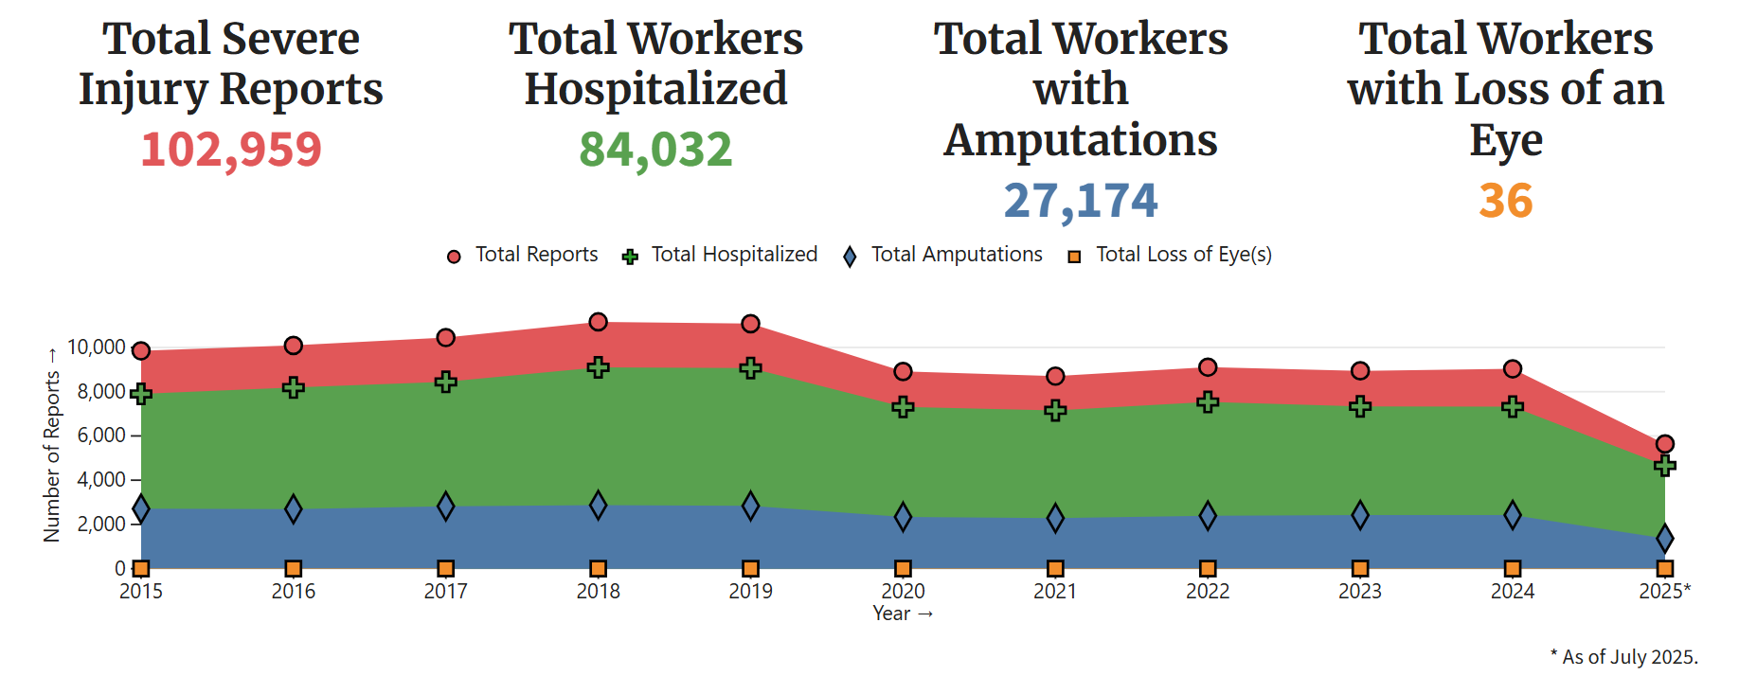
Why is machine guarding important
OSHA’s Severe Injury Report tool-
27,174 severe injuries related to amputations in the workplace since 2015.
Notes:
OSHA’s new Sever Injury Report tool highlights additional information related to severe injuries, with 24,635 related to amputations in the workplace since 2015, and a total of 1,255 occurring in 2024.
Furthermore, of the top 5 events and exposures that lead to severe injuries in the workplace, three of which can be associated with improper guarding as well as a failure to properly implement and execute adequate equipment de-energization, or Lockout Tagout (LOTO).

Slide 6
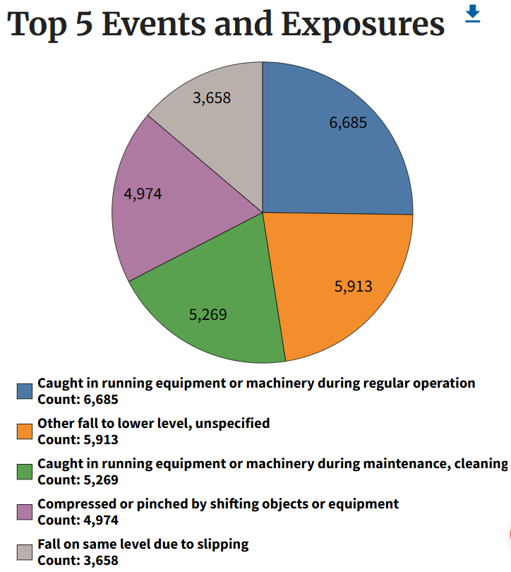
Why is machine guarding important?
Of the top 5 events and exposures that led to severe injuries in the workplace…
Three can be associated with improper machine guarding, Lockout Tagout (LOTO):
Caught in running equipment/machinery during regular operation
Caught in running equipment/machinery during maintenance, cleaning
Compressed or pinched by shifting objects or equipment
Notes:
Furthermore, of the top 5 events and exposures that lead to severe injuries in the workplace, three of which can be associated with improper guarding as well as a failure to properly implement and execute adequate equipment de-energization, or Lockout Tagout (LOTO).

Slide 7
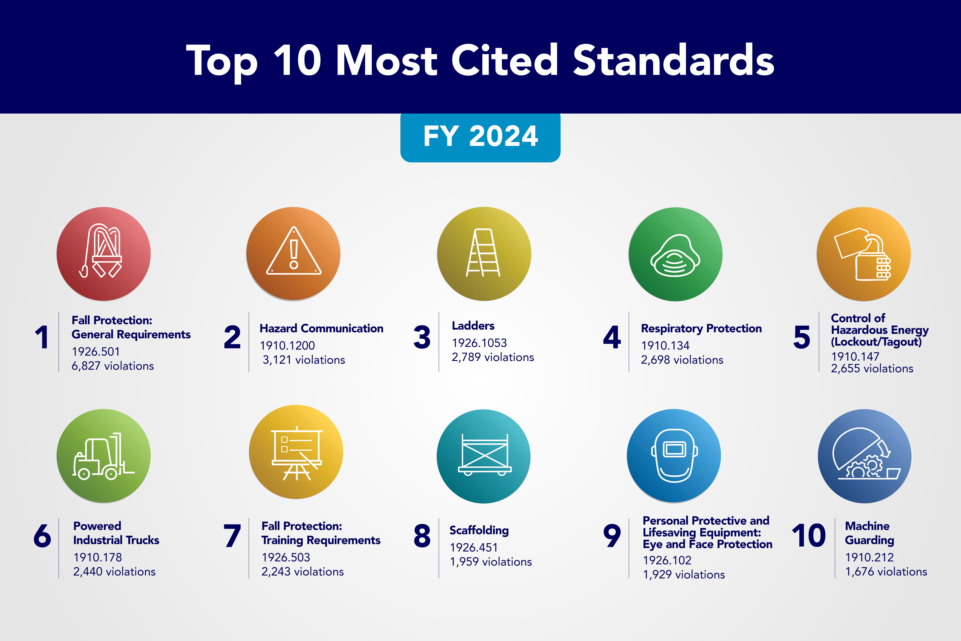
Why is Machine Guarding Important?
10th most cited in FY 2024 (most recent)
1,676 violations
Notes:
For the fiscal year of 2023, the 10th most frequently cited OSHA standard was General Industry’s Machinery and Machine Guarding standard- 29 CFR 1910.212, with 1,635 violations.

Slide 8
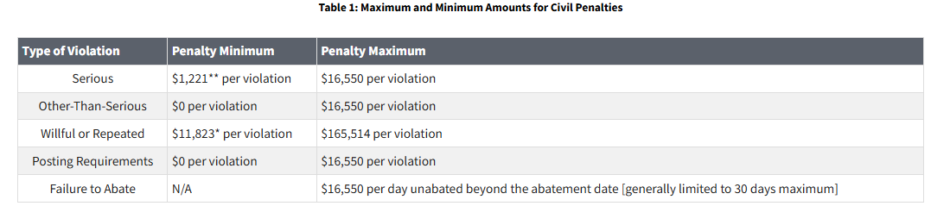
OSHA Citations
Machinery and Machine Guarding standard- 29 CFR 1910.212
10th most commonly cited for FY 2024
1,676 violations

Slide 9
Why is Machine Guarding Important?
Many hazards are created by moving machine parts.
Exposure to machine operator and other employees in the work area:
Nip points
Rotating parts
Flying chips and sparks
Safeguards are essential for protecting workers from preventable injuries.

Slide 10
OSHA Regulations related to Machine Guarding
1910 Subpart O - Machinery and Machine Guarding
1910.211 - Definitions.
1910.212 - General requirements for all machines.
1910.213 - Woodworking machinery requirements.
1910.214 - Cooperage machinery. Reserved
1910.215 - Abrasive wheel machinery.
1910.216 - Mills and calenders in the rubber and plastics industries.
1910.217 - Mechanical power presses.
1910.218 - Forging machines.
1910.219 - Mechanical power-transmission apparatus.
1910 Subpart P - Hand and Portable Powered Tools and Other Hand-Held Equipment
1910.243 - Guarding of portable powered tools.
1904 Subpart E- Reporting Fatality, Injury and Illness Information to the Government
Amputation must be reported to OSHA within 24 hours
1910 Subpart A- General
Workplace free of hazards that can cause severe injury or illness

Slide 11
OSHA's National Emphasis Program (NEP) on
Amputations in Manufacturing Industries
Initially implemented 12/10/2019- Current directive CPL 03-00-022 updated in 2022
In effect for 5 years from most recent
Targets businesses with:
Designated NAICS code with violations related to "focus five"
High BLS rates and amputations
High employer-reported amputation numbers
Programmed and unprogrammed inspections
Complaints and referrals alleging potential exposures to amputation hazards that could result in injury must be handled by an inspection
Notes:
Opening Conference. The Compliance Safety and Health Officer (CSHO) will verify the NAICS codes of the site and the number of employees employed by the employer. 4 The CSHO will also verify with the employer whether any machinery and/or equipment that could cause amputations is present in the workplace. In addition, OSHA 300 logs and 301 incident reports for the current and previous three calendar years will be reviewed during the opening conference in order to identify recorded amputations associated with machinery and/or equipment.
Walkaround. If any machinery or equipment associated with amputations is present in the workplace, the CSHO should exercise professional judgment in conducting an inspection, paying particular attention to employee exposure to nip points, pinch points, shear points, cutting actions, and other points of operation. The CSHO should consider and evaluate employee exposures during setup, regular operation of the machine, clearing jams or upset conditions, making adjustments while the machine is operating, cleaning of the machine, oiling or greasing of the machine or machine pans, scheduled/unscheduled maintenance, and locking out and/or tagging out.
D. Training. Because of the technical nature of some of these inspections and/or
machinery and equipment, CSHOs who conduct inspections under this NEP must have
adequate training and/or knowledge of both general and specific machine guarding
concepts and techniques and hazardous energy control (lockout/tagout) program
requirements.

Slide 12
OSHA's National Emphasis Program (NEP) on
Amputations in Manufacturing Industries
Five Focus OSHA Standards
29 CFR 1910.212- General requirements for machines
29 CFR 1910.213- Woodworking machinery
29 CFR 1910.217- Mechanical power presses
29 CFR 1910.219- Mechanical power-transmissions
29 CFR 1910.147- Control of Hazardous Energy

Slide 13
OSHA's National Emphasis Program (NEP) on
Amputations in Manufacturing Industries
NEP states:
Walkaround of workplace. Pay particular attention to employee exposure to nip points, pinch points, shear points, cutting actions, and other points of operation
Evaluate employee exposures during setup, regular operation of the machine, clearing jams or upset conditions, making adjustments while the machine is operating, cleaning of the machine, oiling or greasing of the machine or machine pans, scheduled/unscheduled maintenance, and locking out and/or tagging out
Notes:
Opening Conference. The Compliance Safety and Health Officer (CSHO) will verify the NAICS codes of the site and the number of employees employed by the employer. 4 The CSHO will also verify with the employer whether any machinery and/or equipment that could cause amputations is present in the workplace. In addition, OSHA 300 logs and 301 incident reports for the current and previous three calendar years will be reviewed during the opening conference in order to identify recorded amputations associated with machinery and/or equipment.
Walkaround. If any machinery or equipment associated with amputations is present in the workplace, the CSHO should exercise professional judgment in conducting an inspection, paying particular attention to employee exposure to nip points, pinch points, shear points, cutting actions, and other points of operation. The CSHO should consider and evaluate employee exposures during setup, regular operation of the machine, clearing jams or upset conditions, making adjustments while the machine is operating, cleaning of the machine, oiling or greasing of the machine or machine pans, scheduled/unscheduled maintenance, and locking out and/or tagging out.
D. Training. Because of the technical nature of some of these inspections and/or
machinery and equipment, CSHOs who conduct inspections under this NEP must have
adequate training and/or knowledge of both general and specific machine guarding
concepts and techniques and hazardous energy control (lockout/tagout) program
requirements.

Slide 14
How to identify amputation hazards
Initial:
Job Hazard Analysis (JHA)/ Job Safety Analysis (JSA)
A technique that focuses on job tasks as a way to identify hazards before they occur
Focuses on the relationship between the worker, the task, the tools, and the work environment
Machine Guarding Assessment (MGA)
Focused technique to identify areas of machines and equipment that have substandard or missing equipment safeguarding
Notes:
JHA Definition from OSHA pub 3071
JHAs look at each job step, the associated hazards, and controls to reduce hazards to a safe level.
Broad- encompasses not only guarding, but PPE use, ergonomics, surrounding tasks that can impact person completing the job, etc.

Slide 15
How to identify amputation hazards
To Maintain:
Pre-Job Machine Setup Checklist
Process where operators verify all machine guards are properly installed and functioning
Preventative Maintenance Program
PM process to test and check guards on equipment, including interlocks and e-stops

Slide 16
When to conduct Machine Guarding Assessments
All current equipment
Any new / incoming equipment prior to start-up
After any major equipment changes
Includes:
Large equipment and processes (e.g., production lines and conveyors, production equipment) and
Independently operated and smaller equipment (e.g., table saws, drill presses, bench grinders, lathes, powered hand tools, machining equipment, woodworking equipment, etc.)

Slide 17
Where to look- Recognizing Amputation hazards
Hazardous Mechanical Components
Hazardous Mechanical Motions
Hazardous Activities
Point of operation
Power-transmission apparatus
Other moving parts
Rotating motion
Reciprocating motion
Transversing motion
Cutting action
Punching action
Shearing action
Bending action
In-running nip points
Machine inspection
Normal production operations
Clearing jams
Machine adjustments
Cleaning of machine
Lubricating of machine parts
Scheduled and unscheduled maintenance

Slide 18
Where Machine Hazards Occur
Point of operation
Point of operation
Power transmission
Operating controls
The point where work is performed on the material, such as cutting, shaping, boring, or forming of stock.
The point of operation is typically the most hazardous part of the machine.
Notes:
Point of operation
The point of operation is that point where work is performed on the material, such as cutting, shaping, boring, or forming of stock. The point of operation is typically the most hazardous part of the machine.

Slide 19
Where Machine Hazards Occur
Point of operation
Power transmission
Power transmission
Operating controls
All components of the mechanical system that transmit energy to the part of the machine performing the work.
Notes:
Power transmission apparatuses
Power transmission apparatuses are all components of the mechanical system that transmit energy to the part of the machine performing the work. These components include flywheels, pulleys, belts, connecting rods, couplings, cams, spindles, chains, cranks, and gears.

Slide 20
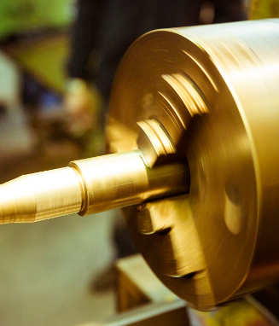
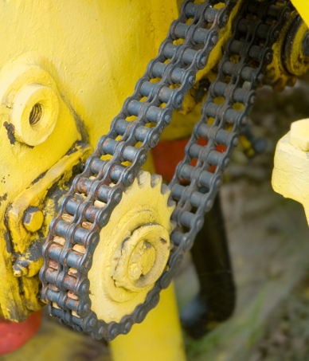
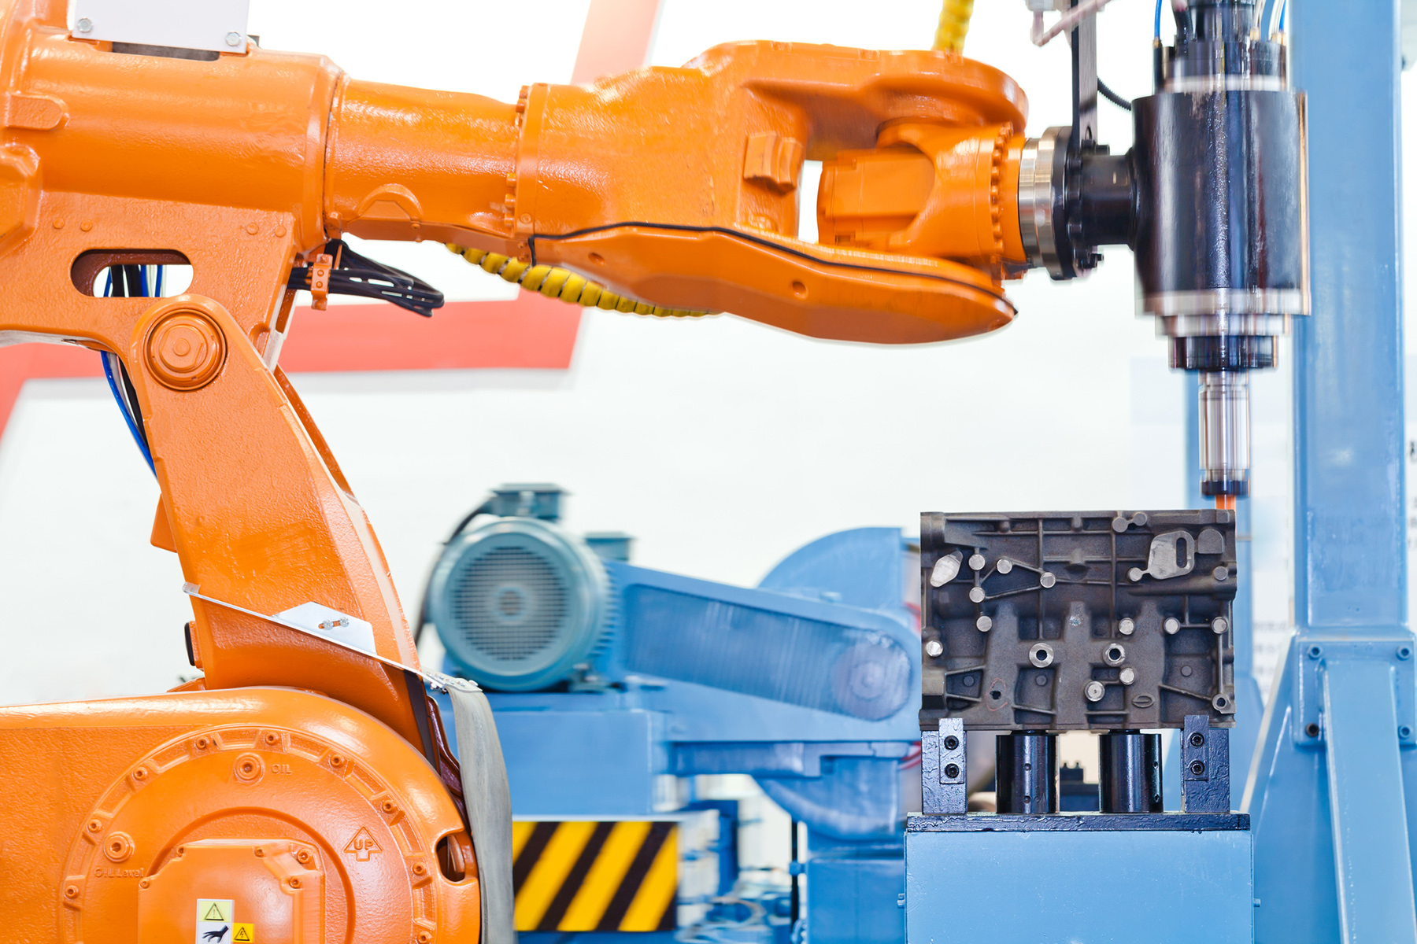
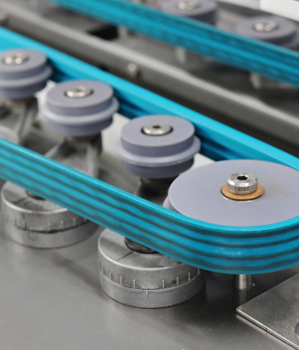
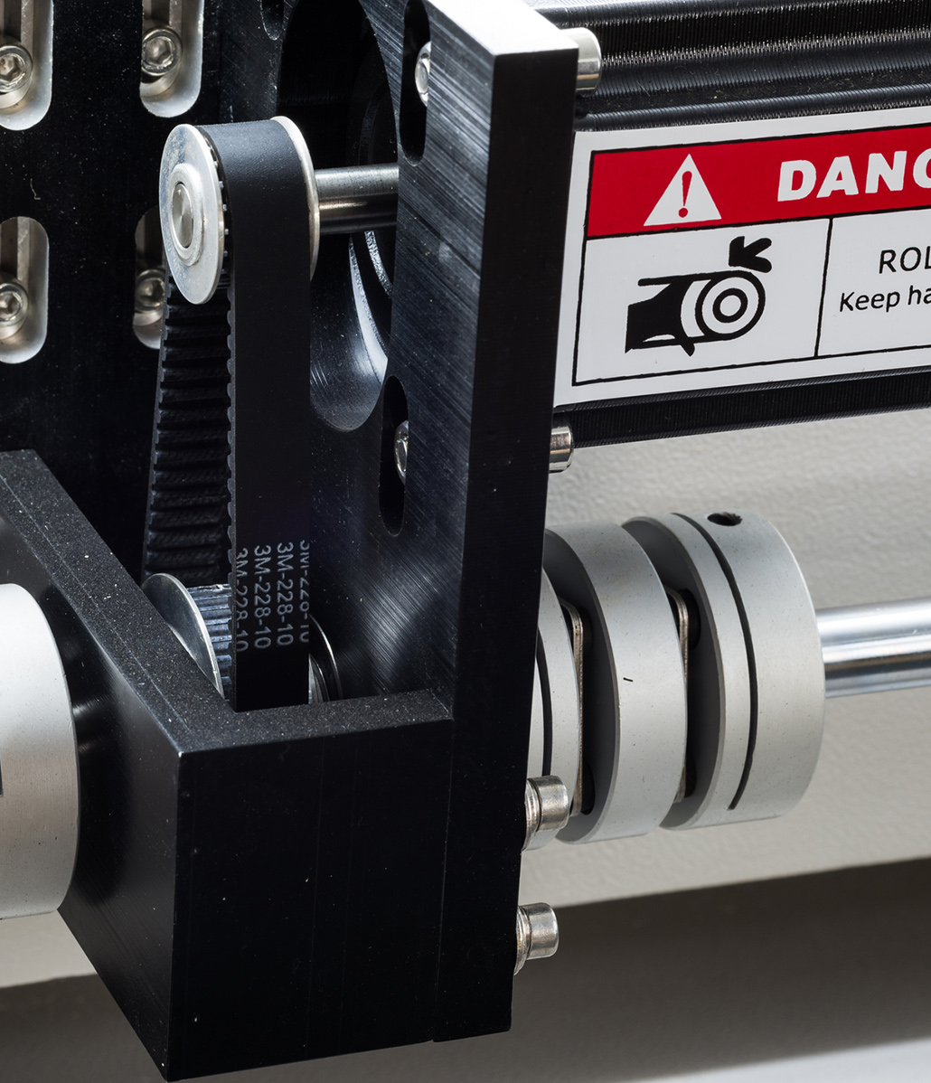
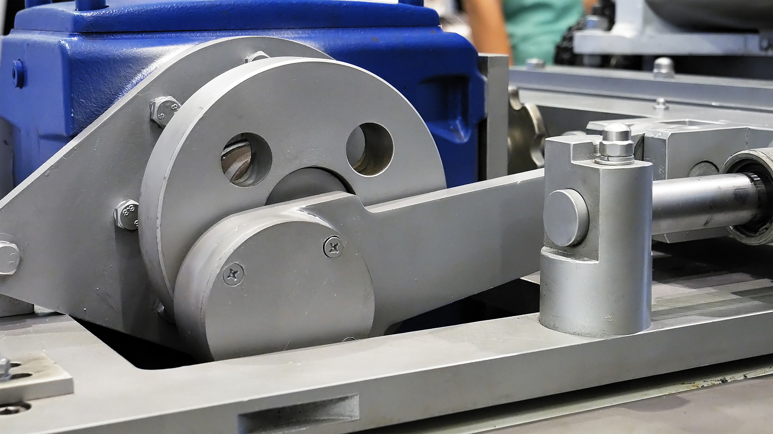

Power Transmission
Power transmission apparatuses include:
Flywheels and pulleys
Connecting rods and couplings
Belts
Cams and cranks
Spindles
Gears and chains
Notes:
The power transmission apparatuses of a machine are the mechanical parts that work with the power source to transmit energy to the part of the machine performing the work. Hazards of the power transmission apparatus include grabbing, nipping, or striking body parts or clothing.
Power transmission apparatuses include:
Flywheels and pulleys
Pulleys
Connecting rods and couplings
Belts
Cams and cranks
Spindles
Gears and chains

Slide 21
Where Machine Hazards Occur
Point of operation
Power transmission
Operating controls
All parts of the machine that move while the machine is working.
Can include reciprocating, rotating, and transverse moving parts, as well as feed mechanisms and auxiliary parts of the machine.
Notes:
Operating controls
Operating controls or other moving parts are all parts of the machine that move while the machine is working. These can include reciprocating, rotating, and transverse moving parts, as well as feed mechanisms and auxiliary parts of the machine.

Slide 22
Hazardous Motions
Rotating Motion
Reciprocating Motion
Transversing Motion
Notes:
Rotating motion can be dangerous; even smooth, slowly rotating shafts can grip hair and clothing, and through minor contact, force the hand and arm into a dangerous position. Injuries due to contact with rotating parts can be severe
Reciprocating motions may be hazardous because, during the back-and-forth or up-and-down motion, a worker may be struck by or caught between a moving and a stationary part.
Transverse motion (movement in a straight, continuous line) creates a hazard because a worker may be struck or caught in a pinch or shear point by the moving part.

Slide 23
Hazardous Motions
Cutting
Punching
Shearing
Bending
Notes:
Cutting action may involve rotating, reciprocating, or transverse motion. The danger of cutting action exists at the point of operation where finger, arm and body injuries can occur and where flying chips or scrap material can strike the head, particularly in the area of the eyes or face. Such hazards are present at the point of operation in cutting wood, metal, and other materials. Examples of mechanisms involving cutting hazards include bandsaws, circular saws, boring and drilling machines, turning machines (lathes), or milling machines.
Punching action results when power is applied to a slide (ram) for the purpose of blanking, drawing, or stamping metal or other materials. The danger of this type of action occurs at the point of operation where stock is inserted, held, and withdrawn by hand. Typical machines used for punching operations are power presses
Shearing action involves applying power to a slide or knife in order to trim or shear metal or other materials. A hazard occurs at the point of operation where stock is actually inserted, held, and withdrawn. Examples of machines used for shearing operations are mechanically, hydraulically, or pneumatically powered shears.
Bending action results when power is applied to a slide in order to draw or stamp metal or other materials. A hazard occurs at the point of operation where stock is inserted, held, and withdrawn. Equipment that uses bending action includes power presses, press brakes, and tubing benders.

Slide 24
Hazardous Motions
Nip Points aka Pinch Points
Points on the machine where:
Parts move toward each other
or
When one part moves past a stationary object
Examples:
Intermeshing gears, rolling mills, calenders
Belt & pulleys, chain & sprocket
Flywheels, screw conveyors

Slide 25
How to Control equipment hazards and avoid amputations
1. Effective Machine Safeguarding
Primary Safeguarding
Secondary Safeguarding
2. Effective Energy Control (lockout/tagout) Program
Lockout/tagout where safeguards are rendered ineffective or do not protect employees from hazardous energy during servicing and maintenance operations
3. Standard Operating Procedures for Alternative Measures
Safe procedures for cleaning, unjamming, job set-up, making adjustments while the machine is operating, oiling or greasing
Must provide equivalent protection
Notes:
Guards provide physical barriers that prevent access to danger areas. To be effective, guards must be strong and fastened by any secure method that prevents the guard from being inadvertently dislodged or removed. Guards typically are designed with screws, bolts and lock fasteners and usually a tool is necessary to unfasten and remove them. Not designed to obstruct operator’s view.
Safeguarding devices either prevent or detect operator contact with the point of operation or stop potentially hazardous machine motion if any part of an individual’s body is within the hazardous portion of the machine. Both types of safeguards need to be properly designed, constructed, installed, used and maintained in good operating condition to ensure employee protection.

Slide 26
Primary Safeguarding Methods- two methods
Guards
Safeguarding devices
Provide physical barriers that prevent access to danger areas
Must be strong
Fastened by secure method that prevents the guard from being inadvertently dislodged or removed
Designed with screws, bolts and lock fasteners
Usually a tool is necessary to unfasten and remove
Not designed to obstruct operator’s view
Either:
Prevent or detect operator contact with the point of operation or
Stop potentially hazardous machine motion if any part of an individual’s body is within the hazardous portion of the machine
Must be properly designed, constructed, installed, used, and maintained in good operating condition

Slide 27
Secondary Safeguarding Methods
Provide lesser degree of employee protection
Do not prevent access to hazardous machine areas
Used in combination with primary, or when primary is infeasible
Includes detection safeguarding devices, awareness devices, safeguarding methods, safe work procedures
Probe detection, awareness/warning devices, e-stops, safe distance, hand-feed tools, foot controls, signage, procedures, training

Slide 28
Primary Equipment Safeguarding
Guards
Safeguarding Devices
Fixed
Adjustable
Self-adjusting
Interlocking barrier guards
Pullback devices
Restraint devices
Presence- sensing devices
Pressure-sensing mats
Two-hand controls
Two-hand trip

Slide 29
Types of Guarding & Devices
Fixed barrier guards (preferred)
Adjustable or self-adjusting barrier guards
Perimeter guarding
Interlocking devices
Presence-sensing devices
Pressure-sensing devices
Two-handed operating devices
Combination
Notes:
There are several types of guarding and devices that can be used to protect personnel.
-Fixed barrier guards- are attached to the equipment at the point of operation to prevent contact with a hazard by a person at or near the location where work is performed upon the material being processed.
Adjustable or self-adjusting barrier guards are point of operation barrier guards that can be moved or adjusted to accommodate the material being worked on.
Perimeter guarding- is A free-standing engineered guard that prevents access to an area around equipment and, therefore, the associated hazards of the equipment. In addition to preventing access, a Perimeter Guard is placed at a sufficient distance from the equipment hazard(s) to prevent contact by any part of the body.
Additionaly, there are several types of safeguarding devices including:
Interlocking devices
Electronic safety devices
Presnce sensing devices, such as light curtains, sensors, or scanners that stop the equipment if the barrier is broken
Pressure sensing devices, such as pressure mats that detect a person approaching the equipment when stepped on, and stop the equipment and
Two hand operating devices
Many times, a combination of guarding and devices may be needed to adequately protect personnel from equipment hazards.

Slide 30
Effective Guarding & A-U-T-O
Must not be able to reach:
Around
Under
Through
Over
a guard and contact the hazard.
Notes:
For a guard to be considered effective, it must be designed to physically prevent a person—or any part of their body—from contacting the equipment hazard and flying debris. A good way to tell if a guard is designed and installed properly is to remember the AUTO principle.
A person must not be able to contact an equipment hazard by reaching around, under, through, or over the guard.
If access to moving parts is achievable through one of these actions, the guard would not be considered sufficient, and should be replaced with an properly designed guard.
Additionally, overhead hazards 7 feet or less above a walking or working surface must also be guarded.
Guarding may not be removed or bypassed during operation of the equipment.

Slide 31
Bench Grinder
Ensure guarding around abrasive wheel bench grinders are set properly

Slide 32
Additional Guarding Considerations
[1910.243(c)(3)] Vertical portable grinders.
Safety guards used on machines known as right angle head or vertical portable grinders shall have a maximum exposure angle of 180°, and the guard shall be so located so as to be between the operator and the wheel during use. Adjustment of guard shall be such that pieces of an accidentally broken wheel will be deflected away from the operator.
[1910.243(c)(4)] Other portable grinders.
The maximum angular exposure of the grinding wheel periphery and sides for safety guards used on other portable grinding machines shall not exceed 180° and the top half of the wheel shall be enclosed at all times.
Notes:
1910.219(c)(4)
Projecting shaft ends.
1910.219(c)(4)(i)
Projecting shaft ends shall present a smooth edge and end and shall not project more than one-half the diameter of the shaft unless guarded by nonrotating caps or safety sleeves.
1910.219(c)(4)(ii)
Unused keyways shall be filled up or covered.

Slide 33
Additional Guarding Considerations
When the periphery of the blades of a fan is less than seven (7) feet above the floor or working level, the blades must be guarded. The guard must not have openings larger than one-half (½) inch. [29 CFR 1910.212(a)(5)]
A machine designed for a fixed location must be securely anchored to prevent walking or moving. [29 CFR 1910.212(b)]
Eye and face protection must be provided to each employee when exposed to eye or face hazards from flying particles. [29 CFR 1910.133(a)]
Notes:
1910.219(c)(4)
Projecting shaft ends.
1910.219(c)(4)(i)
Projecting shaft ends shall present a smooth edge and end and shall not project more than one-half the diameter of the shaft unless guarded by nonrotating caps or safety sleeves.
1910.219(c)(4)(ii)
Unused keyways shall be filled up or covered.

Slide 34
Additional Guarding Considerations
[1910.219(c)(4)] Projecting shaft ends
Smooth edge and end.
Shall not project more than one-half the diameter of the shaft unless guarded by nonrotating caps or safety sleeves.
Unused keyways shall be filled up or covered.
[1910.212(a)(3)(iii)] Special handtools
Used for placing and removing material.
Permit easy handling of material without the operator placing a hand in the danger zone.
Cannot be used in lieu of other guarding, only to supplement protection provided.
[1910.145(f)(7)] - Warning labels are needed on machines which define the hazards and warn employees.
Temp - 140 degrees or greater
Heat from surfaces should be below 140∞F per ASTM C1055 (the Standard Guide for Heated System Surface Conditions that Produce Contact Burn Injuries).
Average person can touch a 140°F surface for up to five seconds without sustaining irreversible burn damage.
ANSI B11.26: 9.1 - Emergency Stop Devices
Notes:
1910.219(c)(4)
Projecting shaft ends.
1910.219(c)(4)(i)
Projecting shaft ends shall present a smooth edge and end and shall not project more than one-half the diameter of the shaft unless guarded by nonrotating caps or safety sleeves.
1910.219(c)(4)(ii)
Unused keyways shall be filled up or covered.

Slide 35
LOTO and Exception
Machine safeguarding must be supplemented by an effective energy control (lockout/tagout) program
Protection from hazardous energy sources during machine servicing and maintenance work activities.
There are some servicing activities (e.g., lubricating, cleaning, releasing jams, making machine adjustments) that are minor in nature and are performed during normal production operations.
It is not necessary to lockout/ tagout a machine if the activity is routine, repetitive and integral to the production operation provided there is an alternative control method used that affords effective protection from the machine’s hazardous energy sources.

Slide 36
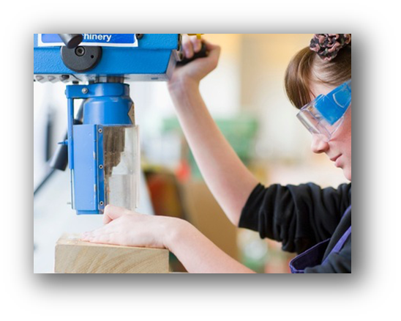


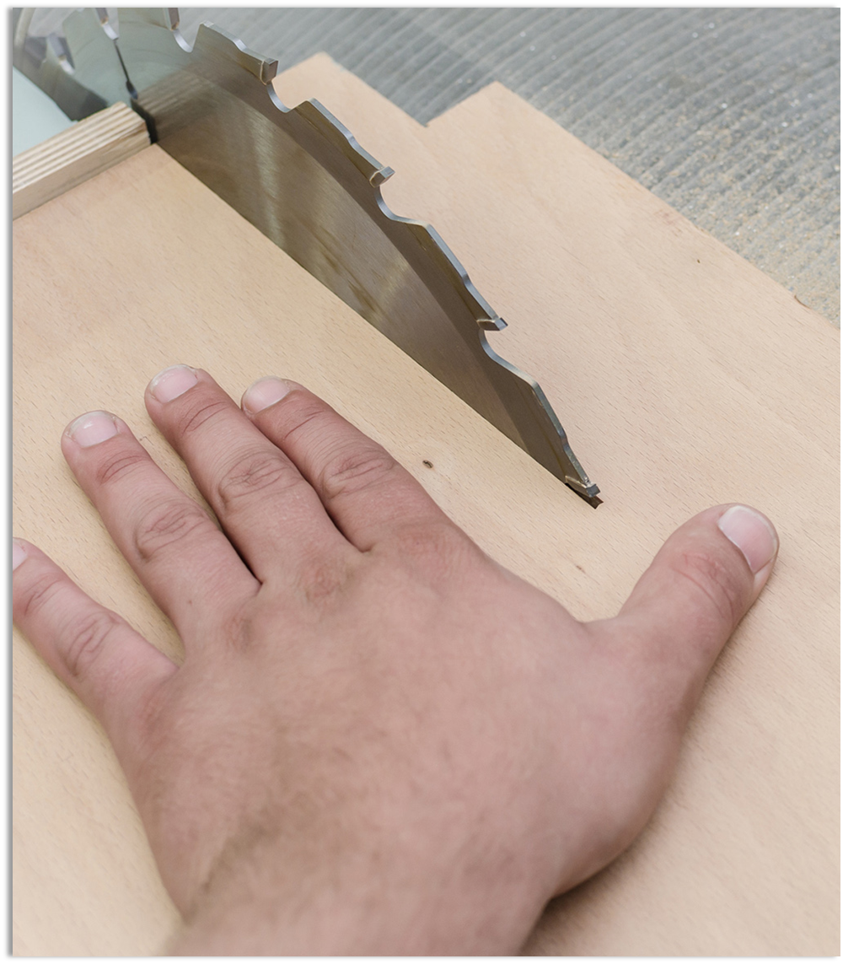
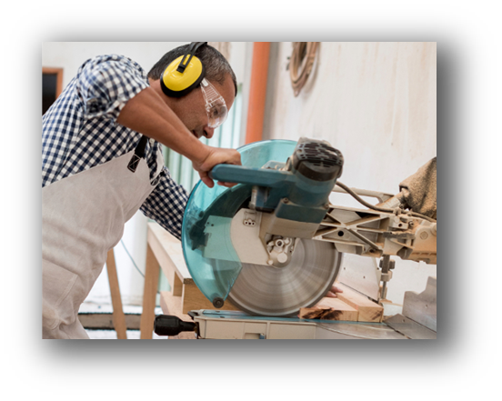
Work Practices And Training
Develop inspection & maintenance schedule
Develop PPE Requirements
No gloves around rotating parts
Develop good work practices & procedures for work with and around machines
Develop training program
Ensure reporting structure is in place
Notes:
Work Practices and procedures
-No loose hair, closthes or dangling objects
-how to hold materials and work pieces, aids
-Where to stand
-When to shut off- not leave running

Slide 37
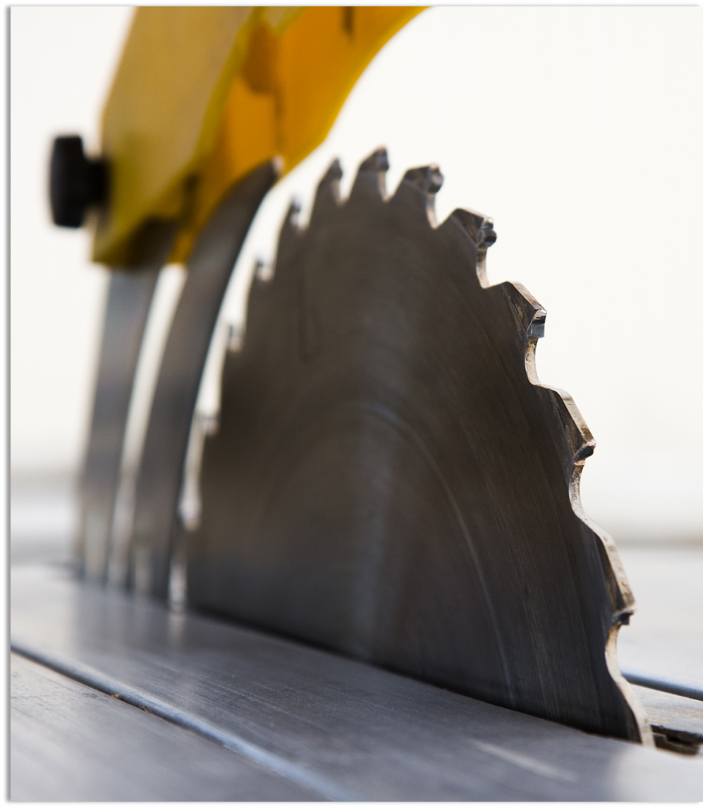
Safeguarding Points to Remember
Understand the OSHA requirements for general machine guarding, as well as equipment specific requirements
Conduct JHAs and Machine Guarding Assessments
Identify guarding gaps and implement corrections
Ensure Hazardous Energy Program and procedures are in place
Develop work practices and training programs to support

Slide 38

Reference Tools
OSHA NEP on Amputations in Manufacturing Industries
https://www.osha.gov/sites/default/files/enforcement/directives/CPL_03-00-022.pdf
OSHA Publication 3170
https://www.osha.gov/sites/default/files/publications/osha3170.pdf
OSHA Machine Guarding e-tool
https://www.osha.gov/etools/machine-guarding

Slide 39
Connect with us for a 15 minute consultation!

Slide 40
Get in Touch: www.Complianceplace.com cmi@complianceplace.com RCAFFREY@complianceplace.com

Slide 41
Questions?
Thank you for joining us.

