Slide 1

TRI Reporting –
What’s New?
Toxic release inventory reporting – JULY 1

Slide 2

OUR TEAM for today’s presentation
Kristian witt
Vice president, environmental services

Slide 3
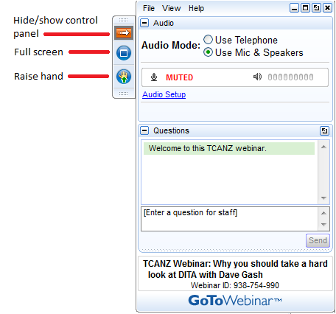
Housekeeping
This presentation is being recorded and will be shared.
Everyone will be muted to prevent background noise.
Use the question button to log your question.

Slide 4


Agenda
What is TRI
Why is TRI important
Do I need to report
I have to report….what next
On-line Reporting
Resources & Tools
New For 2021 Reporting Year
Questions & Answers
Notes:
Complexity of program….EPA’s basic training has 172 slides! This is an overview

Slide 5
What is tri and why is it important…Toxic release inventory
Regulatory information
Plain Language information
Law and regulation created in response in part to large Bhopal, India Union Carbide incident in 1984
TRI is an authorized regulatory program from SARA TITLE III (Emergency Planning and Community Right-to-Know Act [EPCRA] of 1986, Section 313)
TRI Regulations are found at 40 CFR Part 372, Subparts A-E
TRI is a complex reporting program that compiles toxic chemical management & release information from certain facilities
This information is available to the public, NGOs, and other companies to make decisions or be informed
Reported data covers annual releases to air, water, and land
Also requires suppliers to notify customers of TRI chemicals in the materials sold to them

Slide 6

Video Slide – EPA’s informational video on TRI

Slide 7

EPA’s Enforcement practices
EPA aggressively enforces this program, as it is seen as public information
EPA uses other public information (hazardous materials inventories, air emission reports, etc.) to verify presence of TRI chemicals
Penalties levied against businesses of many sizes for:
  Over- and under-estimating toxic releases
  Submission of late reports
  Discovery of unreported compounds through other program data reviews
Notes:
Mention here….bell manufacturer with no reportable discharges

Slide 8

How TRI Data is used
TRI data is commonly referenced in news articles about “highest polluters” in a given area
During public comment periods for permits, the public can access and reference TRI data
EPA uses the data to:
  Identify trends in pollutant releases for future regulation or further study
  Check effectiveness of regulatory programs
  For more info on how EPA uses the data:
  TRI Data in Action

Slide 9
Do I need to report? How do I know?
STAGE 01
Company Type
Number of employee work hours
STAGE 03
Handle a TRI-Compound
STAGE 02
STAGE 04
STAGE 05
Do annual activities exceed:
Determination of reporting
Process
Otherwise Use
Manufacture
(by SIC)
Notes:
The process of completing your TRI forms is a two-step process. In the first step, you determine if your facility is required to report to TRI, and if so, you determine which TRI chemicals you handle in your facility, and then which of these you would need to report on.

Slide 10

Stage 1 - Company Type (Industry Sector)
Only certain company types are required to report under TRI by SIC & NAICS Codes. Below are major SIC Codes covered:
- 10: Metal Mining (some exceptions)
- 12: Coal Mining (some exceptions)
- 1321 : Natural Gas Liquid Extraction
- 4911, 4931, 4939: Electric, Gas, and Sanitary Services combusting coal and/or oil to generate power for commerce
- 4953: Waste handling facilities regulated under RCRA
- 5169: Chemical & Allied Products
- 5171: Petroleum Bulk stations & Terminals
- 7389: Miscellaneous Services in solvent recovery for fee
….and then there is SIC 20-39 (Manufacturing).

Slide 11
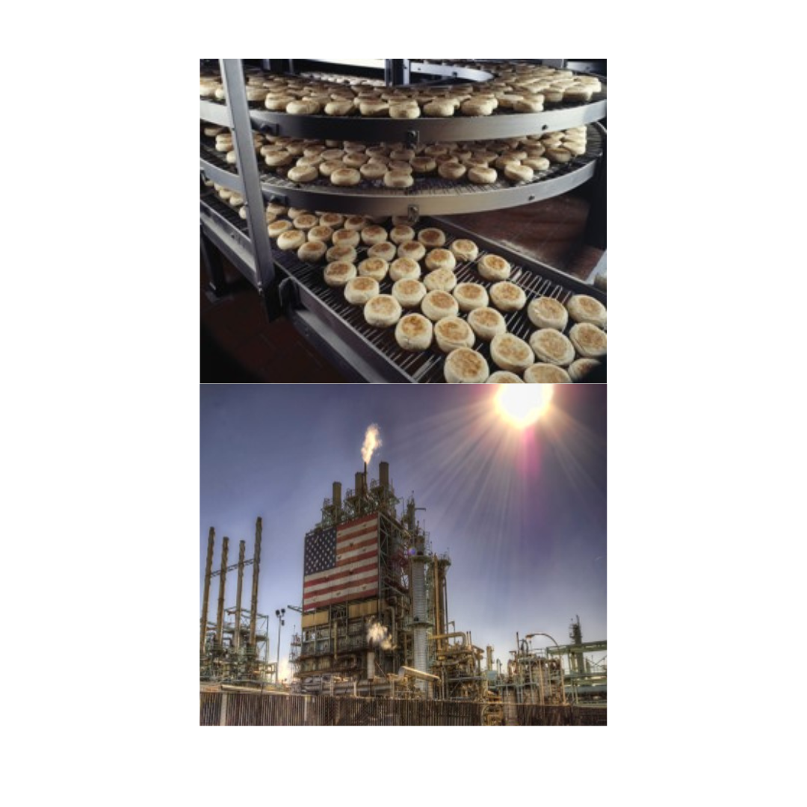
Stage 1 - Company Type (Industry Sector)
The Manufacturing Sector (SIC 20-39) has some complex aspects and exceptions for applicability.
From Bakeries, to Bells, to Refineries, there are many covered industries. Usual exceptions in this category are retail versions.
Example:
  NAICS 3118 (Bakeries & Tortilla Manufacturing) is included, except for 311811 (Retail Bakeries)
EPA provides tools determining Industry Sector Applicability:
TRI-Covered Industry Sectors
Notes:
Any federal faciltiies? If so, can add info about them.

Slide 12

Stage 2 – employee work hours
TRI applicability extends to facilities with at least 10 full-time employees (or equivalent 20,000 work hours at the site).
Different accounting for hours applies for:
Unmanned facilities
Personnel splitting time between facilities
Part-time employees

Slide 13
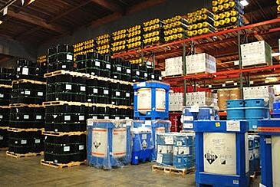
Stage 3 – Handling Covered Chemicals
If your facility is in a qualified industrial sector AND has greater than 10 full-time equivalent employees, then you must evaluate the materials you use.
Covered chemicals are listed due to their ability to create a detrimental health effect upon exposure. Chemicals are included when studies show:
  Cancer or chronic human health effects
  Significant adverse acute human health effects
  Significant adverse environmental effects
Over 775 787 796 individually listed chemicals and 33 categories are listed.
***Check your raw materials (metals, chemicals/solvents, support systems, etc.) for the presence of the chemicals***
Notes:
So what are the TRI chemicals? The current TRI chemical list contains over 800 individual chemicals and chemical categories. The list can be found in EPA’s Reporting Forms and Instructions in Table II, which is available on the TRI website and through the TRI-MEweb reporting application.
The individual TRI chemicals are listed separately for PFAS chemicals and non-PFAS chemicals. Both groups are listed alphabetically by name and they are also listed again by their CASRN or Chemical Abstract Service Registry Number. There is also a list of chemical categories. Coming up we’ll talk about the differences between individual chemicals and chemical categories in more detail. Be aware that the TRI chemical list changes almost every year. Make sure that you’re always using the most current TRI chemical list.
Facilities need to take care in identifying chemicals used or generated at their facility that may fall within a TRI chemical category group. Chemical categories are groups of individual chemicals which must be considered together towards activity thresholds and reporting under TRI.
Many chemical categories are metal compound chemical categories some of which are show here. In many cases, the elemental forms of the metal are also reportable as a separately listed TRI chemical.
Let’s look at lead compounds as an example. Any unique chemical substance that contains lead as part of its chemical infrastructure would be considered part of the lead compounds chemical category.
Note that some of these chemical categories also contain qualifiers. For example, in the case of barium compounds, the category does not include barium sulfate; however, all other barium compounds would need to be considered toward this chemical category.

Slide 14
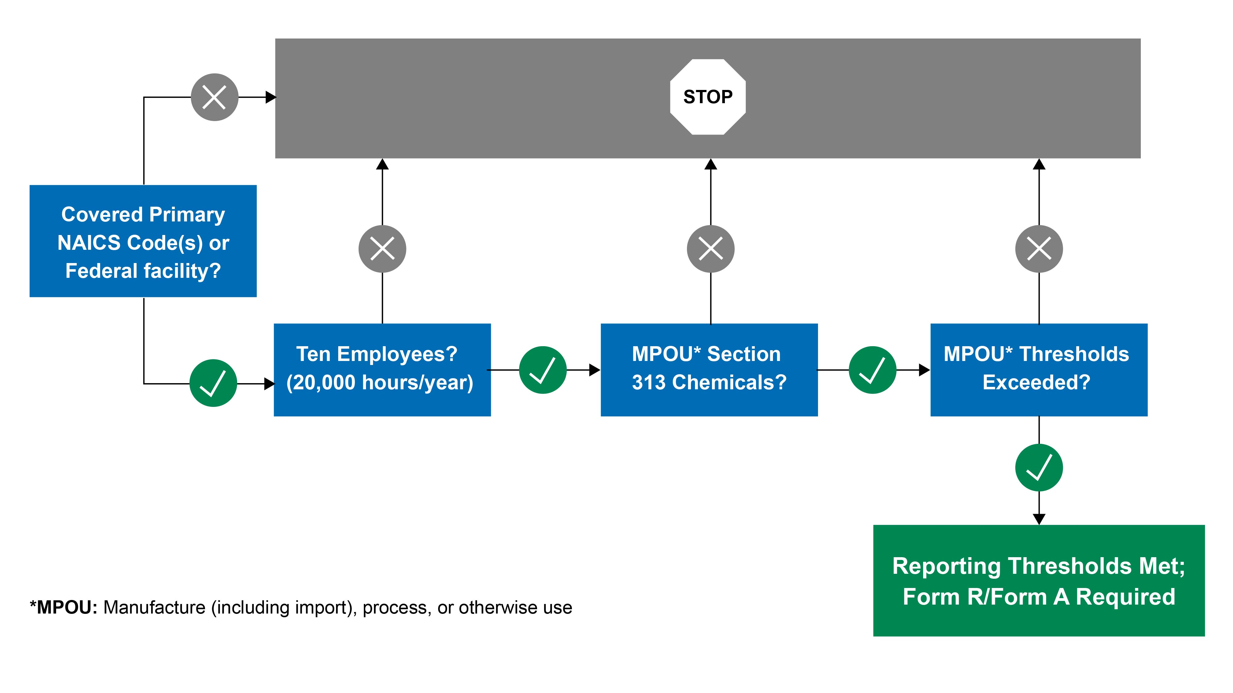
Stage 4 – Covered Chemical Use Quantity
Covered Primary
NAICS Code(s) or
Federal Facility?
NO
Ten Employees?
(20,000 hours/year)
NO
STOP
YES
The reporting thresholds are (separate):
  Manufacture (25,000 lbs): Generating by process as product, or as process intermediary, impurity, by-product, or by import (Generated)
  Process (25,000 pounds): Preparation of a Section 313 chemical, after its manufacture, for distribution in commerce. Reactant, formulation component, repackaging with distribution to commerce (remains in product)
  Otherwise Use (10,000 pounds): Basically, activities not included above (materials used not in final product)
  PBT Chemicals
  **EXCEPTION FOR PFAS & CSCs & QUALIFIERS**
NO
MPOU* Section 313
Chemicals?
YES
NO
MPOU* Thresholds
Exceeded?
YES
YES
Reporting is Required
*MPOU = Manufacturing, Processing, and Otherwise Use
Notes:
***EXCEPTIONS FOR PBTs***
***CONCENTRATION EXCEPTIONS***
Many of the listed TRI chemicals have parenthetic qualifiers. These chemicals are only subject to TRI reporting if they are manufactured, processed, or otherwise used in the specific form described in the qualifier.
The tables shown here are just some of the qualifiers for TRI chemicals. For example, aluminum and zinc, have the qualifier ‘fume or dust’. This means that aluminum would only be considered under TRI in the fume or dust form. Isopropyl alcohol is another example. It would only need to be considered under TRI if the facility is manufacturing isopropyl alcohol and using a process called the ‘strong acid process’.
Another example is sulfuric acid, which is only considered under TRI in an acid aerosol form. Facilities that have aqueous sulfuric acid which are not aerosolizing the acid in any way would not need to consider their sulfuric acid towards the threshold or reporting. These are just some of the qualifiers on the TRI chemical list. Facilities should always be sure to be aware of the chemical qualifiers associated with the chemicals that may be present at their facility.
Example of Calculating Activity Thresholds
Over the course of a reporting year, a facility manufactures 24,000 pounds of chemical with 25,000/10,000-pound reporting thresholds, subsequently processes 24,000 pounds, and also happens to otherwise use 9,000 pounds of the same chemical.
That facility has not exceeded the chemicals with 25,000-pound manufacturing and processing thresholds nor the 10,000-pound otherwise use thresholds and would NOT be required to submit a TRI report for that chemical.

Slide 15

Stage 05 – applicability determination
Information needed to evaluate use against reporting thresholds:
  Calendar year quantities of materials purchased/used/generated/manufactured
  SDSs for chemicals and raw materials
  Understanding of processes utilizing covered chemicals (to categorize as Manufacture, Process or Otherwise Use)
For each covered chemical handled, a documented determination should be made (even if you don’t have to report all chemicals). CHECK GUIDANCE
If no report necessary, you are done!
If a report is necessary, move on to reporting…
Notes:
***EXCEPTIONS FOR PBTs***
***CONCENTRATION EXCEPTIONS***
Step 2, shown on the right, is the release and waste management reporting. This is the information that you would put on a TRI form. What information do facilities report to TRI? For the Form R, which is the more common means of TRI reporting, facilities report on how the TRI chemical is managed as waste, including onsite releases, treatment, energy recovery, recycling of the TRI chemical and offsite transfers, and pollution prevention activities that are conducted at the facility for that chemical.

Slide 16
I Have to Report…What Now?
Form a | Form r
Only for use for non-CSCs in facilities with: total use <1,000,000 pounds per year AND <500 lbs waste management | Can be used for any reportable material; Must be used for CSCs, or reportable materials not meeting Form A criteria
Form requires only Facility ID and contact information | Form requires Facility ID and contact information, all disposition/release information (air, water, land release & management)
The determination is complete, and reporting is required.
The two forms for reporting are shown in the table to the right. A Form R can be used for any material; a Form A can only be used in certain circumstances.
To determine which form can be used:
  Total quantity of material used/manufactured
  Total amount releases (disposal, recycling, energy recovery, treatment)
  If Form R required, additional data will be needed (mass balance):
  Offsite waste, recycling, disposal, and water discharge quantity and character
  Onsite air emissions (including control device), disposal (injection wells, incineration, recycling)
  Production/activity ratios, pollution prevention efforts

Slide 17

On-Line Reporting – Logistics
Electronic filing via TRI-MEweb is required (TRI-MEweb is an application in EPA’s Central Data Exchange, or CDX, system)
  Must register for a personal account with CDX, and activate access to TRI-MEweb
  Must enroll facility as a TRI facility, or request access by providing reporting information (from a previous report)
  One CDX user must be designated with CERTIFYING OFFICIAL role in TRI-MEWeb application
Some states require separate entry in similar report (e.g., NJ RPPR), and some require fees after submittal.

Slide 18
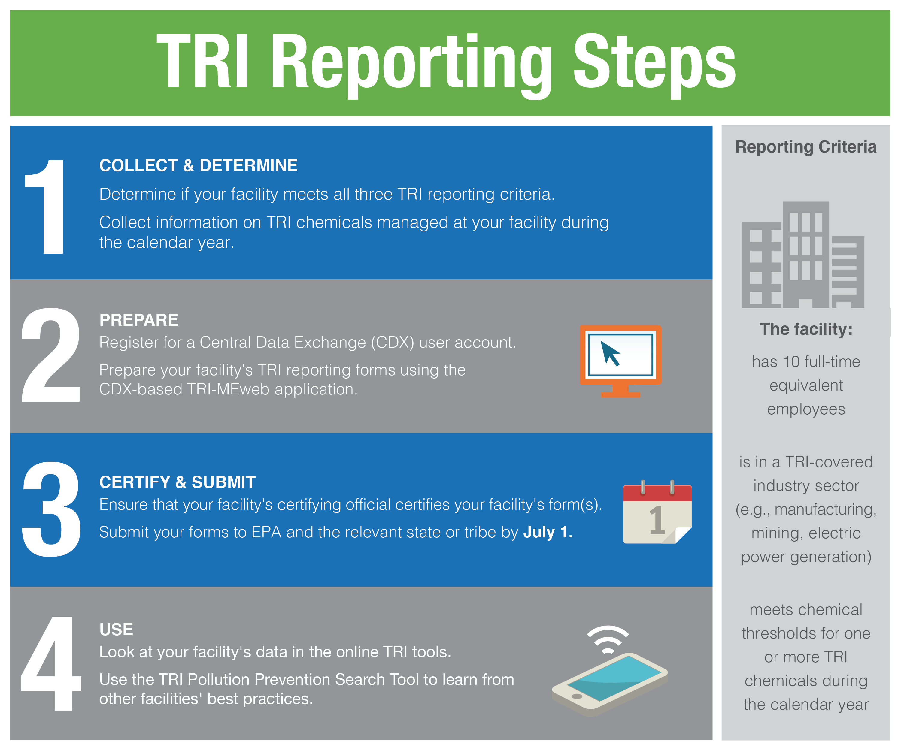
TRI Resources & Tools
  Overall Guidance
  GuideMe System – This system has the following easy-to-follow links:
    Chemical-specific Guidance
    Industry Sector Guidance
    Reporting Form Completion Instructions
    Threshold Screening Tool
    Q&A for exemptions from applicability determination, reporting, etc.
    TRI Program contacts, CDX links, and more detailed training presentations
  Air Emissions – AP-42 Emission Factors
  TRI Data Reported – ENVIROFACTS FORM R
  TRI Toxics Tracker by location – TRI Program page

Slide 19
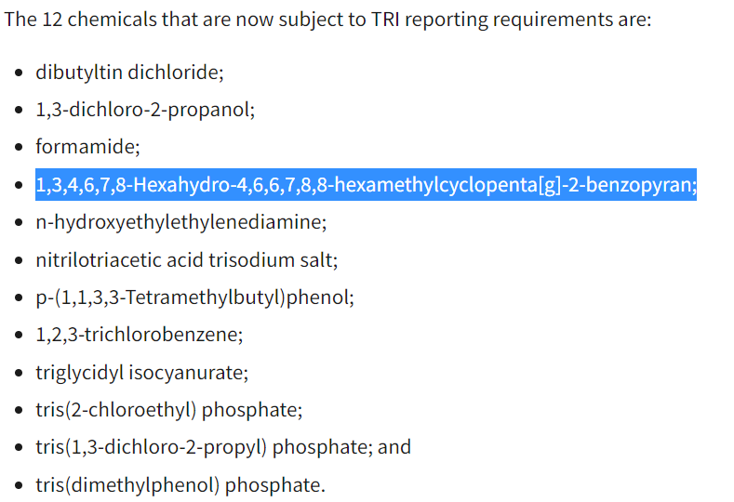
New for 2024 REPORTING YEAR (THIS YEAR)
New TRI program aspects of note for 2023:
Addition of PFAS (very pervasive) – 9 for 2023 reporting year
Addition of Certain PFAS to the TRI by the National Defense Authorization Act | US EPA
EPA adding more PFAS Guidance at PFAS Reporting Resources | US EPA
For 2024 Reporting (Report due July 1, 2025),
seven more PFAS chemicals will required to be reported.
EPA added a category of diisononyl phthalate (DINP) chemicals for
2023
Getty Images

Slide 20


Get in touch
15 Minute Consultation about your TRI
www.Complianceplace.com
kwitt@complianceplace.com

Slide 21

Questions?
Any and all are welcome!

